Slide 1
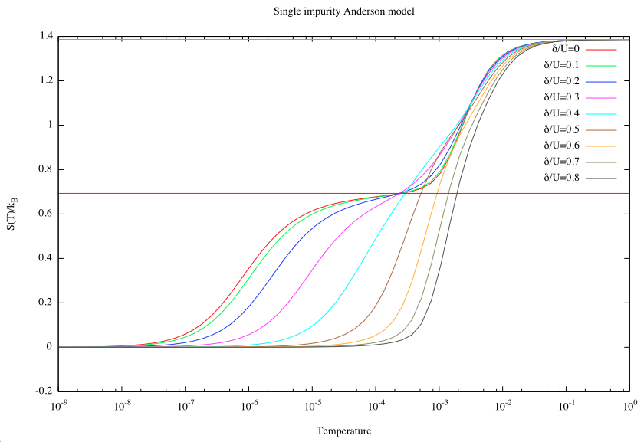
Try increasing the parameter δ=ε+U/2. What happens when δ>U/2?

Slide 2
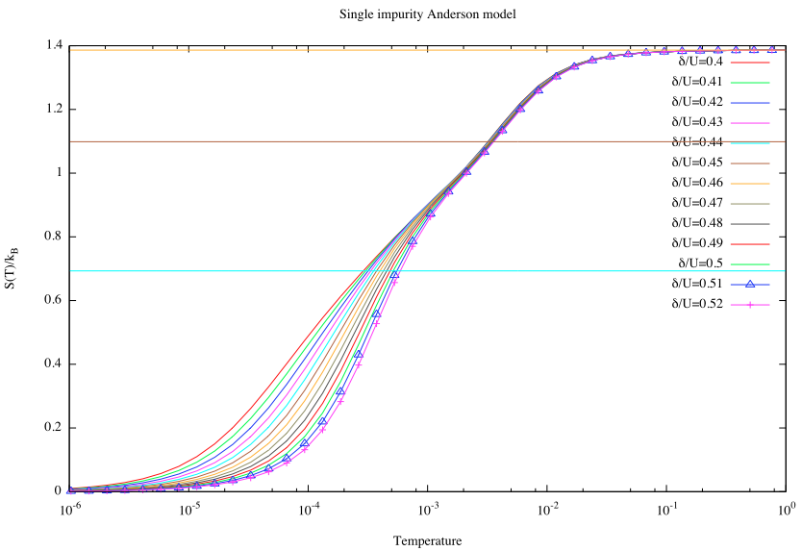

Slide 3
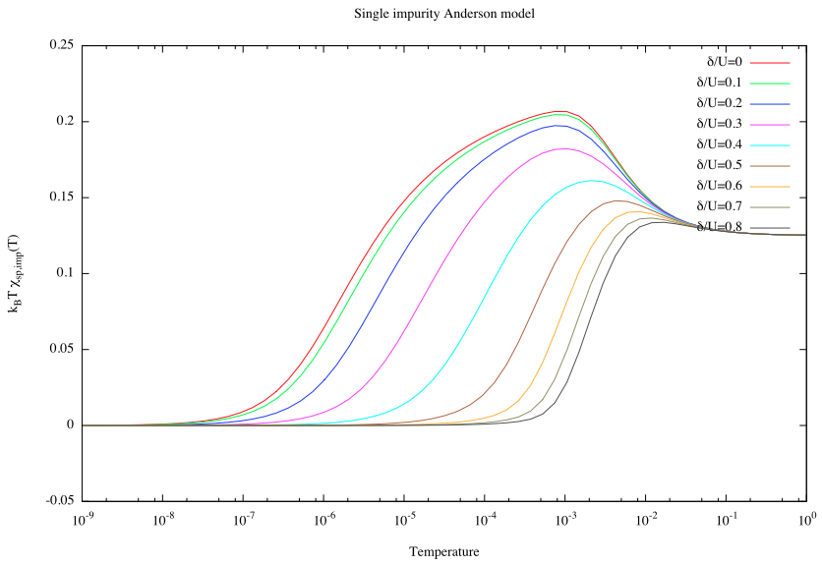

Slide 4
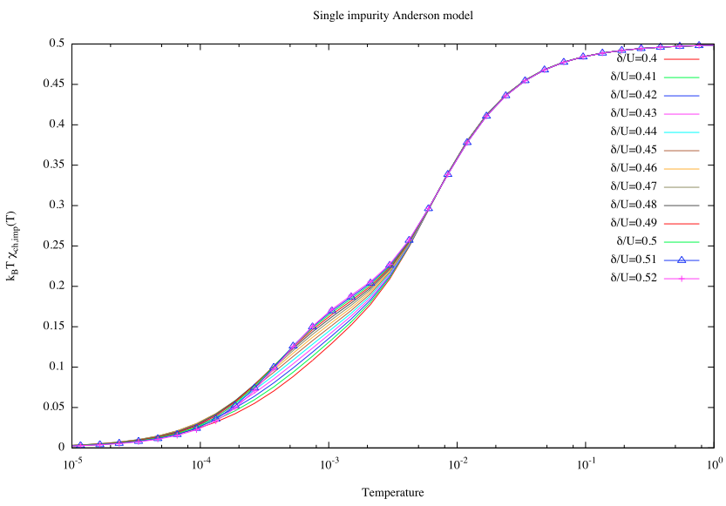

Slide 5
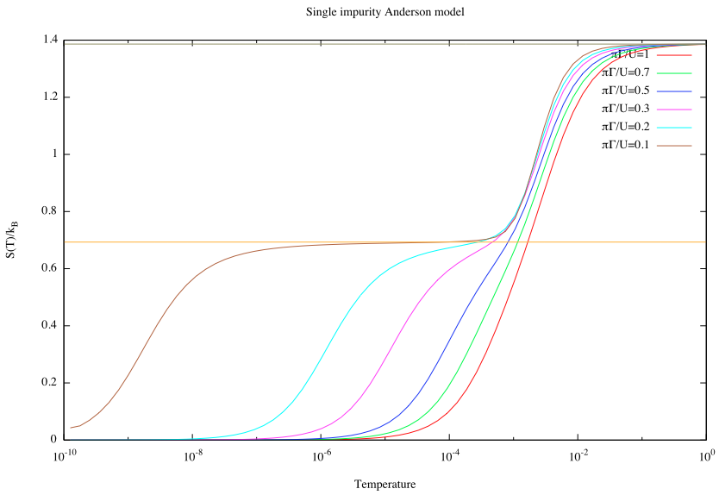
Try increasing the parameter Γ. What happens when Γ>U/π?

Slide 6
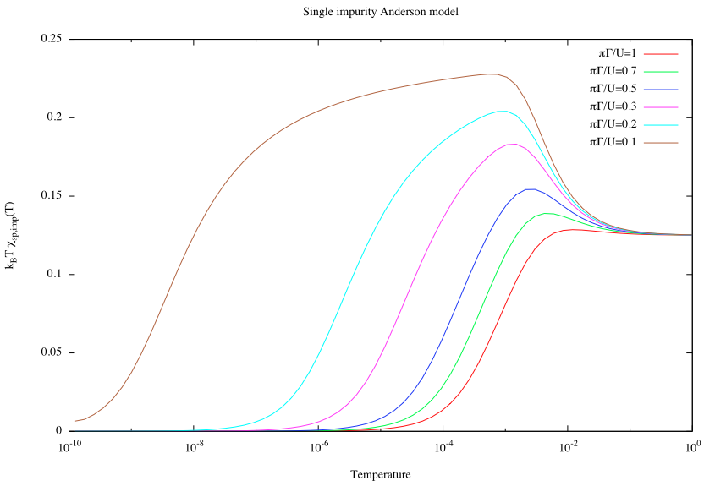

Slide 7
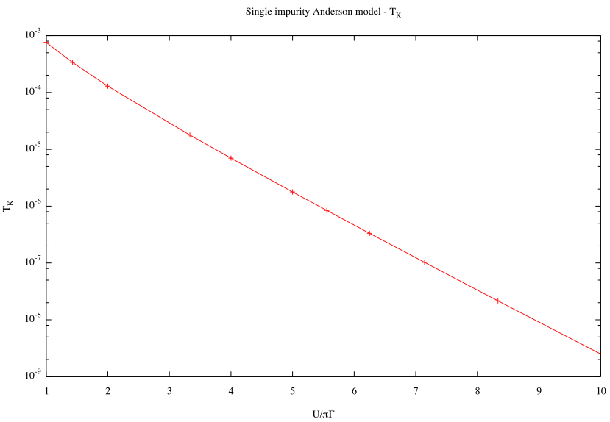
Verify the formula for T_{K}, by performing the calculation for a range of Γ and plotting lnT_{K} vs. Γ.

Slide 8
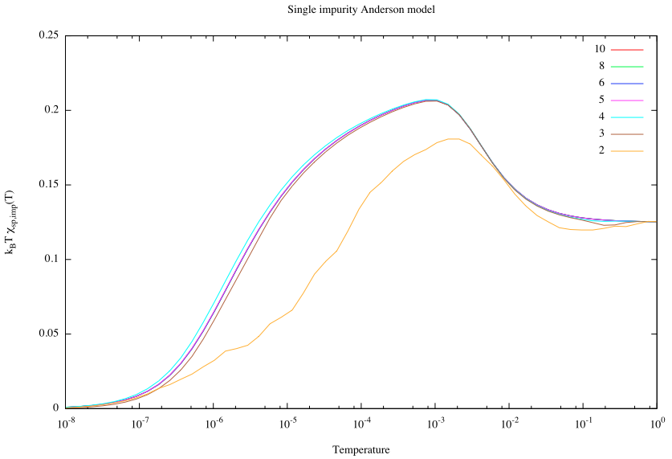
Decrease systematically keepenergy from 10 to small values. How does the quality of the results deteriorate?

Slide 9
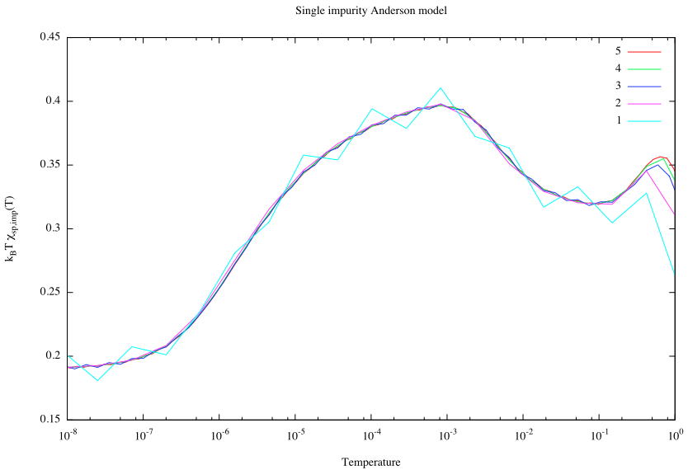
Increase Λ (to 4, then to 8). Try to do the z-averaging with a different number of z values.

Slide 10
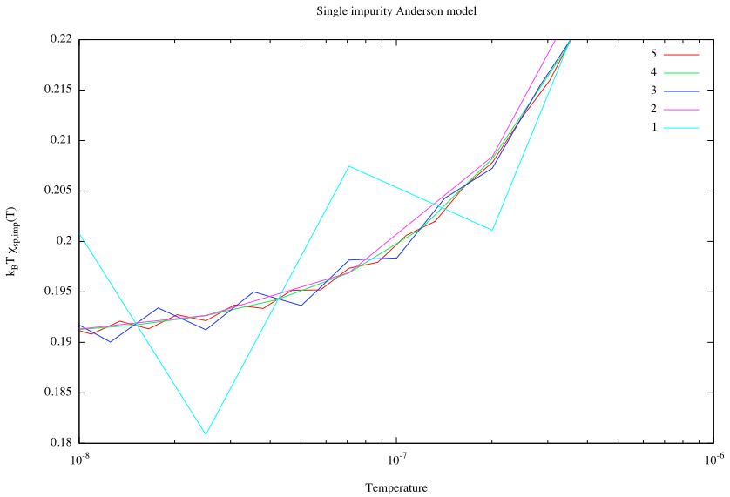

Slide 11
Change the symmetry type from QS to QSZ. How much slower is the calculation?
ISO
All: 10 s
QS
All: 58 s
QSZ
All: 394 s
SPSU2
All: 490 s
SPU1
All: 3452 s

Slide 12
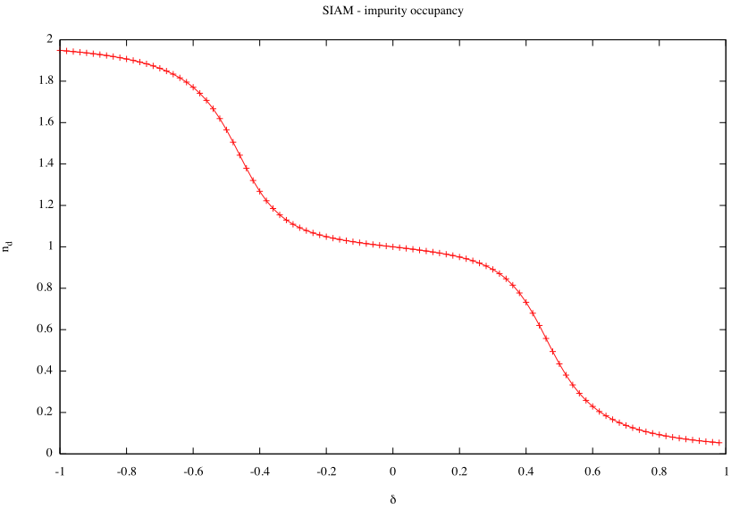
For SIAM, plot n_d for a sweep of the parameter δ. Notice how the occupancy is pinned to 1 in a wide interval of δ.

Slide 13
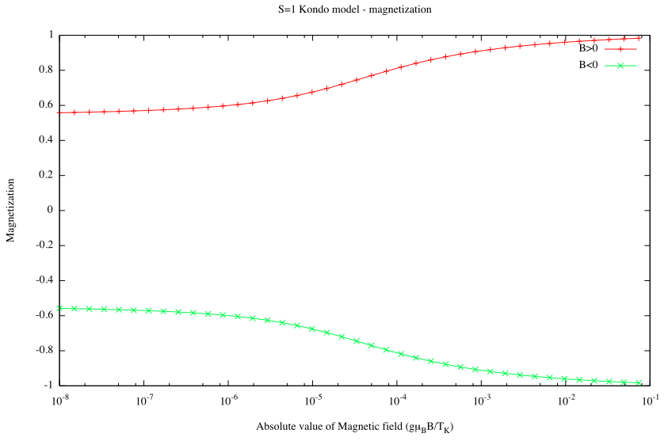
For Kondo model, calculate the spin polarization SZ for a S=1 Kondo model for a range of magnetic field B going from negative to positive values.

Slide 14
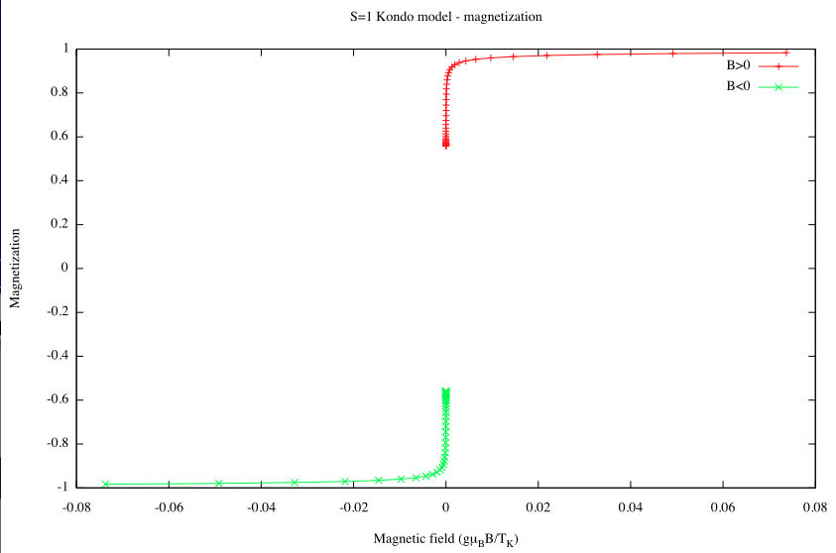

Slide 15
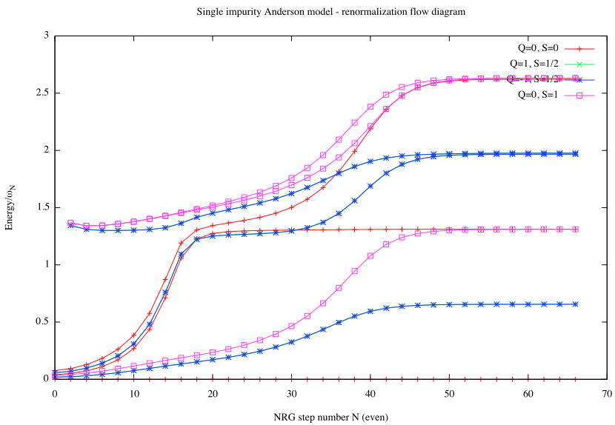
Increase δ to large values. How is the low-energy fixed point affected? Compare the flow diagrams for even and odd chain lengths.

Slide 16
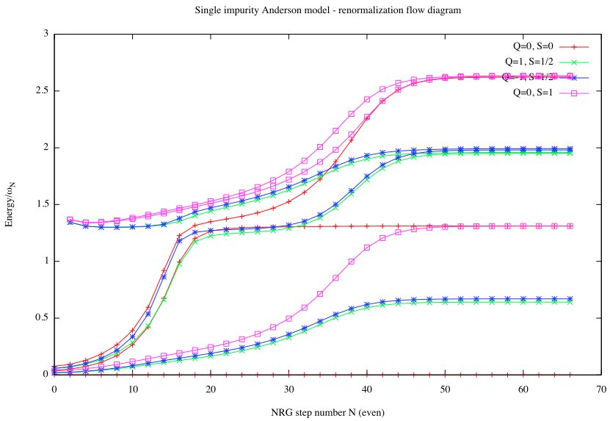

Slide 18
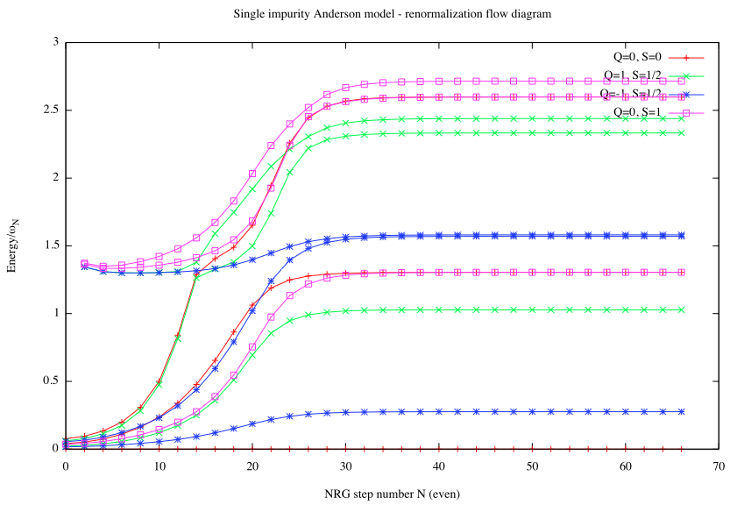

Slide 19
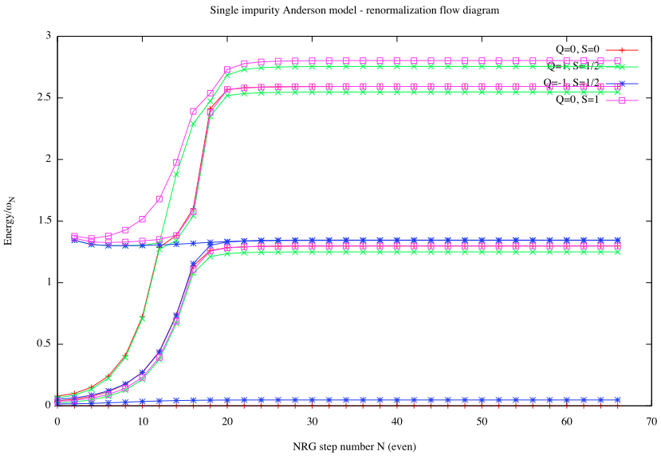

Slide 20
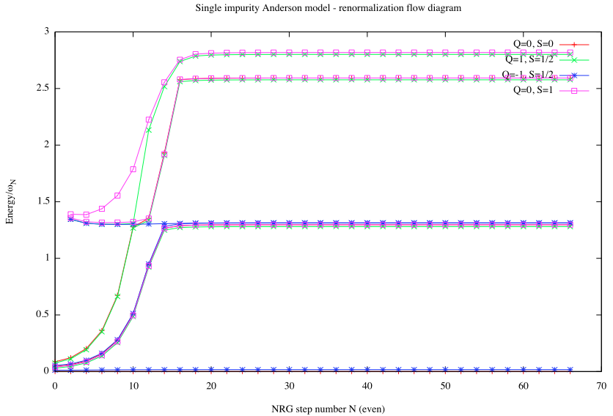

Slide 21
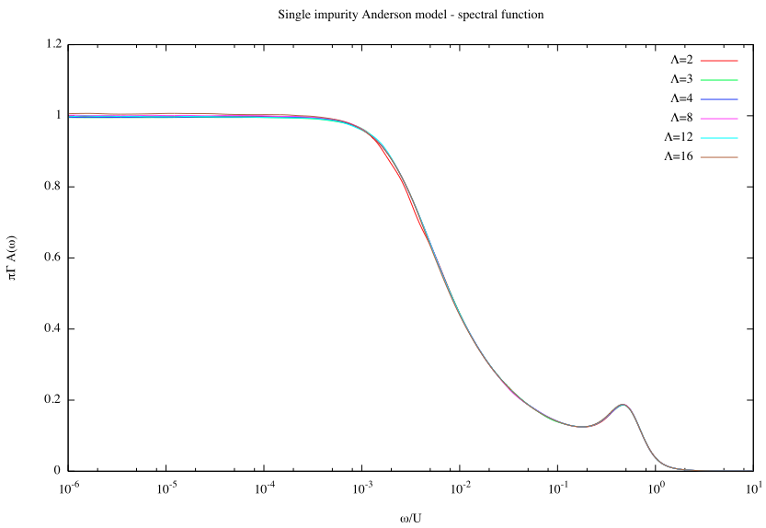
Try increasing Λ. How do the results deteriorate?

Slide 22
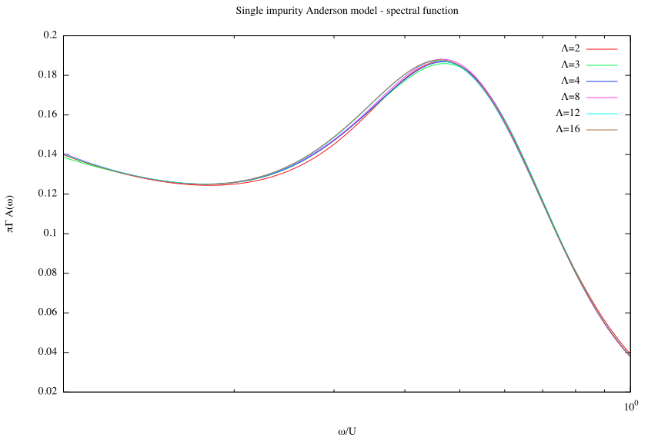

Slide 23
