Slide 1
Tutorial 6: DMFT calculations for the Hubbard model, metal-insulator transition,
KLM, PAM
Rok Žitko
Institute Jožef Stefan
Ljubljana, Slovenia

Slide 2
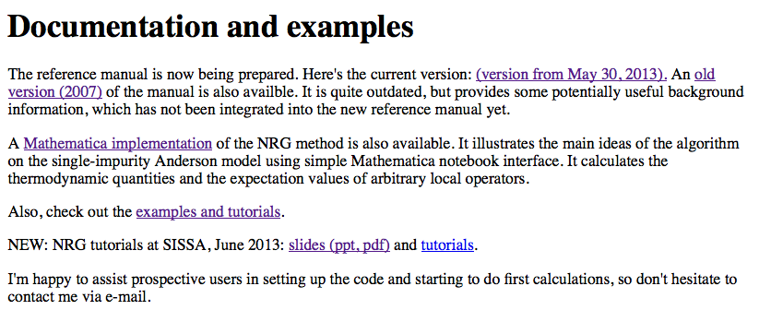
Updated lecture & tutorial slides, and update materials for tutorials:
http://nrgljubljana.ijs.si/
(Note: 50MB compressed. )

Slide 3
Implementation using shell and perl scripts
dmft_mon:
  initializes the calculation (dmft_init, builds an approximation for Δ)
  runs nrginit and submits the calculations (nrgrun) to the cluser
  waits for the calculations to finish, processes the results (dmft_done)
  checks for convergence (checkconv): if not, starts a new loop

Slide 4
dmft_done:
  average: do the z-averaging of spectral functions
  realparts: Kramers-Kronig to obtain real parts of G and F
  sigmatrick: compute Σ
  bandDOS: compute lattice G
  copyresults (snapshot of current DMFT step), occupancies (<n>, etc.)
  dmftDOS: compute Δ for new DMFT step
  broyden: do the Broyden mixing in order to obtain improved Δ

Slide 5
#!/usr/bin/env looper
#
#PRELUDE: $Nz=4; $DELTA=`cat param.delta`;
#AUTOLOOP: ../odesolv1 ; nrginit ; nrgrun
[dmft]
Nz=4
# D=1/scale=0.1, thus W=2D=0.2
scale=10
clip=1e-4
# Target occupancy
goal=0.8
# Broyden
offset=1
M=1000
alpha=0.5
[param]
xmax=15
adapt=false
tri=cpp
preccpp=2000
prec=100
symtype=QS
model=../model.m
fixeps=1e-10
param.loop
param.delta contains δ,
the shift of the center of the conduction
band (note than μ=0)
discretization solver
we need to rescale all the energies
to make them fit in the NRG energy
window of [-1:1]
fixed occupancy calculation
with <n>=0.8
parameters for odesolv
parameters for tridiagonalization

Slide 6
U=0.22
delta=$DELTA
Lambda=4.0
Tmin=1e-10
keepmin=500
keepenergy=10.0
keep=8000
discretization=Z
band=asymode
dos=../Delta.dat
@$z = 1.0/$Nz; $z <= 1.00001; $z += 1/$Nz
z=$z
strategy=kept
ops=A_d self_d n_d n_d_ud Himp Hhyb Hpot
specd=A_d-A_d self_d-A_d
0.22 x scale -> U=2.2D
arbitrary DOS

Slide 7
fdm=true
fdmexpv=true
broaden=false
savebins=true
bins=1000
T=1e-09
broaden_max=4
broaden_ratio=1.01
broaden_min=1e-8
width_custom=20
prec_custom=14
done=true

Slide 8
model.m
def1ch[1];
H1 = delta number[d[]] + U/2 pow[number[d[]]-1, 2];
Hc = Sum[gammaPolCh[ch] hop[f[ch-1], d[]], {ch, CHANNELS}];
Himp = H1;
Hhyb = Hc;
Hpot = U hubbard[d[]];
H = Himp + Hhyb + H0;
(* All operators which contain d[], except hybridization (Hc). *)
Hselfd = Himp;
selfopd = ( Chop @ Expand @ komutator[Hselfd /. params, d[#1, #2]] )&;

Slide 9
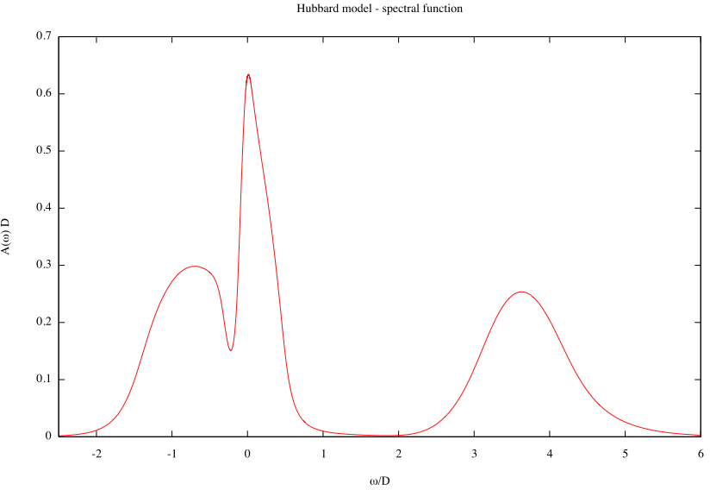
3a_plot
45_Hubbard
<n>=0.8, U/D=4, T=0

Slide 10
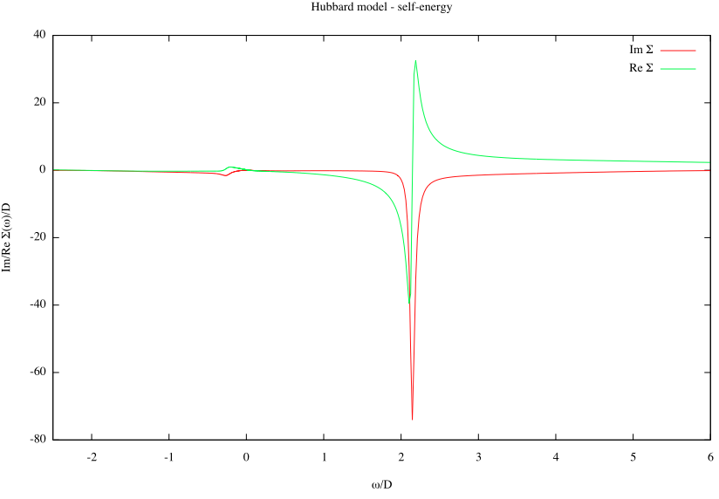
3b_plot_sigma

Slide 11
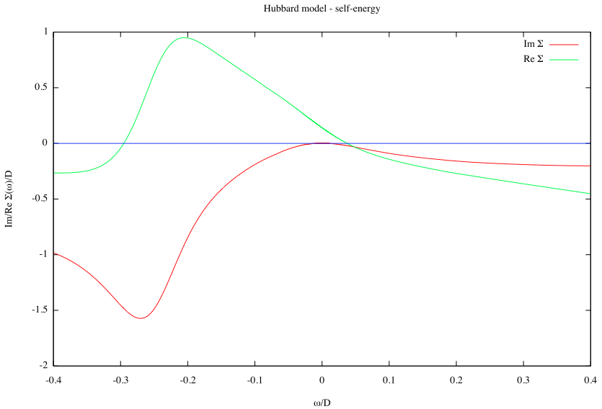
3b_plot_sigma_zoom

Slide 12
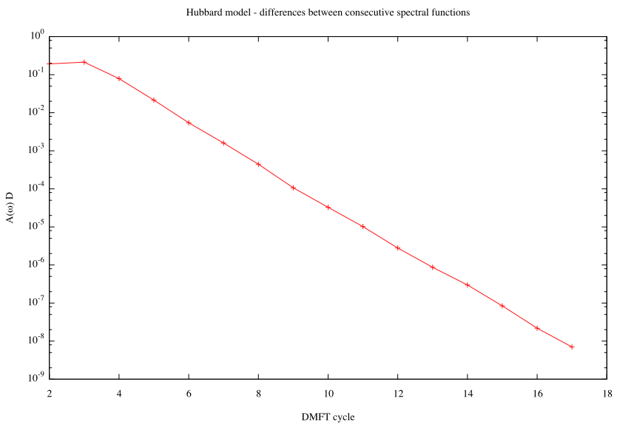
3d_plot_diffs

Slide 13
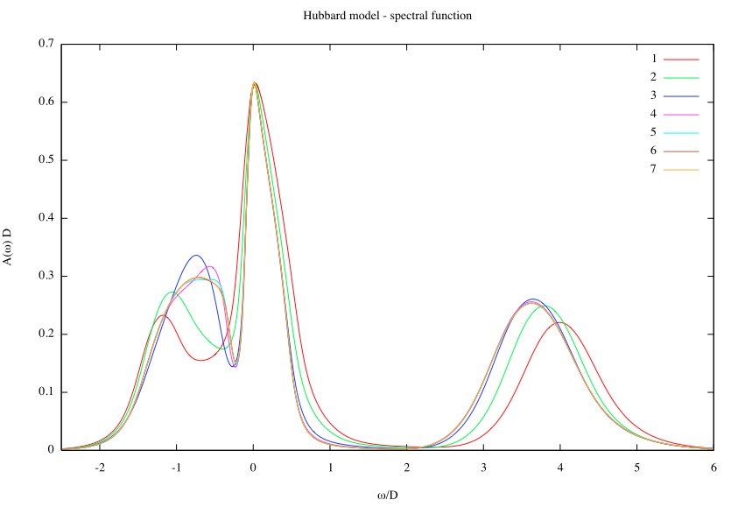
3e_plot_all

Slide 14
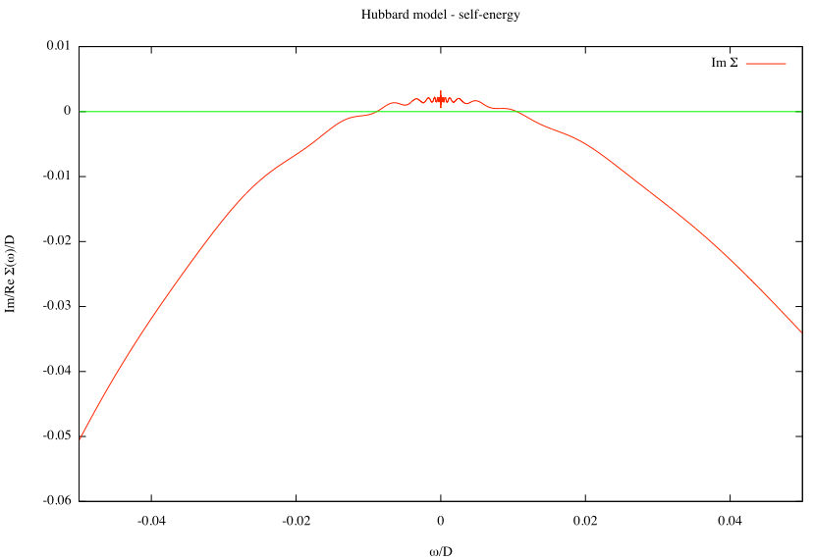
Causality violation: well-known problem in NRG!

Slide 15
NOTE: when restarting a DMFT calculation, erase the file ITER. This tells the code to restart (and prevents Broyden mixer from complaining that the previous results cannot be loaded). This will still reuse the result from the previous calculation as an initial approximation.
If you want to start from scratch, erase the file ITER and all files named Delta*.

Slide 16
Exercises
Reduce the doping (i.e., goal ➝ 1). How does the quasiparticle peak evolve?
Increase the temperature. Follow the changes in the spectral function and in Σ.
Try different initial hybridization functions (i.e., create a file DeltaFirst.dat). Is the converged solution always the same?
Note: see also 47_Hubbard_fast, larger Λ=4, much faster calculations!

Slide 17
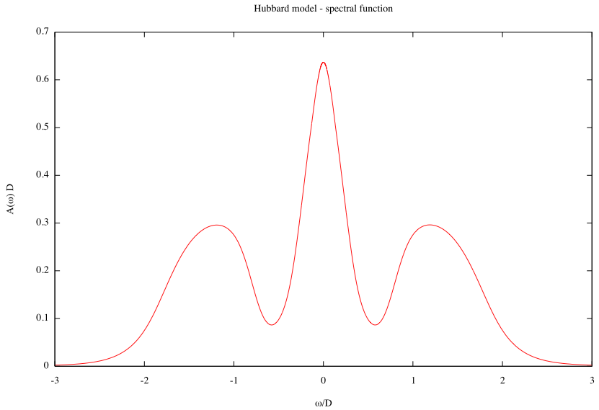
3a_plot
46_Hubbard_MIT

Slide 18
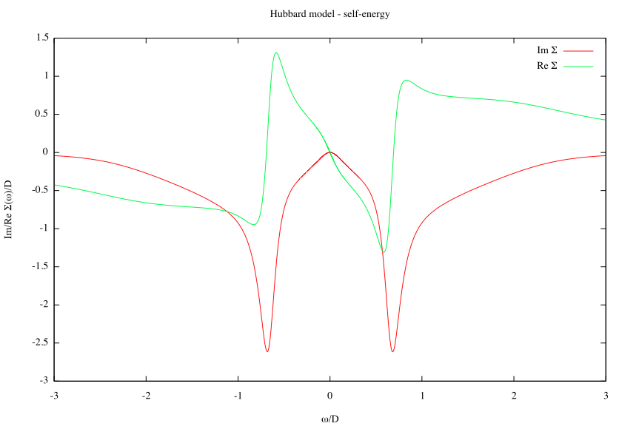
3b_plot_sigma

Slide 19
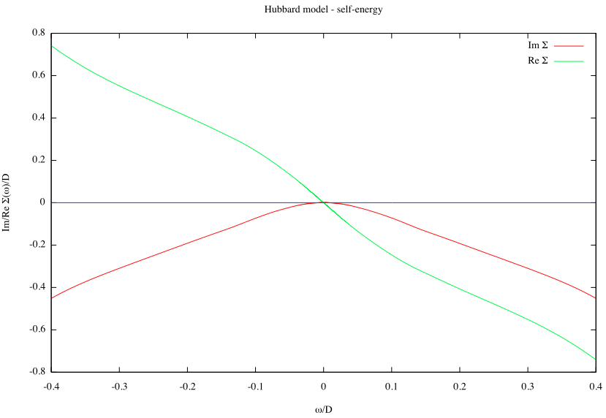
3b_plot_sigma_zoom

Slide 20
Exercises
Increase U and locate the MIT at U=U_{c2}.
Starting from an insulating initial approximation, reduce U and locate the MIT at U=U_{c1}.
Do an U-sweep at finite temperature T=0.06D. Observe the cross-over from metal-like to insulator-like spectral functions.

Slide 21
Kondo lattice model
48_klm

Slide 22
def1ch[1];
If[!paramexists["spin", "extra"],
MyError["Define the spin of the impurity!"];
];
SPIN = ToExpression @ param["spin", "extra"];
MyPrint["SPIN=", SPIN];
Module[{sz, sp, sm, sx, sy, oz, op, om, ss},
sz = spinketbraZ[SPIN];
sp = spinketbraP[SPIN];
sm = spinketbraM[SPIN];
sx = spinketbraX[SPIN];
sy = spinketbraY[SPIN];
oz = nc[ sz, spinz[ d[] ] ];
op = nc[ sp, spinminus[ d[] ] ];
om = nc[ sm, spinplus[ d[] ] ];
ss = oz + 1/2 (op + om) // Expand;
Hk = Jkondo ss;
];
SPIN
J
d
model.m

Slide 23
H = H0 + H1 + Hc + Hk;
MAKESPINKET = SPIN;
(* All operators which contain d[], except hybridization (Hc). *)
Hselfd = H1 + Hk;
selfopd = ( Chop @ Expand @ komutator[Hselfd /. params, d[#1, #2]] )&;

Slide 24
[extra]
spin=1/2
Jkondo=0.05
[param]
xmax=15
adapt=false
tri=cpp
preccpp=2000
prec=100
symtype=QS
model=../model.m
fixeps=1e-10
U=0
delta=$DELTA
Gamma=-999
param.loop

Slide 25
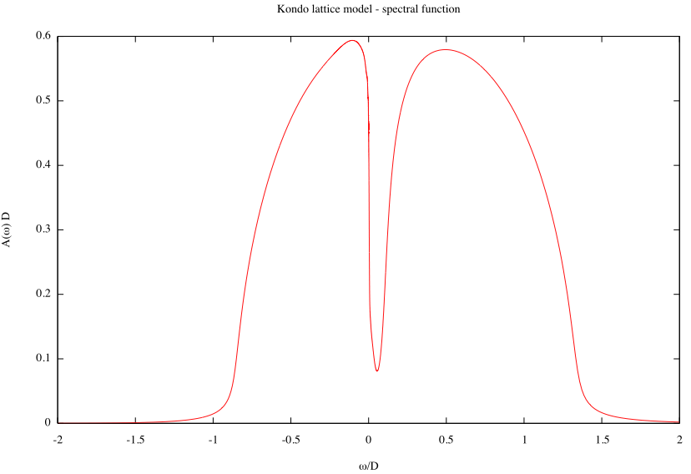
3a_plot

Slide 26
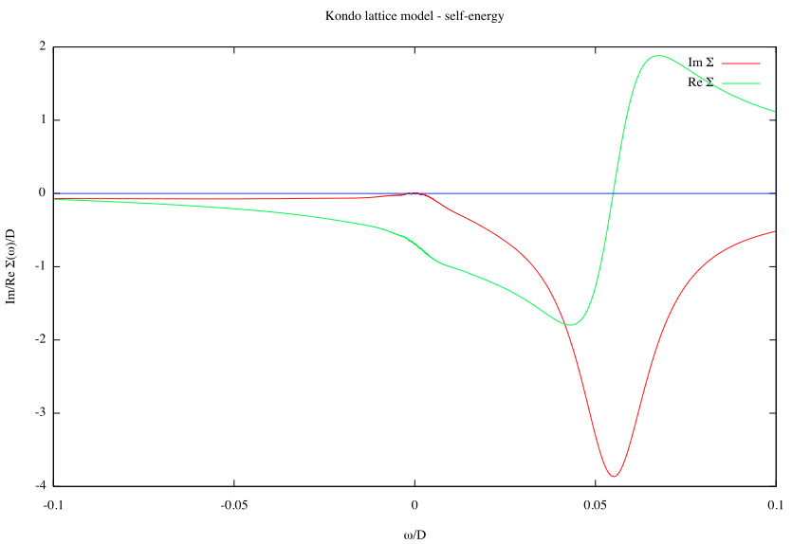
3c_plot_sigma_zoom

Slide 27
Exercises
Change the target occupancy (parameter goal in param.loop) towards 1. What happens?
Increase J. How does the width of the pseudogap decrease?

Slide 28
Periodic Anderson model
f
f
f
t
t
t
c
c
c
49_pam

Slide 29
def1ch[2];
Ha = eps number[a[]] + Uf hubbard[a[]];
H1a = t hop[d[], a[]];
H = H0 + H1 + Hc + Ha + H1a;
(* All operators which contain d[], except hybridization (Hc). *)
Hselfd = H1 + H1a;
selfopd = ( Chop @ Expand @ komutator[Hselfd /. params, d[#1, #2]] )&;
model.m

Slide 30
[extra]
Uf=0.3
eps=-0.15
[param]
xmax=15
adapt=false
tri=cpp
preccpp=2000
prec=100
symtype=QS
model=../model.m
fixeps=1e-10
U=0
t=0.05
delta=$DELTA
Gamma=-999
param.loop

Slide 31
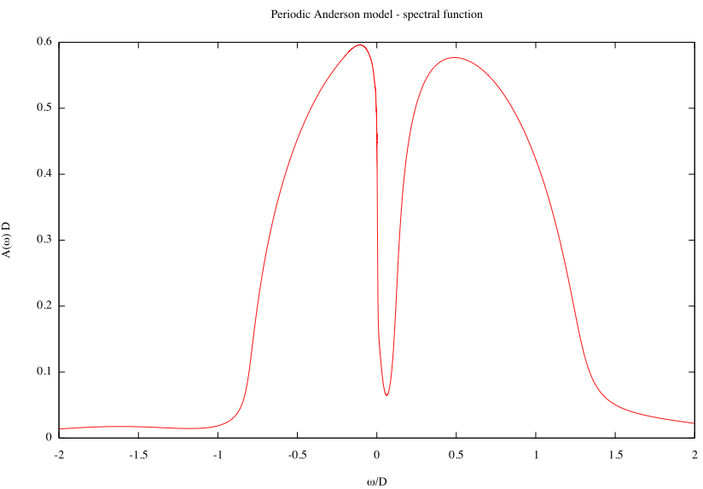

Slide 32
Exercises
Decrease U_{f} towards 0. What happens?
Increase t. What happens?

