Slide 1
Discretization, z-averaging, thermodynamics, flow diagrams
Rok Žitko
Institute Jožef Stefan
Ljubljana, Slovenia

Slide 2
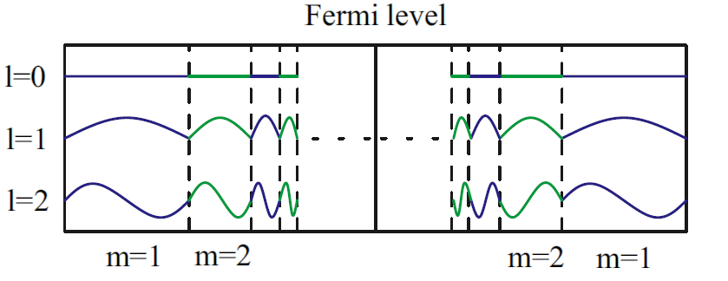
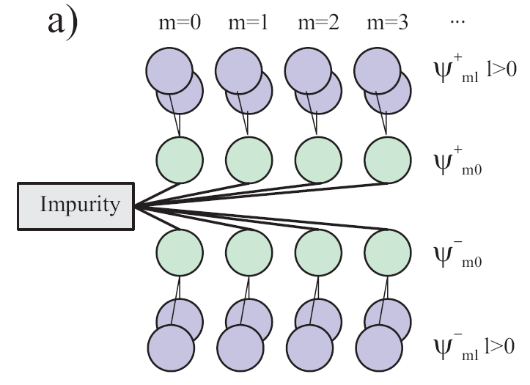

Numerical renormalization group (NRG)
Λ^{-n/2}
Wilson, Rev. Mod. Phys. 47, 773 (1975)

Slide 3
f₀ – the first site of the Wilson chain
The f₀ orbital is also the average state of all "representative states".

Slide 4

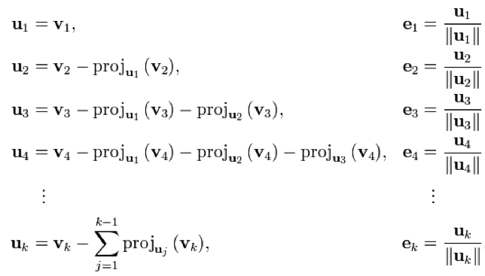
Gram-Schmidt orthogonalization
http://en.wikipedia.org/wiki/Gram%E2%80%93Schmidt_process

Slide 5
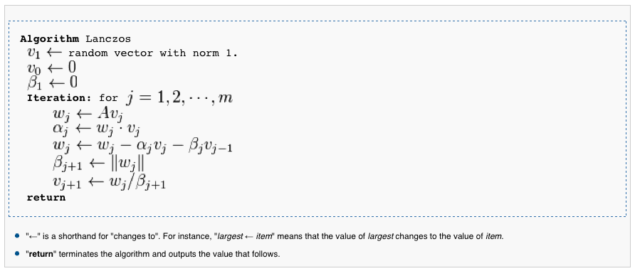
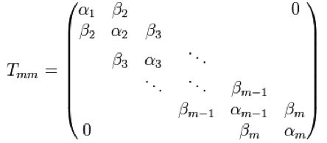
Lanczos algorithm
H_{band} in truncated basis
We take f₀ instead of the random vector!
The NRG Ljubljana contains a stand-alone tool nrgchain for tridiagonalization (in addition to the tridiagonalization code in initial.m and tridiag.h).
http://en.wikipedia.org/wiki/Lanczos_algorithm

Slide 6
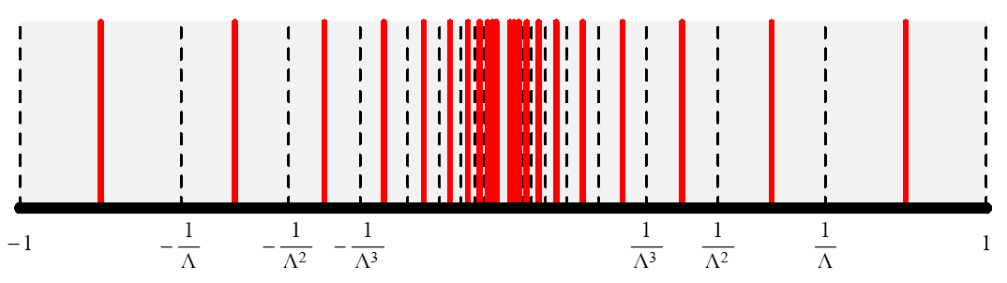

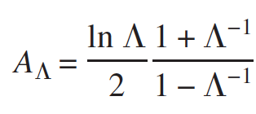
Logarithmic discretization
Good sampling of the states near the Fermi energy!
Correction:
Wilson, Rev. Mod. Phys. 47, 773 (1975)

Slide 7
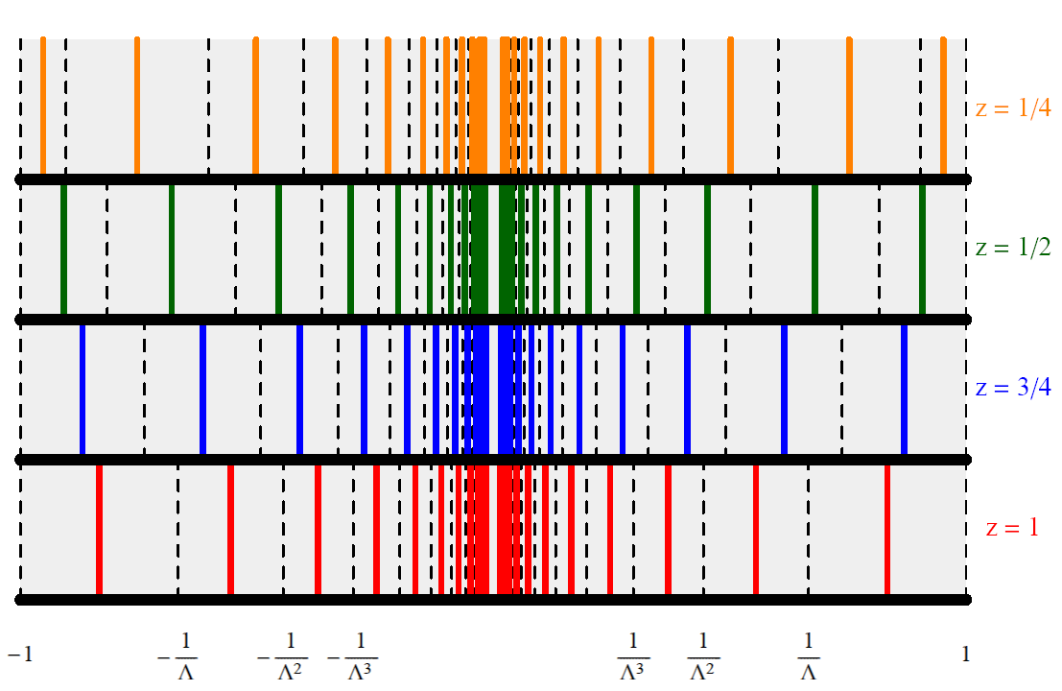


“z-averaging” or “interleaved method”
Frota, Oliveira, Phys. Rev. B 33, 7871 (1986)
Oliveira, Oliveira: Phys. Rev. B 49, 11986 (1994)

Slide 8
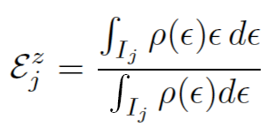
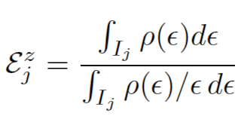
Discretization schemes
1) Conventional scheme
2) Campo-Oliveira scheme
Chen, Jayaprakash, JPCM 7, L491 (1995); Ingersent, PRB 54, 11936 (1996); Bulla, Pruschke, Hewson, JPCM 9, 10463 (1997).
Campo, Oliveira, PRB 72,
104432 (2005).
ρ(ε) = density of states in the band

Slide 9
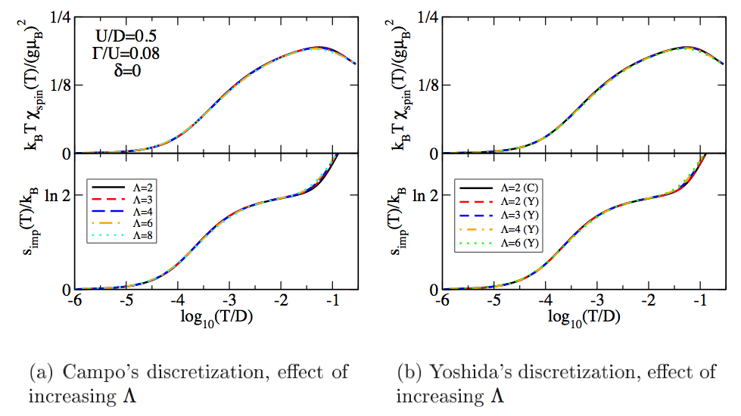
With z-averaging it is possible to increase Λ quite significantly without introducing
many artifacts in the results for thermodynamics (especially in the low-temperature limit).

Slide 10
Can we obtain high-resolution spectral functions by using
1) many values of z and
2) narrow Gaussian broadening?
Notes:
The short answer: yes, with some caveats. More importantly, on the way of resolving this problem we encountered other problems with the way the discretization is performed, which were not known before.

Slide 11
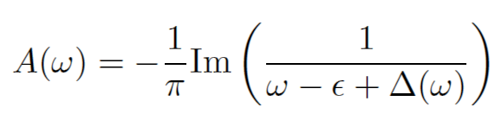
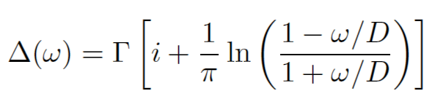
Test case: resonant-level model
for a flat band,
ρ(ω)=const.
Notes:
Equally difficult as fully interacting problems.

Slide 12
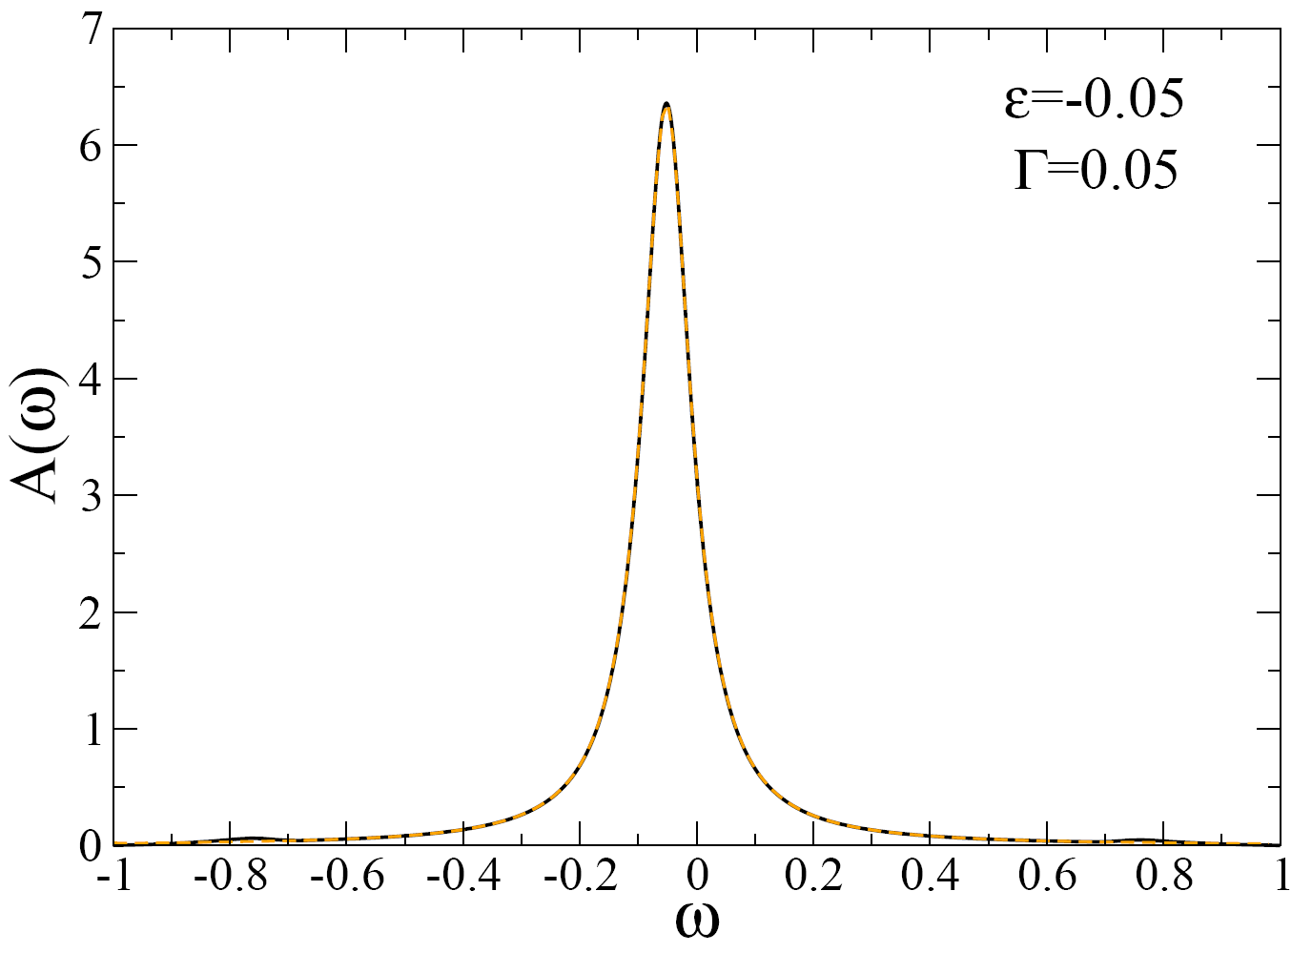

Slide 13
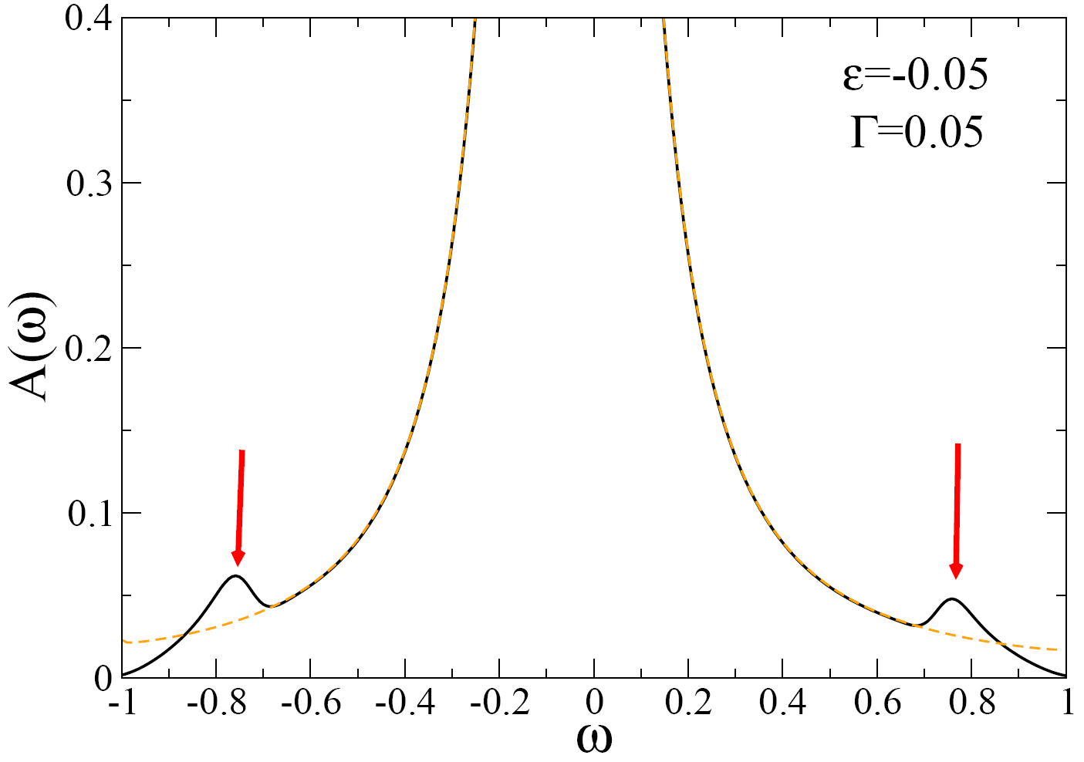
Notes:
calc/SIAM/Campo

Slide 14
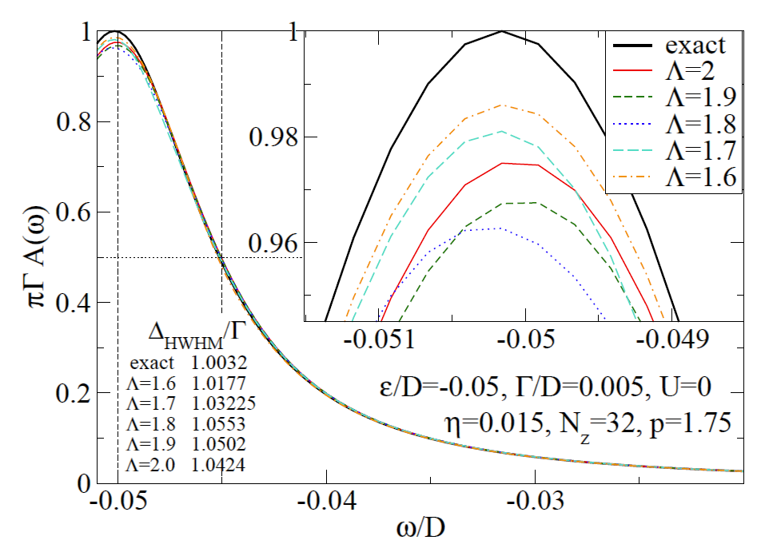

Slide 15
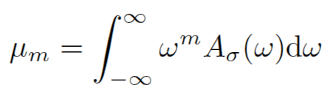


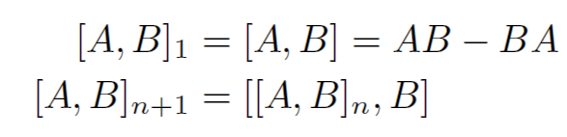
Higher-moment spectral sum rules

Slide 16


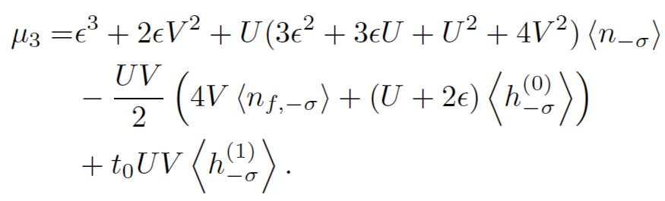


Slide 17
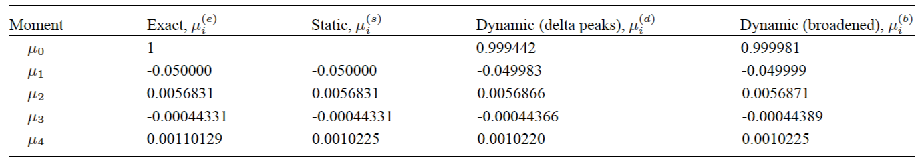
Spectral moments for the resonant-level model
7 percent discrepancy!

Slide 18
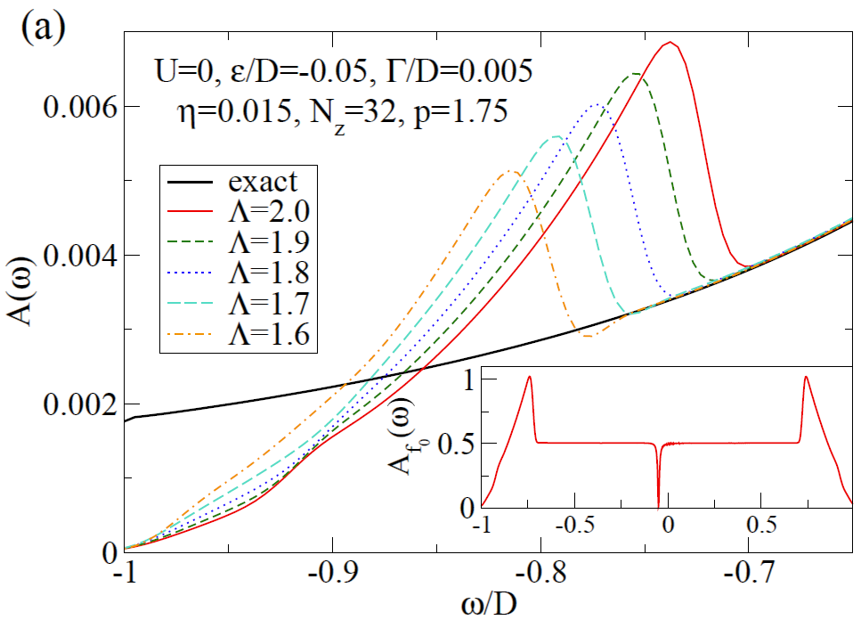

Slide 19
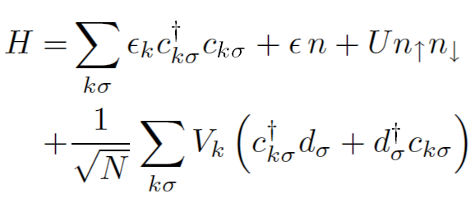
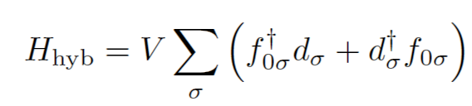
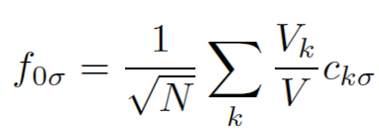
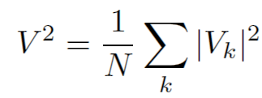

Slide 20
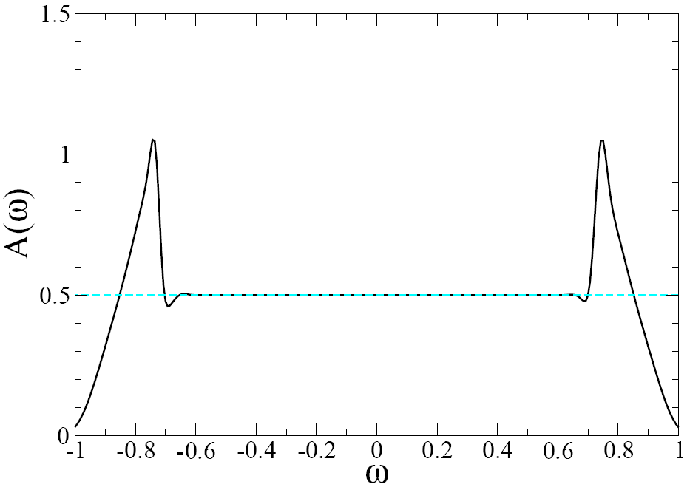

Slide 21
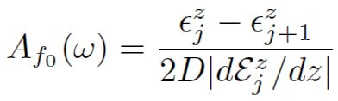

Origin of the band-edge artifacts

Slide 22
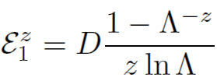

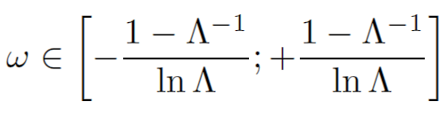

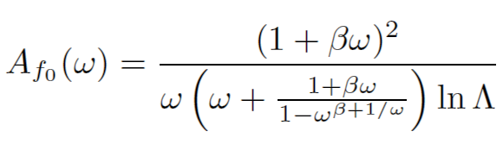

Campo, Oliveira, PRB 72, 104432 (2005).
for ω near band-edges

Slide 23
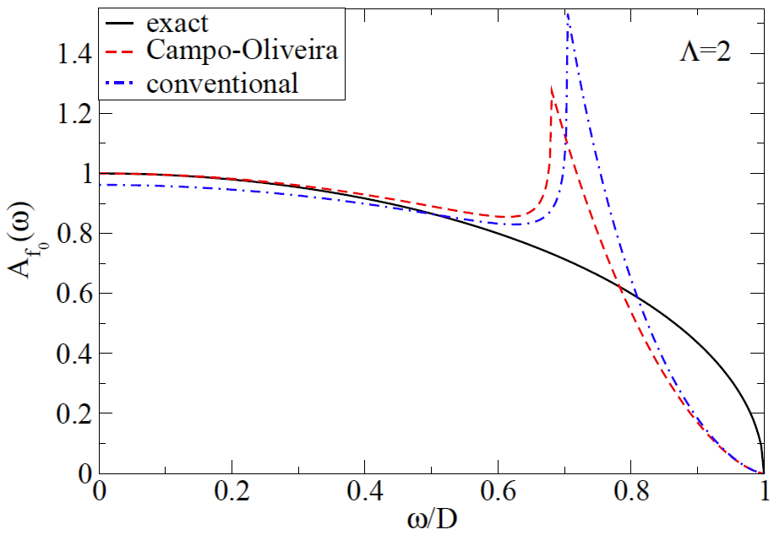
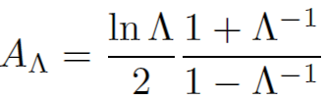
NOTE: analytical results, not NRG.

Slide 24

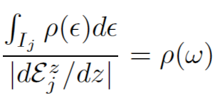


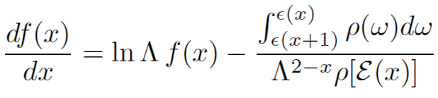
Can we do better?
Yes! We demand
R. Žitko, Th. Pruschke, PRB 79, 085106 (2009)
R. Žitko, Comput. Phys. Comm. 180, 1271 (2009)

Slide 25
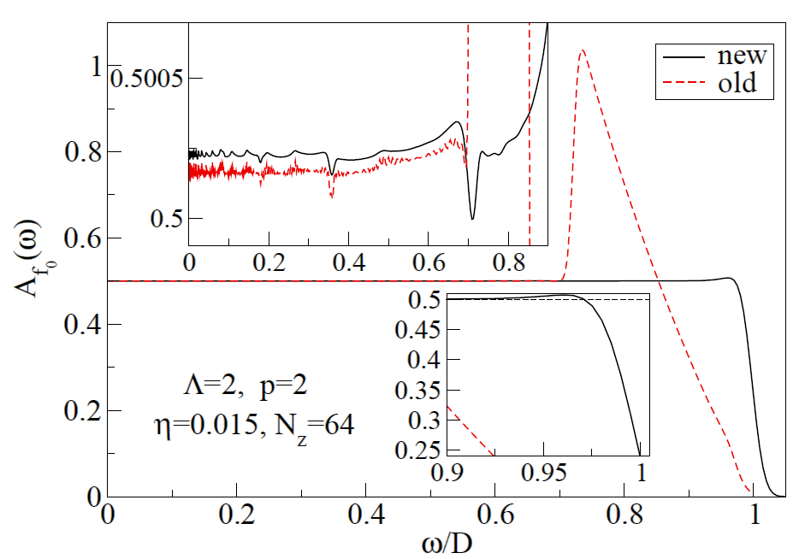

Slide 26
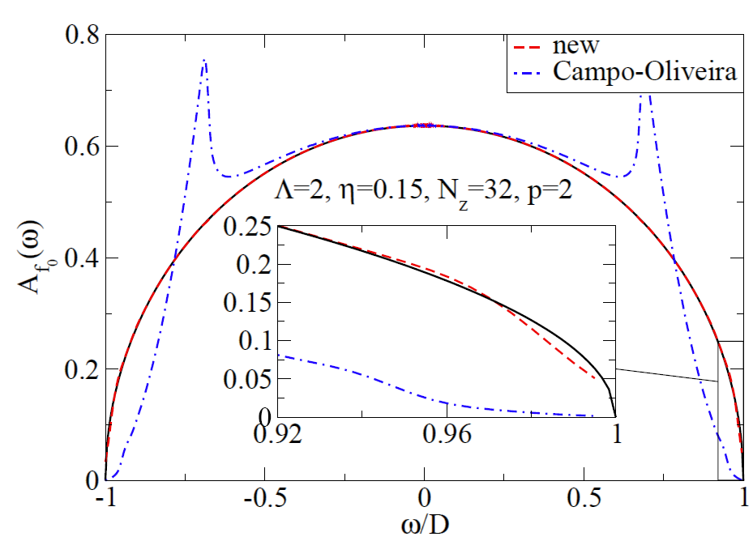

Slide 27
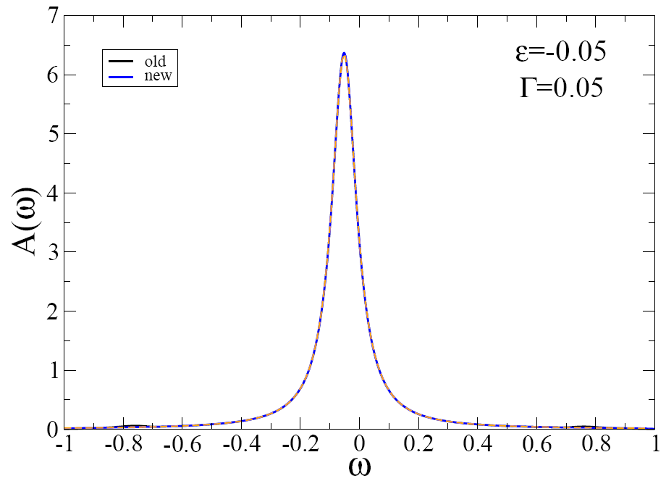

Slide 28
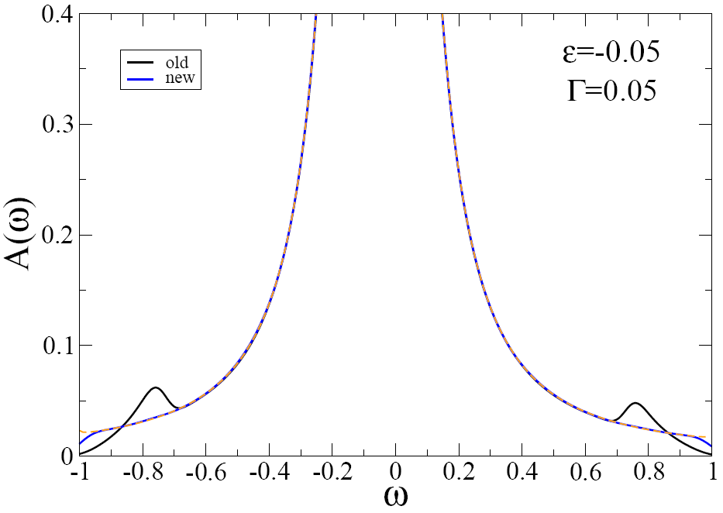

Slide 29
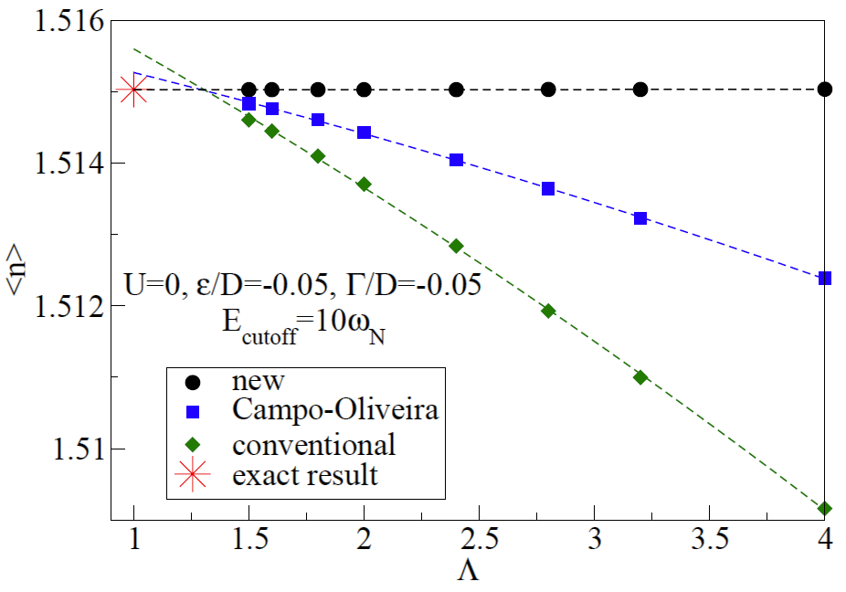
Main success: excellent convergence of various expectation values

Slide 30
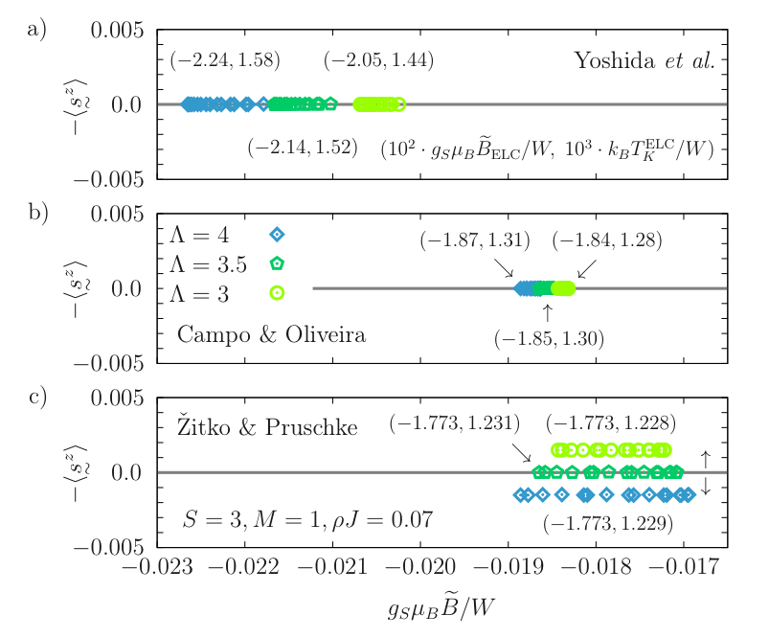
Höck, Schnack, PRB 2013

Slide 31
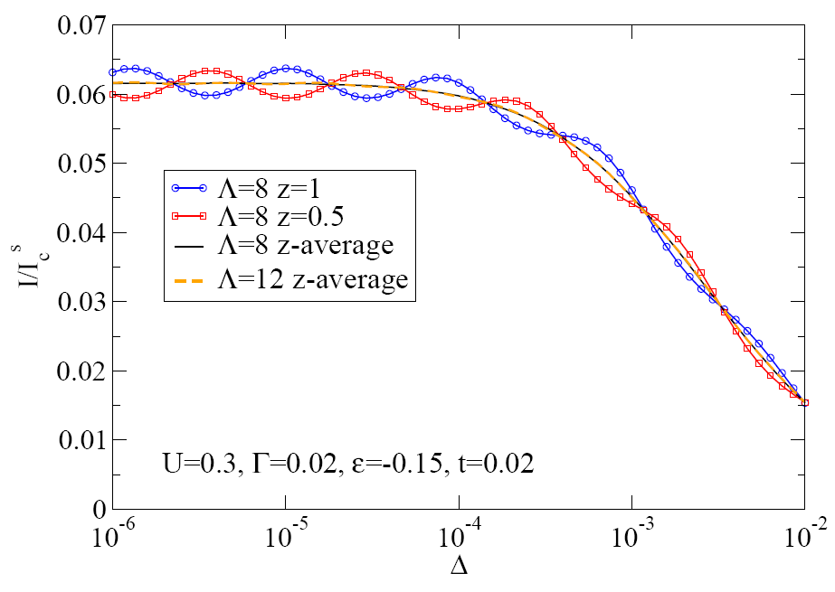
Cancellation of Λ-periodic NRG discretization artifacts by the z-averaging
R. Žitko, M. Lee, R. Lopez, R. Aguado, M.-S. Choi, Phys. Rev. Lett. 105, 116803 (2010)

Slide 32
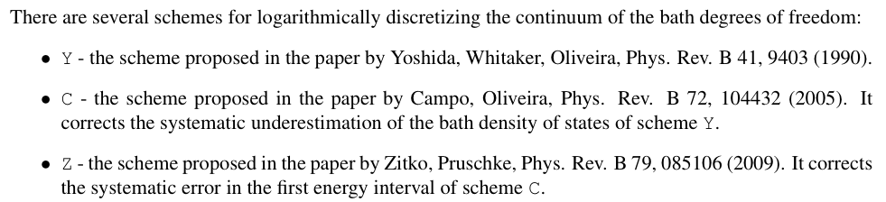

Slide 33

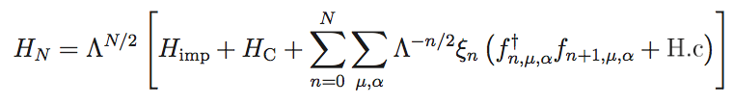



Iterative diagonalization

Slide 34
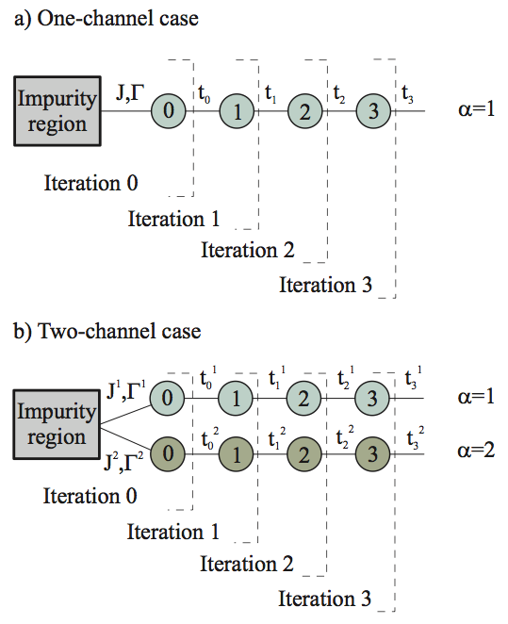

Slide 35
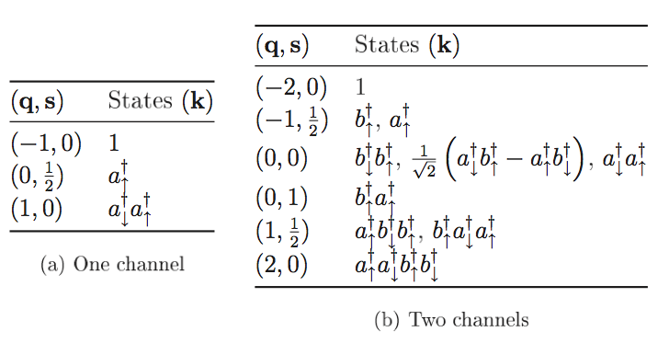
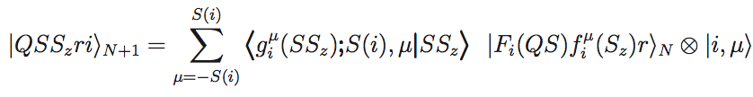


Slide 36
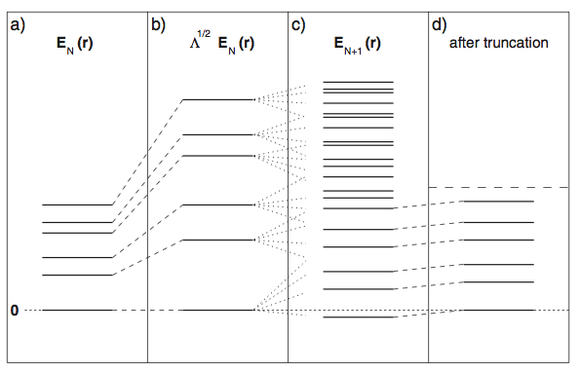
Bulla, Costi, Pruschke, RMP 2008

Slide 37



Characteristic energy scale at the N-th step of the NRG iteration:
discretization=Y
discretization=C or Z

Slide 38






RG, fixed points, operators
linear operator
relevant operator
irrelevant operator
See Krishnamurthy, Wilkins, Wilson,
PRB 1980 for a very detailed analysis
of the fixed points in the SIAM.
marginal operator

Slide 39
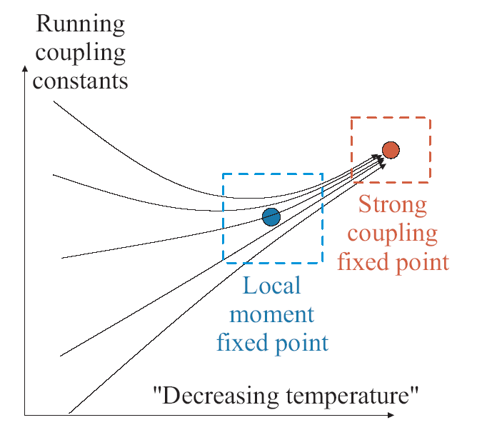
Universality

Slide 40
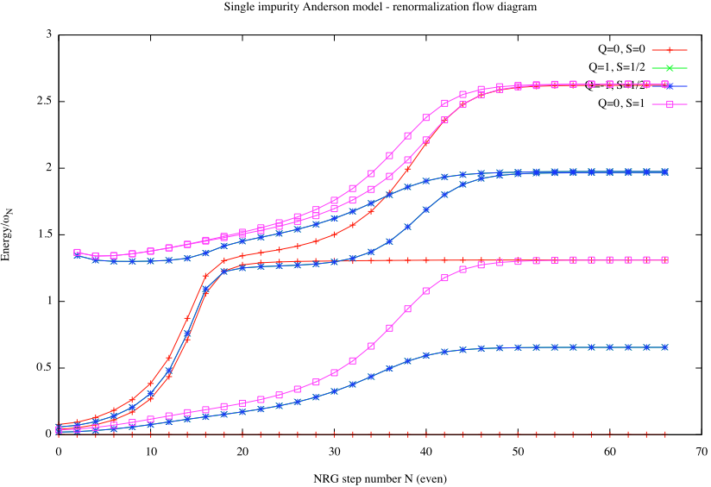

Slide 41
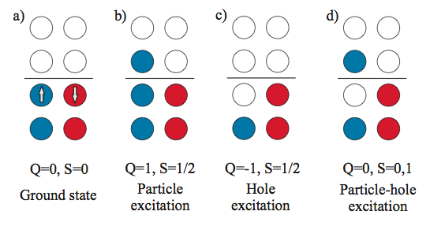
Fermi-liquid fixed points

Slide 42


Slide 43
Thermodynamic quantities

Slide 44



Computing the expectation values
Conventional approach: use H_{N} as an approximation for full H at temperature scale T_{N}.
Alternatively: use FDM for given T. Also works for thermodynamics:
Merker, Weichselbaum, Costi, Phys. Rev. B 86, 075153 (2012)

Slide 45

Local vs. global operators
Local operators: impurity charge, impurity spin, d†_{σ} . In general, any operator defined on the initial cluster.
Global operators: total charge, total spin, etc.
Example:

Slide 46




(Magnetic) susceptibility
If [H,S_{z}]=0:
General case:

Slide 47

Kondo model
ρJ=0.1
Zitko, Pruschke, NJP 2010
Notes:
ljubljana/examples/KONDO/global_op_chi/convergence

Slide 48

Ground state energy
(binding energy, correlation energy,
Kondo singlet formation energy)
Zitko, PRB 2009

