Slide 1
Dynamical mean-field theory and the NRG as the impurity solver
Rok Žitko
Institute Jožef Stefan
Ljubljana, Slovenia

Slide 2
DMFT
Goal: study and explain lattice systems of strongly correlated electron systems.
Approximation: local self-energy Σ
Dynamical: on-site quantum fluctuations treated exactly
Pro: tractable (reduction to an effective quantum impurity problem subject to self-consistency condition)
Con: non-local correlations treated at the static mean-field level

Slide 3


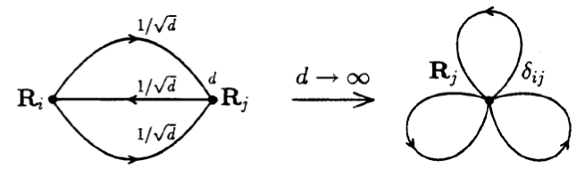
Infinite-D limit
See, for example, D. Vollhardt in The LDA+DMFT approach to strongly correlated materials, Eva Pavarini, Erik Koch, Dieter Vollhardt, and Alexander Lichtenstein (Eds.), 2011

Slide 4

Infinite-D limit
Derivation of the DMFT equations by cavity method:
write the partition function as an integral over Grassman variables
integrate out all fermions except those at the chosen single site
split the effective action
take the D to infinity limit to simplify the expression
result: self-consistency equation
Georges et al., RMP 1996

Slide 5



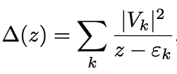

Hubbard ⇒ SIAM
Γ(ω)=-Im[ Δ(ω+iδ) ]
hybridization plays the
role of the Weiss field

Slide 6
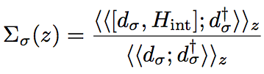




Slide 7
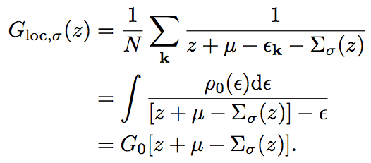

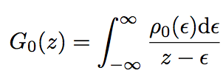

Slide 8

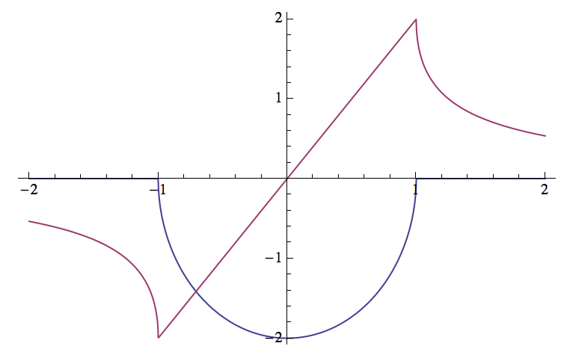
Bethe lattice
Re
Im

Slide 9
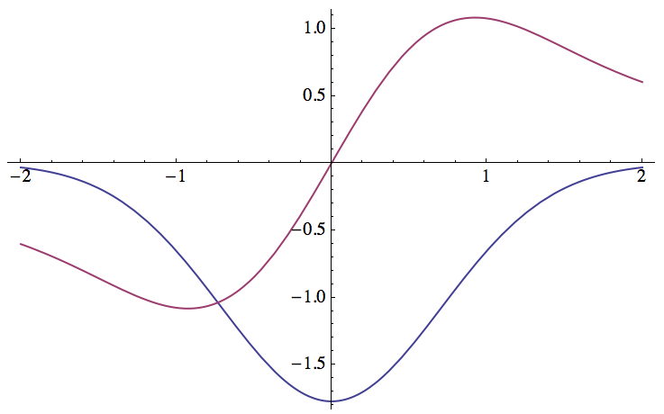
Hypercubic lattice

Slide 10
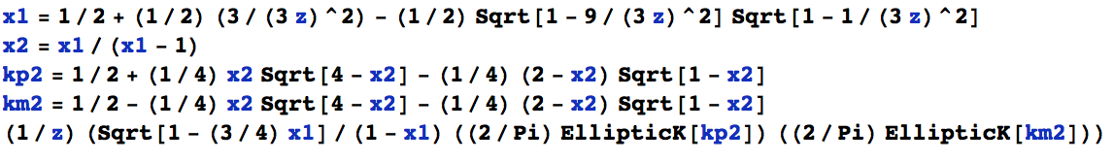
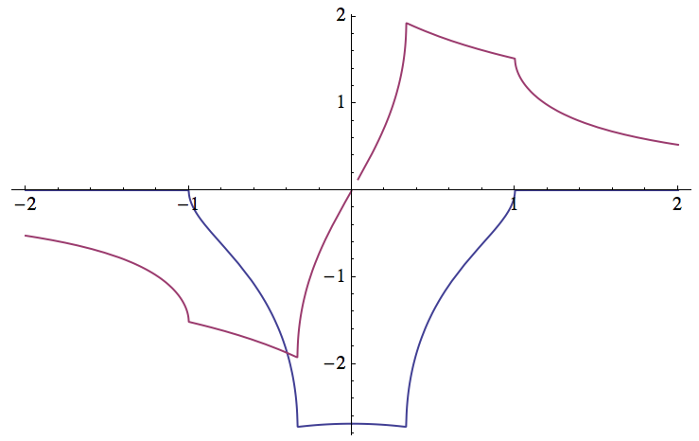
3D cubic lattice

Slide 11

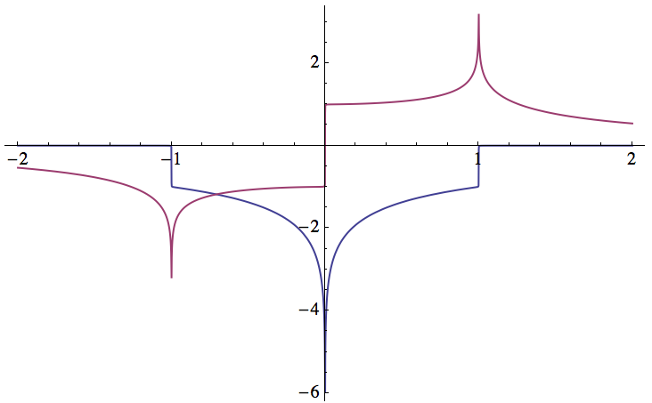
2D cubic lattice

Slide 12
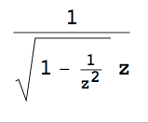
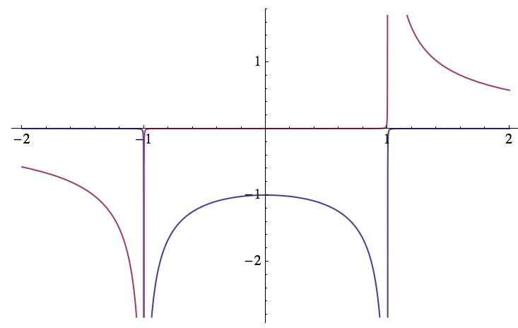
1D cubic lattice (i.e., chain)

Slide 13

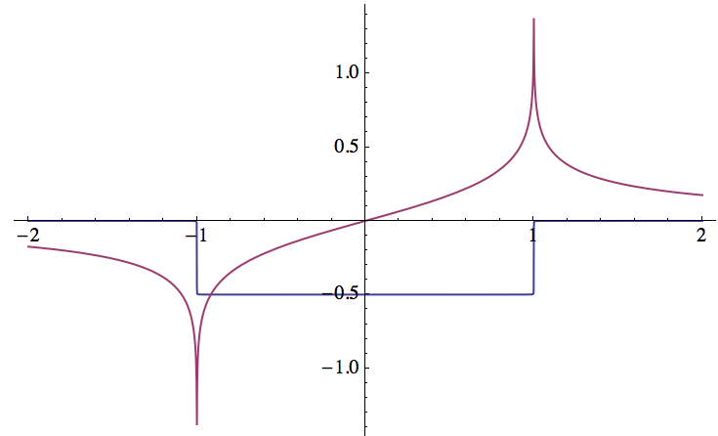
Flat band

Slide 14




Achieving convergence: self-consistency constraint viewed as a system of equations
DMFT step:
Self-consistency:
Linear mixing (parameter α in [0:1]):

Slide 15
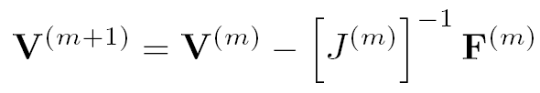

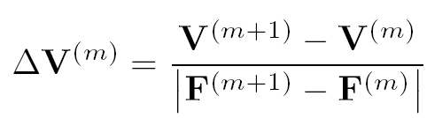
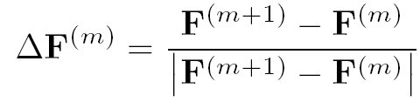
Broyden method
F^{(m)}=F[ V^{(m)} ]
Newton-Raphson method:
Broyden update:

Slide 16
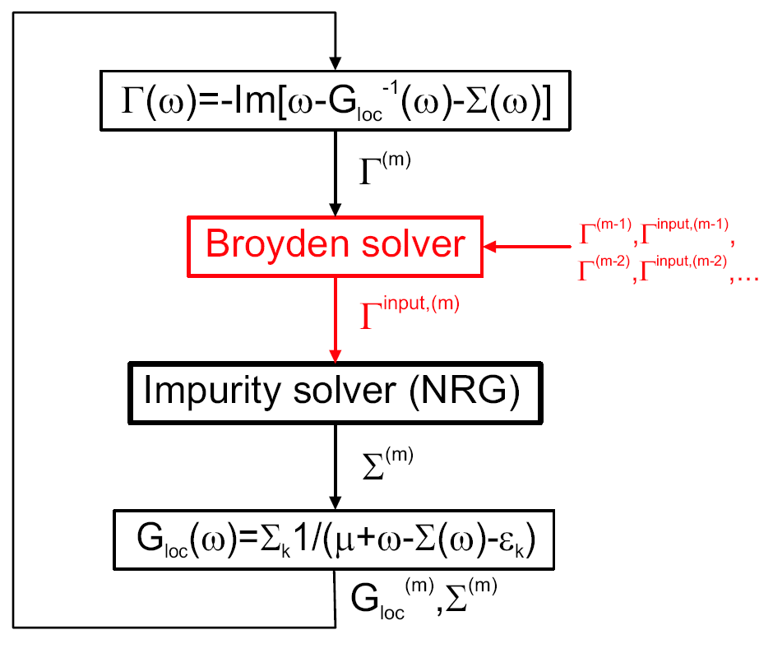
Note: can also be used to control the chemical potential in
fixed occupancy calculations.
R. Žitko, PRB 80, 125125 (2009).

Slide 17
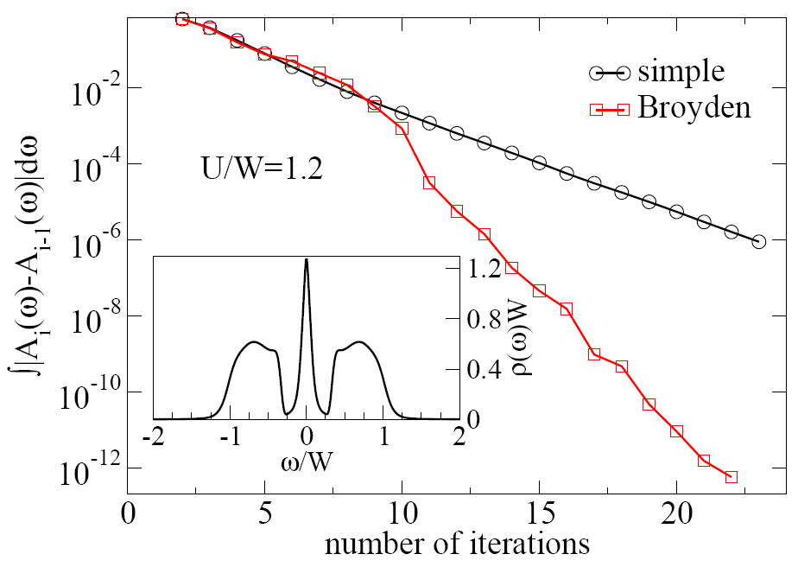

Slide 18
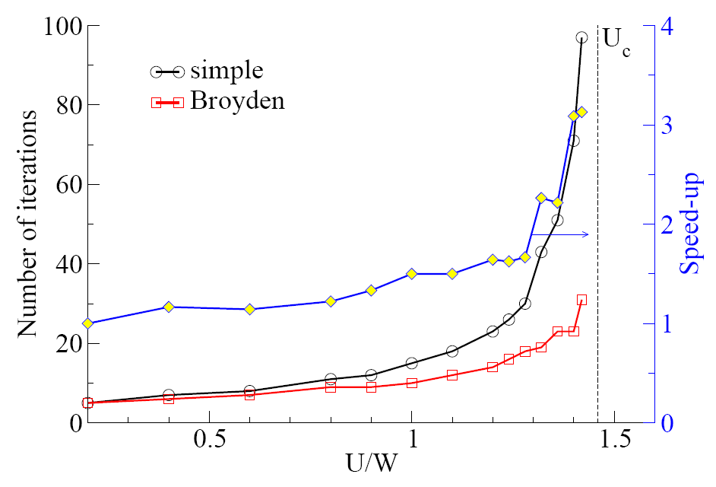

Slide 19
Recent improvements in NRG
DM-NRG, CFS, FDM algorithms ⇒ more reliable spectral functions, even at finite T
discretization scheme with reduced artifacts ⇒ possibility for improved energy resolution

Slide 20
NRG vs. CT-QMC
NRG: extremely fast for single-impurity problems
NRG: access to arbitrarily low temperature scales, but decent results even at high T (despite claims to the contrary!)
NRG: spectral functions directly on the real-frequency axis, no analytic continuation necessary
NRG: any local Hamiltonian can be used, no minus sign problem
NRG: efficient use of symmetries
CT-QMC: (numerically) exact
CT-QMC: can handle multi-orbital problems (even 7-orbital f-level electrons)

Slide 21
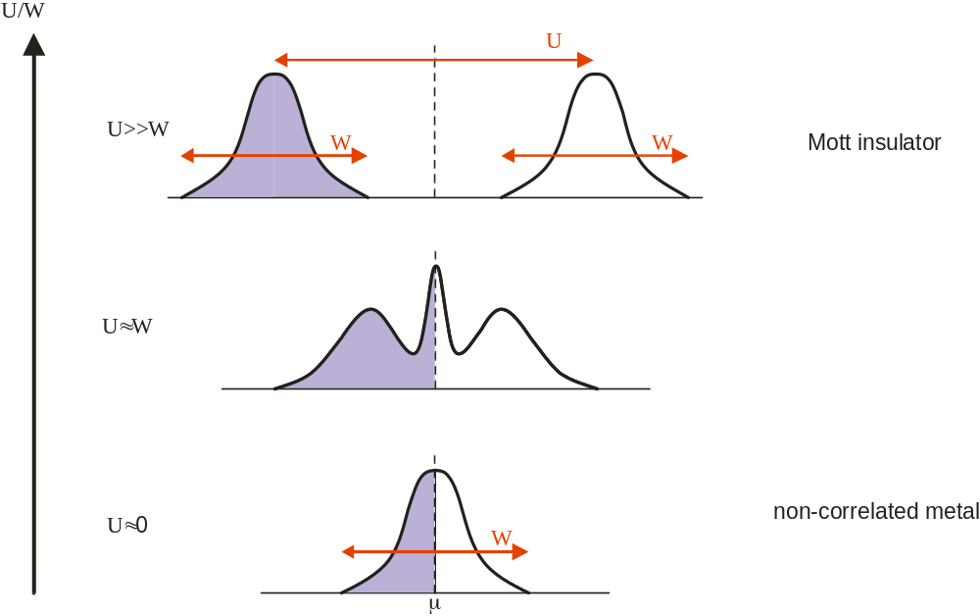
Mott-Hubbard phase transition
← DMFT prediction
Kotliar, Vollhardt

Slide 22
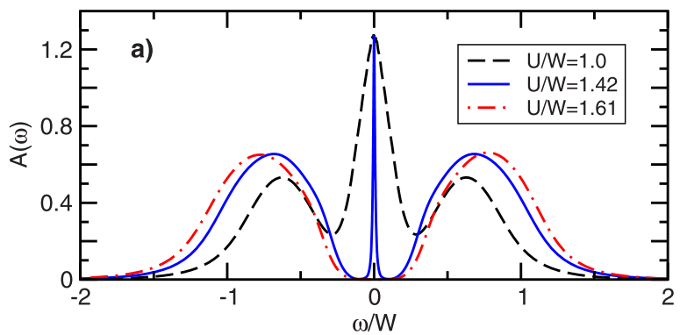
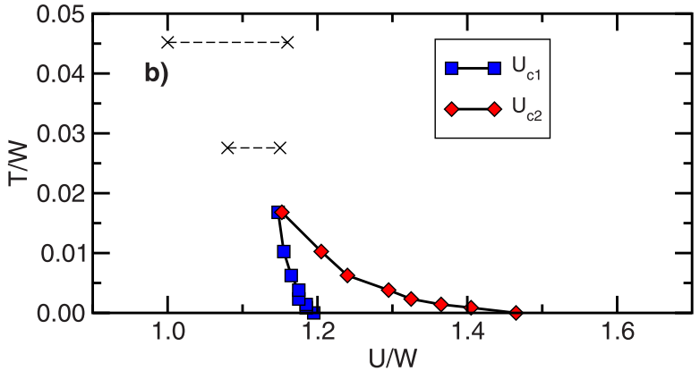
Bulla, 1999, Bulla et al. 2001.

Slide 23
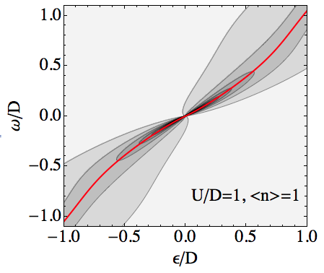
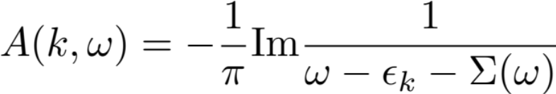
k-resolved spectral functions

Slide 24
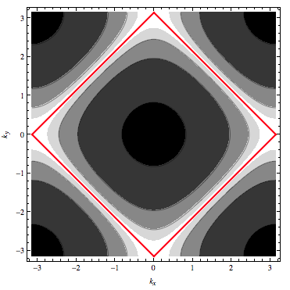
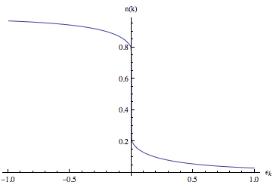
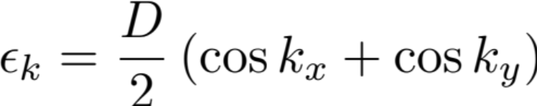
quasiparticle
renormalization
factor
Z
Momentum distribution function
A(k,ω=0)
2D cubic lattice DOS:
Caveat: obviously, DMFT is not a good approximation for 2D problems.
But 2D cubic lattice is nice for plotting...

Slide 25
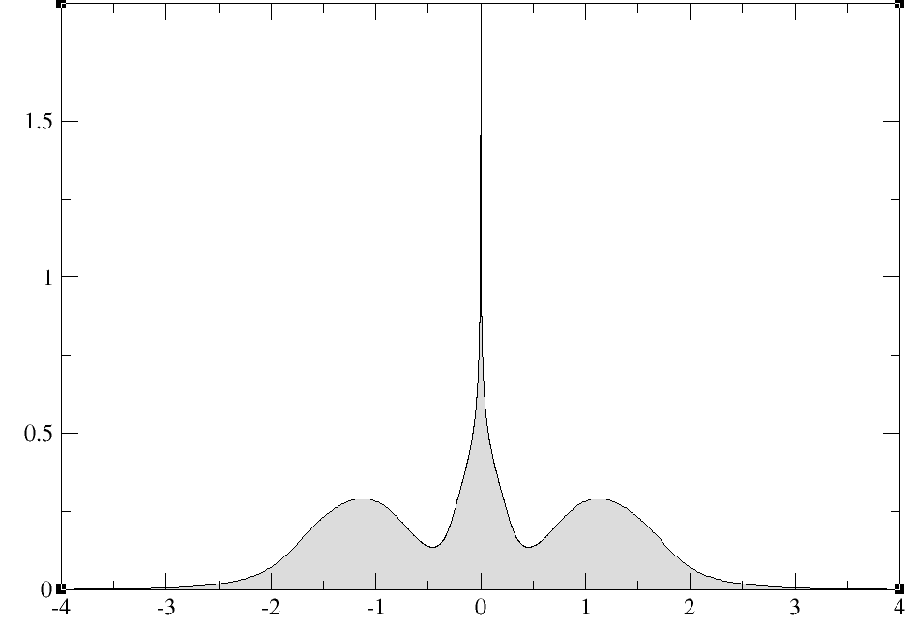
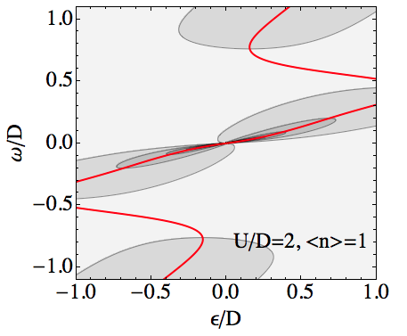
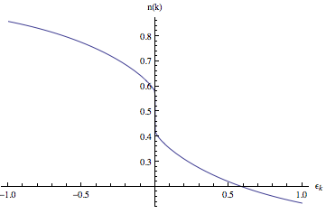

Slide 26
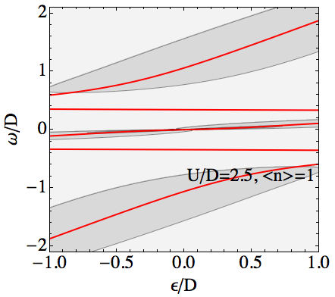
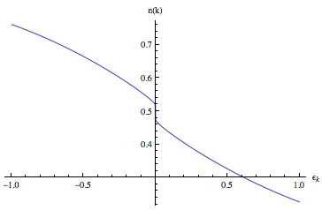

Slide 27
Ordered phases
Ferromagnetism: break spin symmetry (i.e., add spin index σ, use QSZ symmetry type)
Superconductivity: introduce Nambu structure, compute both standard G and anomalous G (use SPSU2 symmetry type)
Antiferromagnetism: introduce AB sublattice structure, do double impurity calculation (one for A type, one for B type)

Slide 28
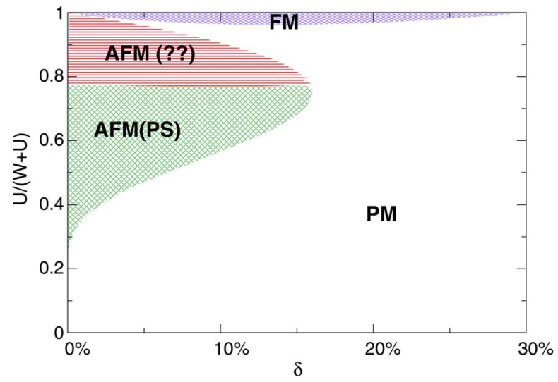
Hubbard model: phase diagram
Zitzler et al.

Slide 29
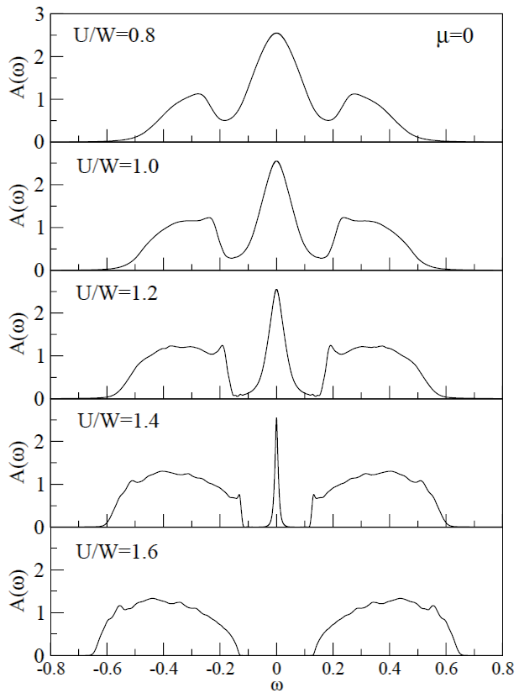
High-resolution spectral functions?
Hubbard model on the Bethe lattice,
PM phase
inner band-edge features
See also DMRG study,
Karski, Raas, Uhrig,
PRB 72, 113110 (2005).

Slide 30
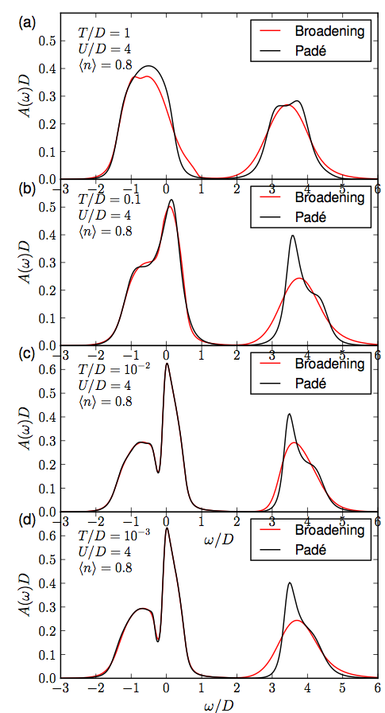
Z. Osolin, RZ, 2013

Slide 31
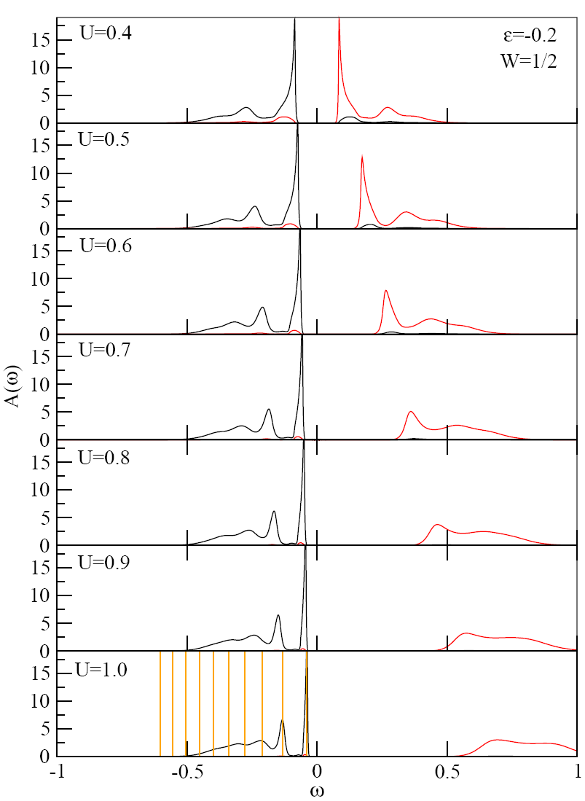
Hubbard model on the Bethe lattice,
AFM phase
spin-polaron structure
(“string-states”)

Slide 32
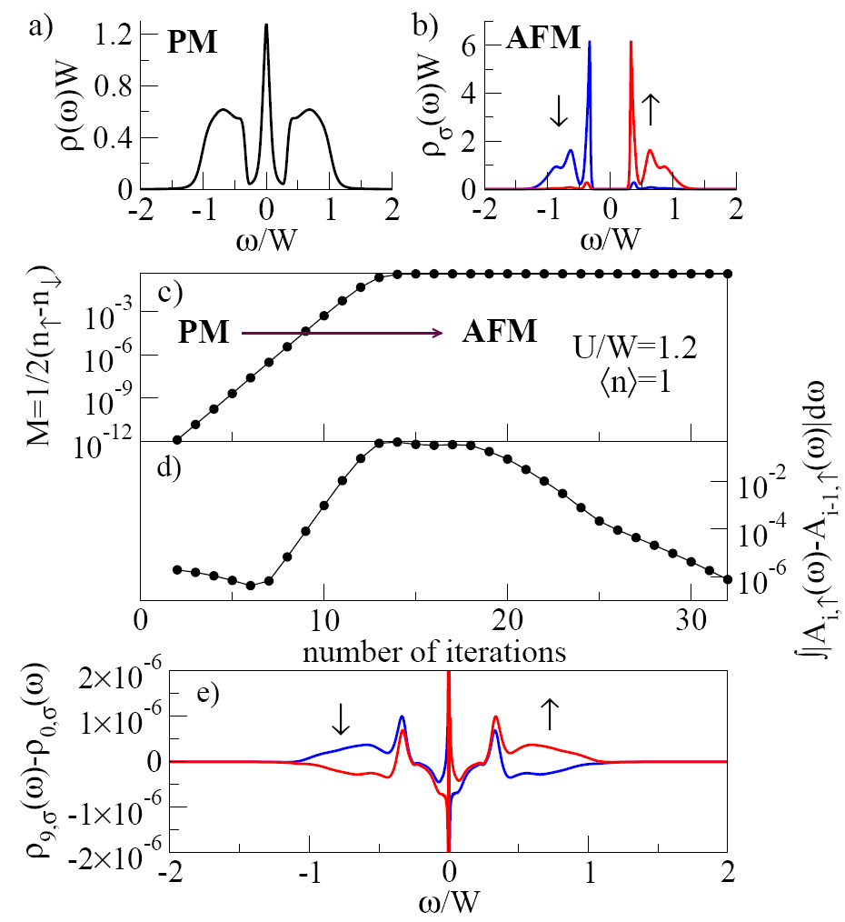

Slide 33
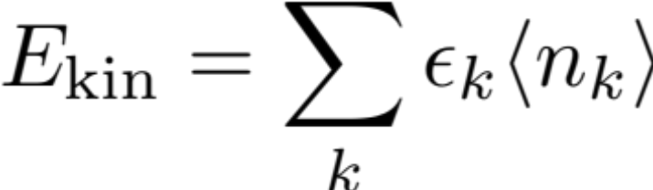
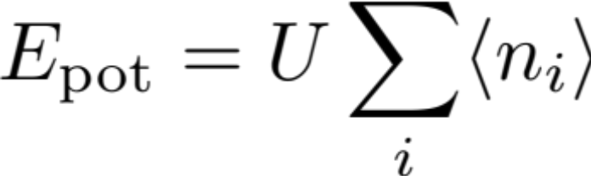

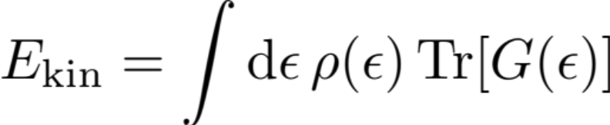
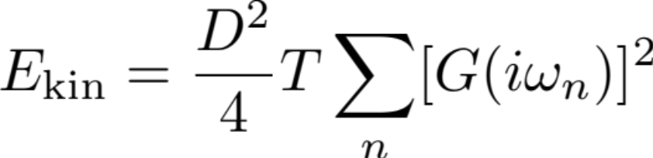
Thermodynamics
Note:
Bethe lattice:

Slide 34
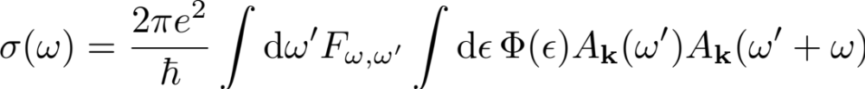
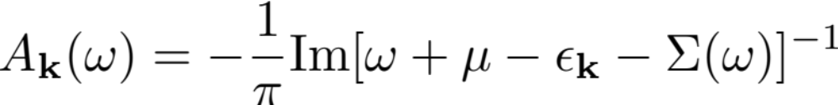
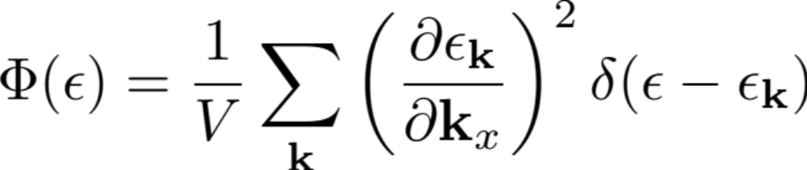
Transport in DMFT
Vertex corrections drop out, because Σ is local, and v_{k} and ε_{k} have different parity.

Slide 35
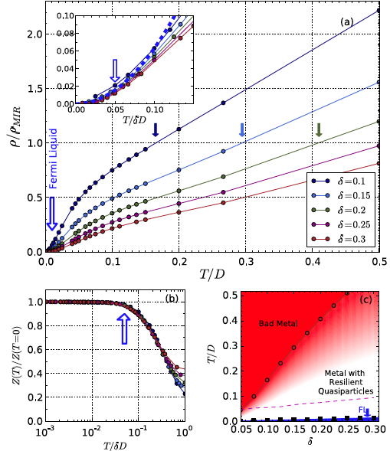

X. Deng, J. Mravlje, R. Zitko,
M. Ferrero, G. Kotliar,
A. Georges, PRL 2013.

Slide 36
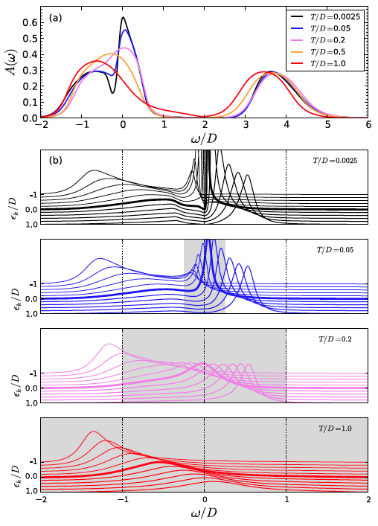

Slide 37
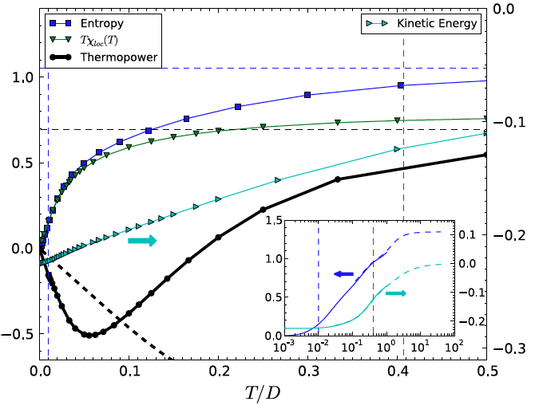
qmc
nrg

Slide 38
Other applications
Hubbard (SC, CO)
two-orbital Hubbard model
Hubbard-Holstein model (near half-filling)
Kondo lattice model (PM, FM, AFM, SC phases)
Periodic Anderson model (PAM), correlated PAM

