Slide 1
Tutorial 4: Kondo peak splitting in magnetic field, transport integrals, conductance and thermopower
Rok Žitko
Institute Jožef Stefan
Ljubljana, Slovenia

Slide 2
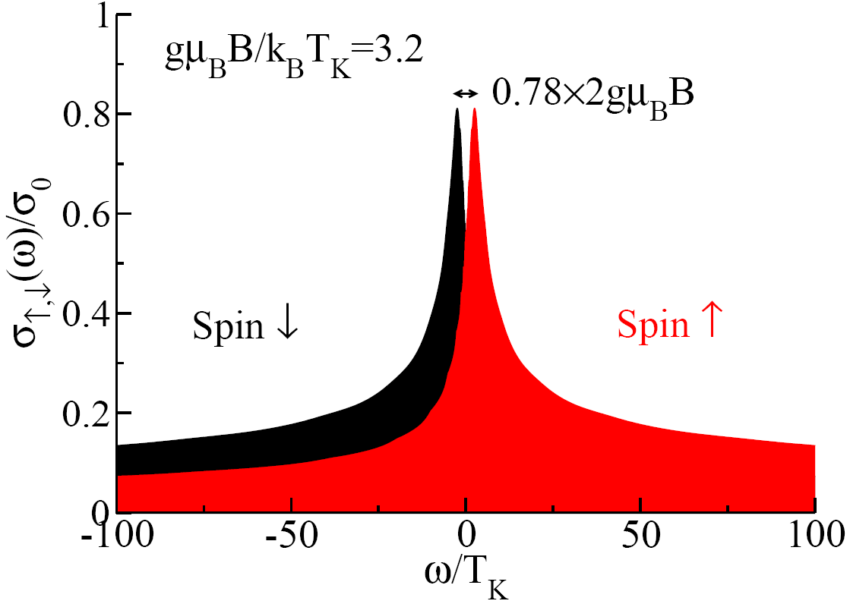
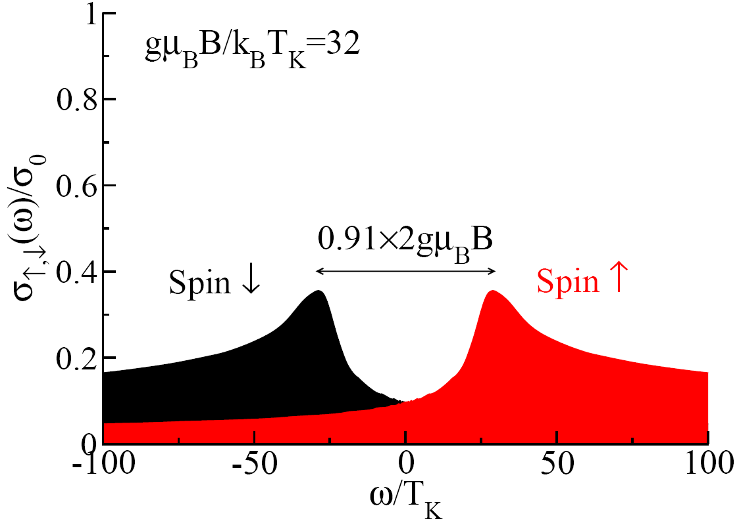
Kondo resonance splitting
Notes:
Šele nedavno je bila metoda izboljšana do te mere, da je možno natancno računati spektre pri visjih energijah.
Asimetrija ne pride do izraza pri meritvah, delno se izgubi, ko seštejemo obe komponenti, verjetno pa tudi zaradi dodatne termične razširitve vrhov.
“the question of the prefactor is interesting, but it’s important to point out that in the range of experimentally relevant
Magnetic fields it does not change much”

Slide 3
#!/usr/bin/env looper
#AUTOLOOP: nrginit ; nrgrun
#OVERWRITE
[extra]
B=1e-4
[param]
symtype=QSZ
discretization=Z
@$z = 1/4; $z <= 1; $z += 1/4
z=$z
Lambda=3
Tmin=1e-10
keepenergy=10
keep=10000
model=SIAM
variant=MAGFIELD
U=0.01
Gamma=0.001
delta=0
ops=A_d SZd
specd=A_d-A_d-u A_d-A_d-d
broaden_max=0.1
broaden_min=1e-8
broaden_ratio=1.02
fdm=true
T=1e-10
smooth=new
alpha=0.5
omega0=1e-99
06_splitting/1_zloop

Slide 4
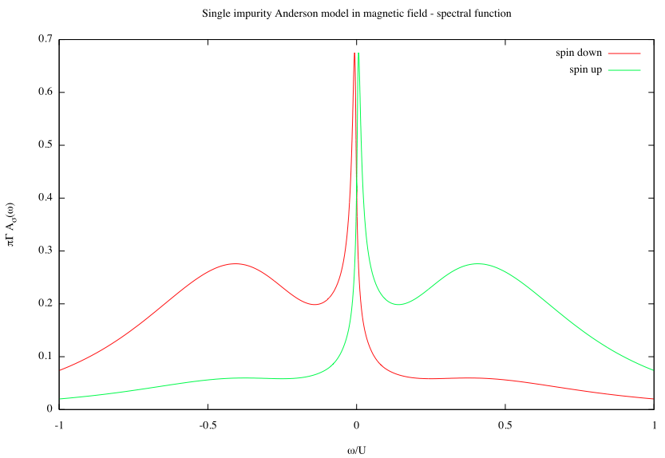
2a_plot

Slide 5
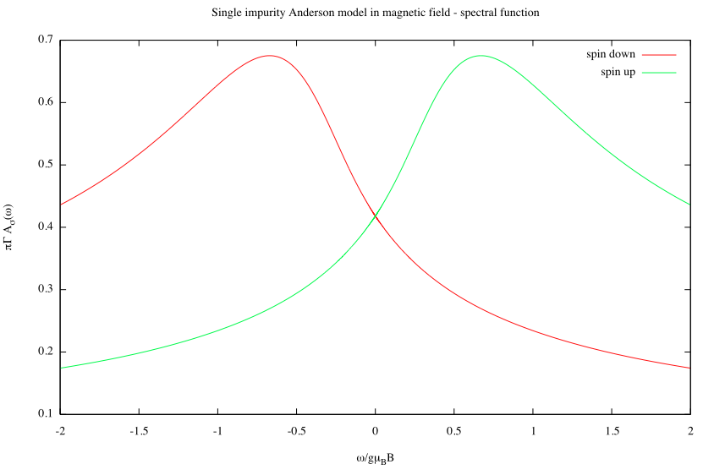
2a_plot_zoom_B

Slide 6
FT vs. DMNRG vs. CFS vs. FDM
FT = traditional approach, no density matrix
DMNRG = density matrix evaluated at the last NRG iteration, necessary for cases where the low-energy fixed point affects the high-energy part of the spectral function; recommended in the presence of magnetic field or other marginal and relevant perturbations.
CFS = complete Fock space, similar to DMNRG, but fulfills the normalization sum rule by construction, no overcounting; recommended at higher values of Λ.
FDM = full density matrix, ρ is constructed on all energy shells; recommended for finite-temperature calculations.

Slide 7
#!/usr/bin/env looper
#AUTOLOOP: nrginit ; nrgrun
#OVERWRITE
[extra]
B=3e-4
[param]
symtype=QSZ
discretization=Z
@$z = 1/4; $z <= 1; $z += 1/4
z=$z
Lambda=2
Tmin=1e-10
keepenergy=10
keep=10000
model=SIAM
variant=MAGFIELD
U=0.01
Gamma=0.001
delta=0
ops=A_d SZd
specd=A_d-A_d-u A_d-A_d-d
broaden_max=0.1
broaden_min=1e-8
broaden_ratio=1.02
finite=true
dmnrg=true
cfs=true
fdm=true
T=1e-10
goodE=2.1
smooth=new
alpha=0.5
omega0=1e-99
06_splitting_methods

Slide 8
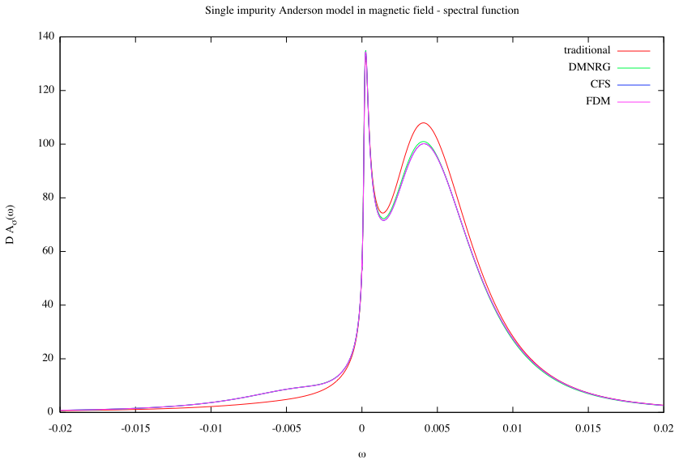
3_plot

Slide 9
bash-3.2$ ./4_sum_rule
Sz (custom) = -0.3646425
Sz (FT) = -0.402076352947836 diff=10.265905084524%
Sz (DMNRG) = -0.364642938937181 diff=0.000120374663126479%
Sz (CFS) = -0.364479526193025 diff=-0.0446941338365653%

Slide 10
Transport integrals for SIAM
07_cond/1_zloop
#!/usr/bin/env looper
# Conductance calculation for SIAM
#AUTOLOOP: nrginit ; nrgrun
#OVERWRITE
[param]
symtype=QS
discretization=Z
@$z = 1/8; $z <= 1; $z += 1/8
z=$z
Lambda=2
Tmin=1e-10
keepenergy=10
keep=10000
model=SIAM
U=0.01
Gamma=0.001
delta=0
ops=A_d
specgt=A_d-A_d
speci1t=A_d-A_d
speci2t=A_d-A_d
gtp=0.7

Slide 11
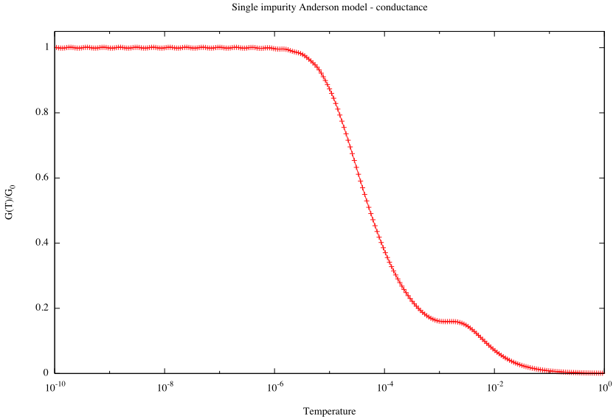
3a_plot

Slide 12
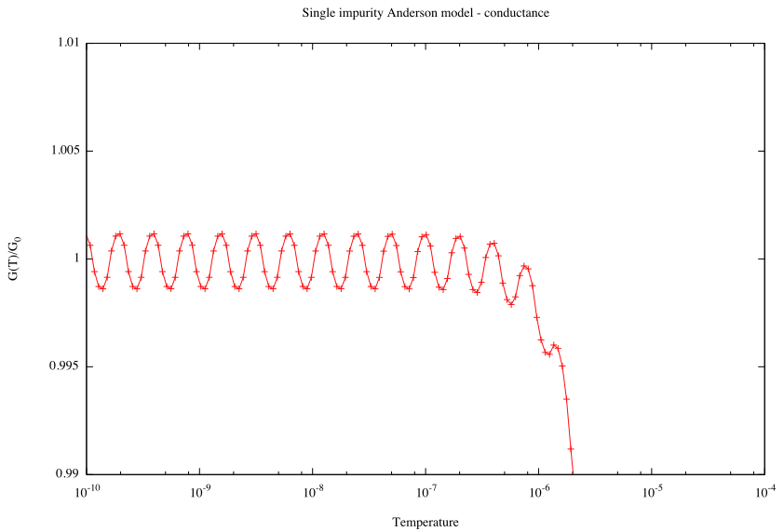

Slide 13
Conductance for the Kondo model
08_cond_kondo/1_zloop
model=../kondo.m
ops=hyb_f SfSk
specd=hyb_f-hyb_f
specgt=hyb_f-hyb_f
speci1t=hyb_f-hyb_f
speci2t=hyb_f-hyb_f
broaden_max=0.1
broaden_min=1e-8
broaden_ratio=1.02
fdm=true
T=1e-15
smooth=new
alpha=0.3
omega0=1e-99
#!/usr/bin/env looper
#AUTOLOOP: nrginit ; nrgrun
#OVERWRITE
[extra]
spin=1/2
Jkondo=0.2
[param]
symtype=QS
discretization=Z
@$z = 1/4; $z <= 1; $z += 1/4
z=$z
Lambda=2
Tmin=1e-10
keepenergy=10
keep=10000

Slide 14
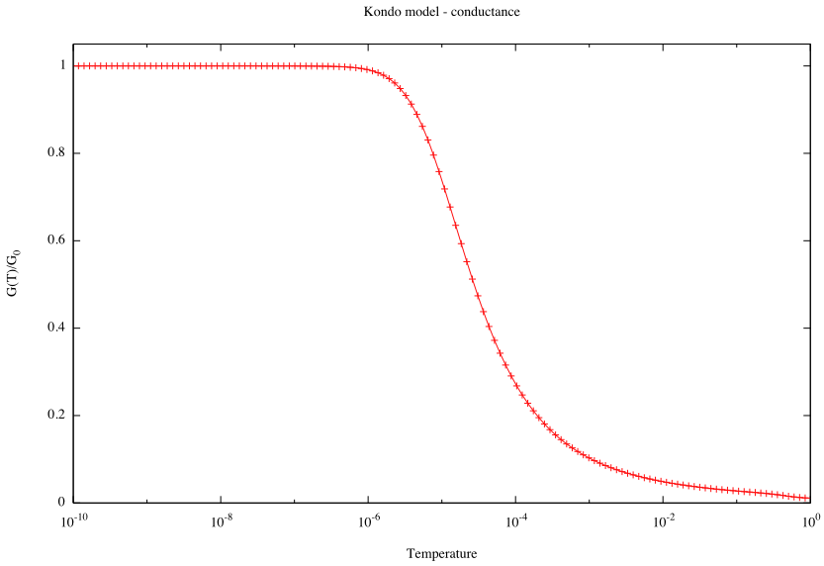

Slide 15
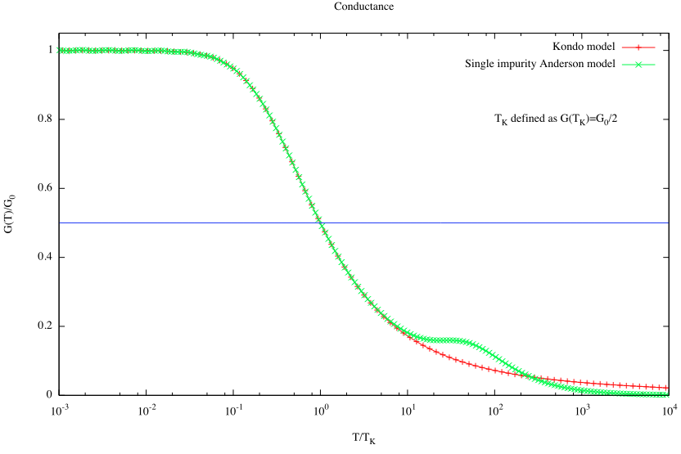

Slide 16
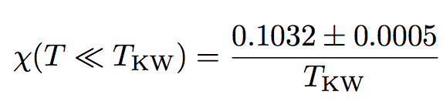

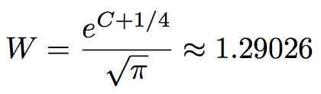
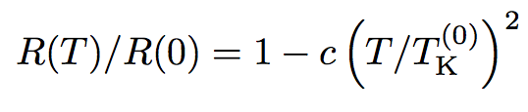
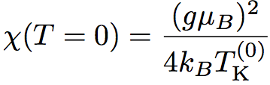

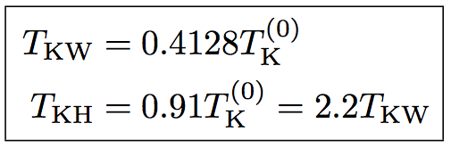
Different definitions of T_{K}
Wilson's definition
"Fermi-liquid definition"
Hamann definition

Slide 17
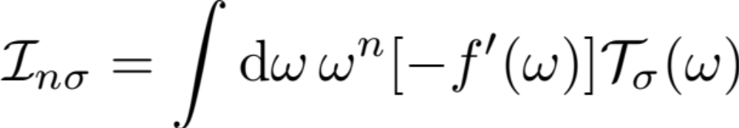
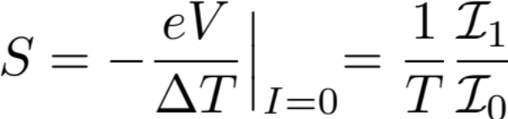
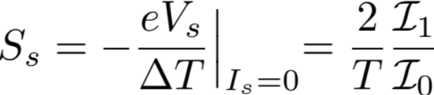
(Charge and spin) thermopower
B=0
δ=0 (particle-hole symmetric point)
(charge) Seebeck coefficient
spin Seebeck coefficient

Slide 18
Charge thermopower in SIAM
#!/usr/bin/env perl
use warnings;
$Nz = 4;
$file = "gt_GT_dens_A_d-A_d.dat";
system "intavg $file $Nz";
system "mv $file i0.dat";
$file = "i1t_I1T_dens_A_d-A_d.dat";
system "intavg $file $Nz";
system "mv $file i1.dat";
system "divy i1.dat i0.dat >tmp";
system "divybyx tmp >S_charge.dat";
unlink "tmp";
I1/I0
(I1/I0)/T

Slide 19
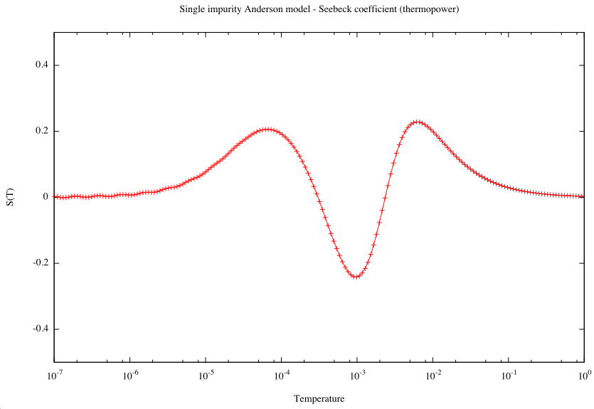
07_tp/3_plot
T_{K}

Slide 20
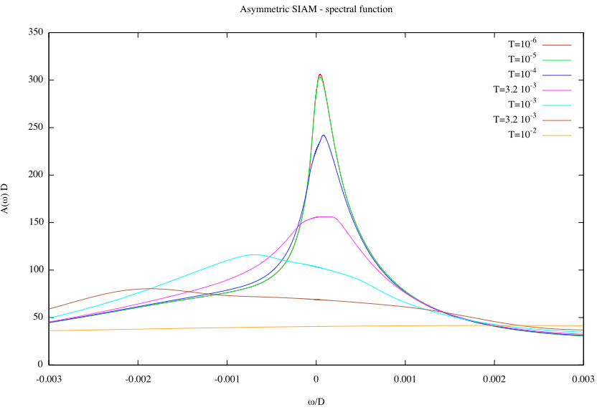
07_tp_spec

Slide 21
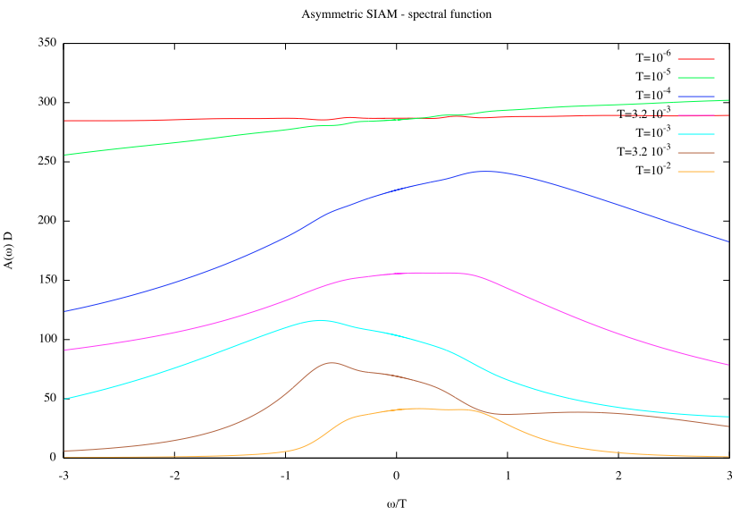
07_tp_spec

