Slide 1
Transport properties: conductance and thermopower
Rok Žitko
Institute Jožef Stefan
Ljubljana, Slovenia

Slide 2
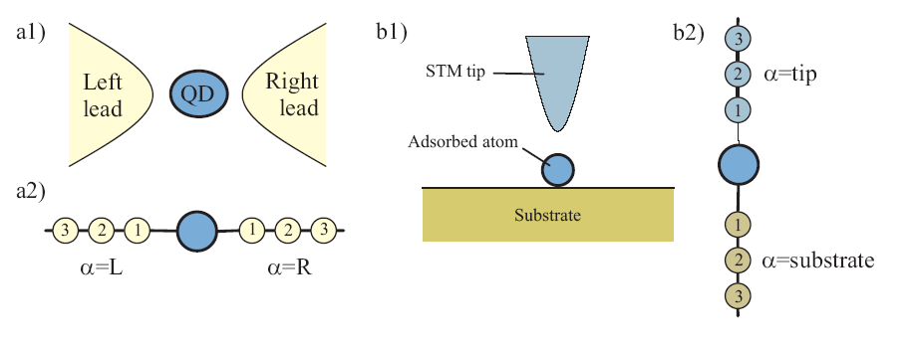
Transport in nanostructures

Slide 3
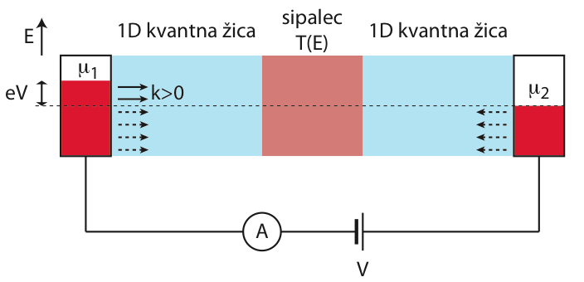
Landauer formalism

Slide 4

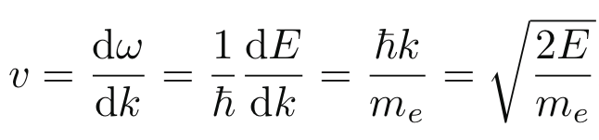

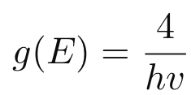

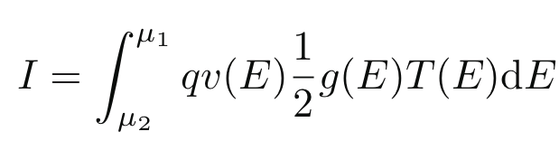
Density of states per unit length:
(Includes factor 2 for spin)

Slide 5


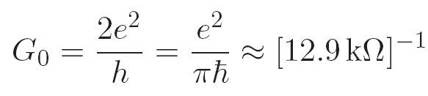



For T(E)=1 (ballistic conductor):
In general, at T=0:
Multi-channel leads:
resistance
quantized contact resistance

Slide 6
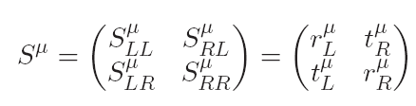

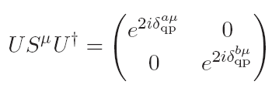



Scattering theory
quasiparticle phase shifts
Spin symmetry, single effective channel:

Slide 7

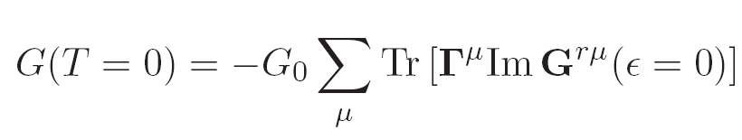

Keldysh approach
Relection symmetric problems:
One impurity:
Also known as the Meir-Wingreen formula

Slide 8
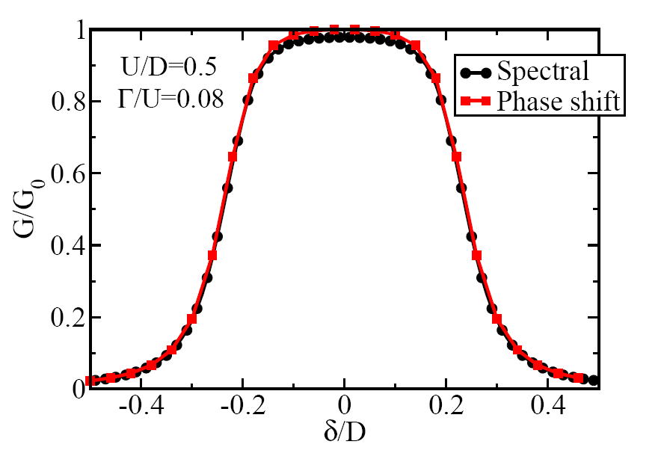
Conductance of quantum dot (SIAM)

Slide 9
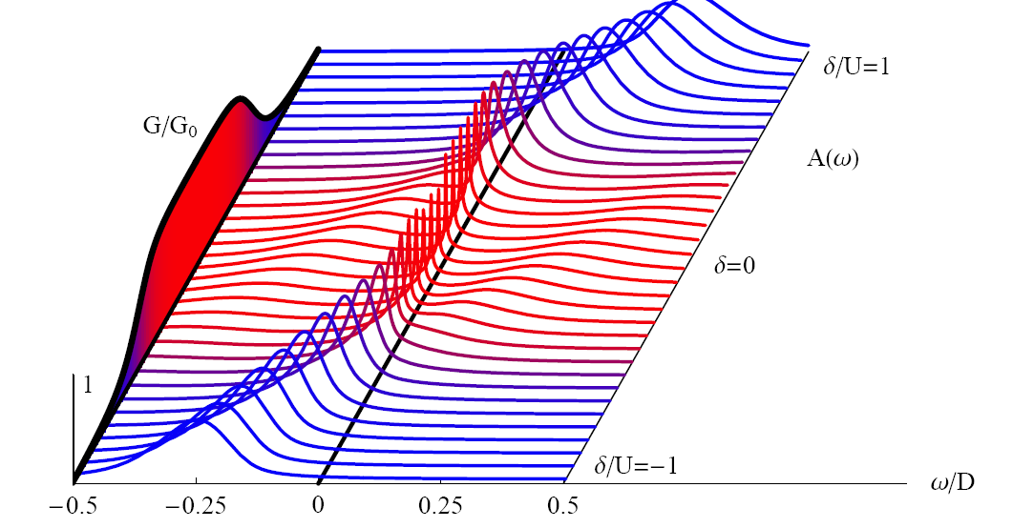

Slide 10
Finite temperatures

Slide 11
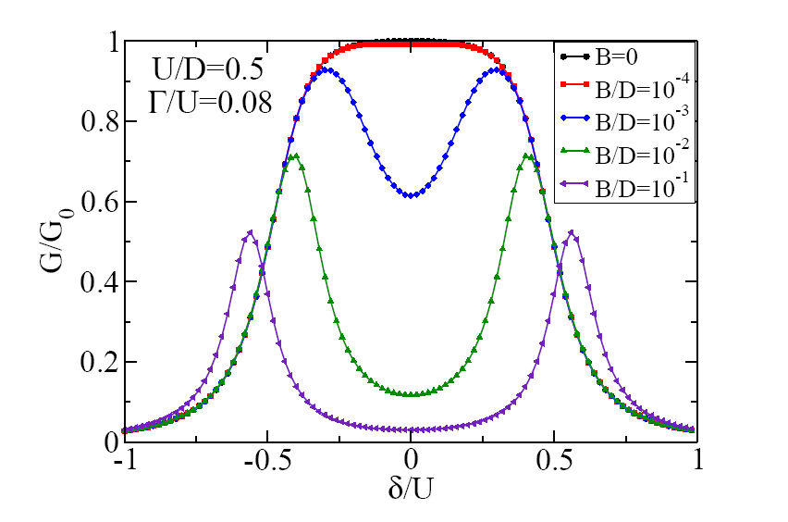
Effect of the magnetic field

Slide 12
Notes:
Before I continue, let me say a few words about the inelastic tunneling spectroscopy.
Two metals, establish voltage difference, current flows.
If everything is featureless, one finds perfectly linear dependence. The only information we obtain is the DOS (slope of the curve).

Slide 13
ħω
Inelastic scattering
ħω
ħω
Information about internal degrees of freedom!
Notes:
Adsorbat ima notranje prostostne stopnje: nihajne, spin.
Elasticno tuneliranje, dodatno neelasticno. Priblizno privzamemo, da se kanala med seboj ne motita, zato se celotna prepustnost poveca.
dI/dV je energijsko odvisna prepustnost, diferencialna prevodnost.

Slide 14

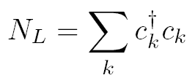

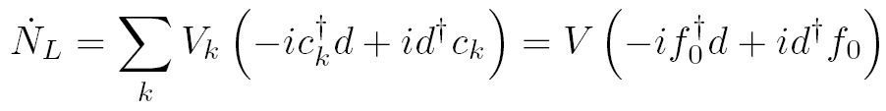

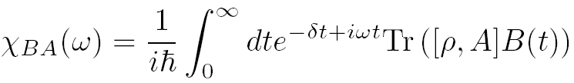
Linear response theory for calculating the conductance of nanostructures
Kubo (1957)

Slide 15


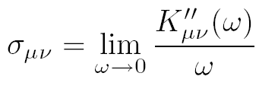
Standard approach:
Difficulty: the slope is difficult to calculate reliably!
Solution: we can work with the global operator N_{ν} itself!

Slide 16
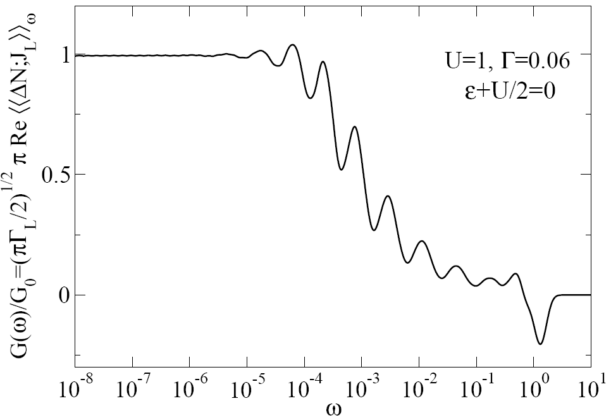
Test case: single-impurity Anderson model

Slide 17
Proposed application: conductance of a S-QD-N structure
Open problem:
the transition from G=4e²/h to G=2e²/h conductance as the gap closes
Anyone interested?

Slide 18
Transport integrals, thermopower

Slide 19
B=0
δ=0 (particle-hole symmetric point)
(charge) Seebeck coefficient
spin Seebeck coefficient

Slide 20
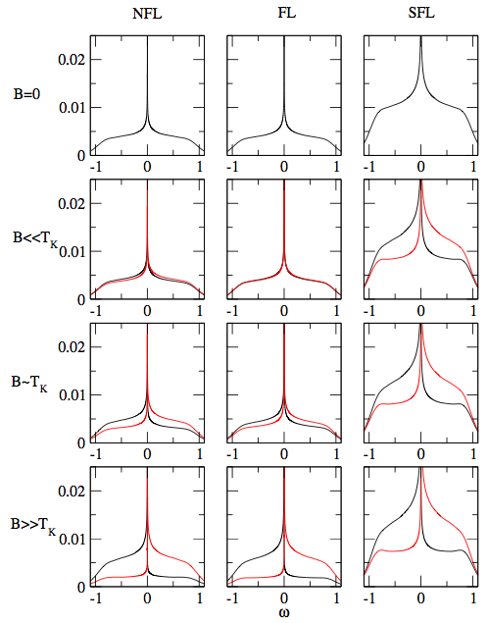

Slide 21
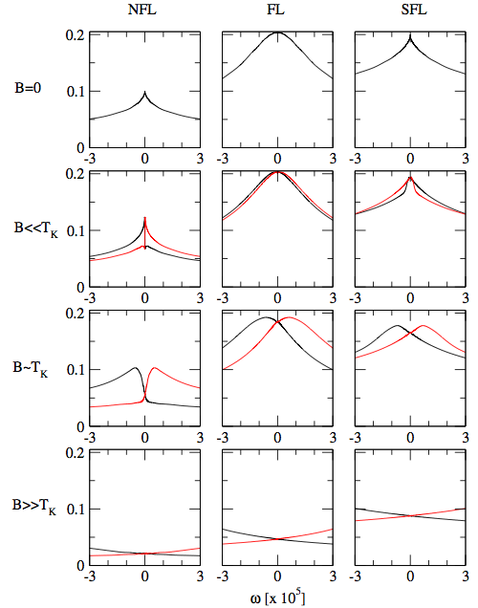

Slide 22
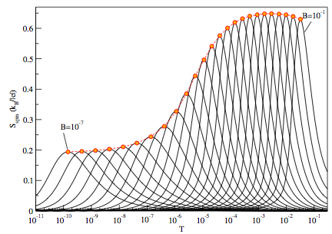
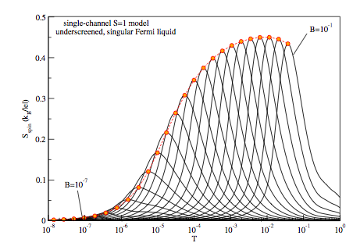
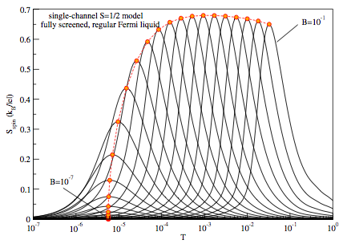
Žitko, Mravlje,
Ramšak, Rejec,
manuscript
in preparation.
Spin thermopower is a sensitive probe of the response of the system in magnetic field.

