Slide 1
Tutorial 3: spectral functions for SIAM, arbitrary DOS, finite-tempratures,
T-matrix for Kondo model
Rok Žitko
Institute Jožef Stefan
Ljubljana, Slovenia

Slide 2
Spectral funcion
05_spec
[param]
symtype=QS
discretization=C
Lambda=2
Tmin=1e-10
keepenergy=10
keep=5000
model=SIAM
U=0.01
Gamma=0.001
delta=0
ops=A_d
specd=A_d-A_d
broaden_max=0.1
broaden_min=1e-7
broaden_ratio=1.02
fdm=true
T=1e-10
smooth=new
alpha=0.6
omega0=1e-99
creation/annihilation operator
spectral function <<d;d†>>
grid for the broadened
(smooth) spectral function
full-density-matrix method
temperature for
the spectral-function calculation
broadening parameters

Slide 3

Output: spectral function = imaginary part of the Green's function
The corresponding real part can be computed using the Kramers-Kronig transformation
tool "kk", which comes bundled as part of the NRG Ljubljana package.

Slide 4
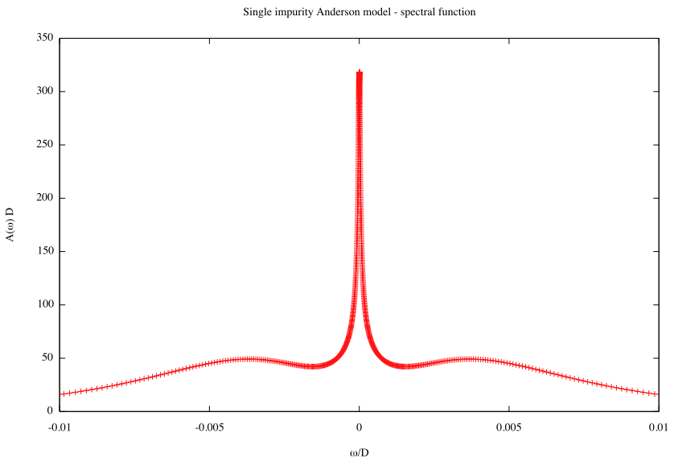
2a_plot

Slide 5
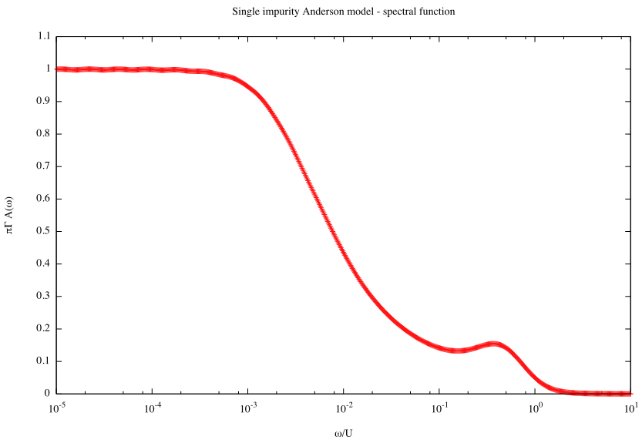
2a_plot_log

Slide 6
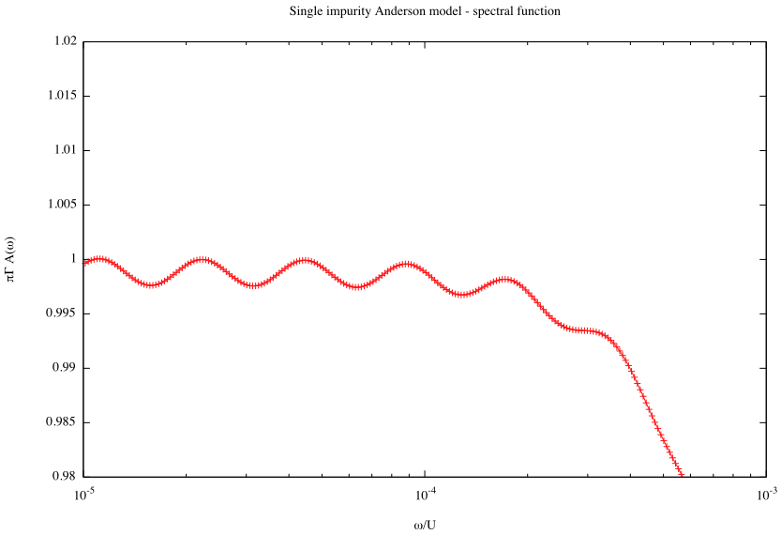
2a_plot_log_friedel

Slide 7
Removing oscillations using the z-averaging
#!/usr/bin/env looper
#AUTOLOOP: nrginit ; nrgrun
#OVERWRITE
[param]
symtype=QS
discretization=Z
@$z = 1/4; $z <= 1; $z += 1/4
z=$z
Lambda=2
Tmin=1e-10
keepenergy=10
keep=10000
model=SIAM
U=0.01
Gamma=0.001
delta=0
ops=A_d
specd=A_d-A_d
broaden_max=0.1
broaden_min=1e-8
broaden_ratio=1.02
fdm=true
T=1e-10
smooth=new
alpha=0.3
omega0=1e-99
May be reduced!
05_spec_z/1_zloop

Slide 8
05_spec_z/2_proc
#!/bin/sh
FN=spec_FDM_dens_A_d-A_d.dat
Nz=4
intavg ${FN} ${Nz}
Gamma=`getparam Gamma 1_zloop`
U=`getparam U 1_zloop`
scaley=`echo 3.14159*${Gamma} | bc`
scalex=`echo 1/${U} | bc`
scalexy ${scalex} ${scaley} ${FN} >A-rescaled.dat
intavg is a tool for z-averaging the spectral functions

Slide 9
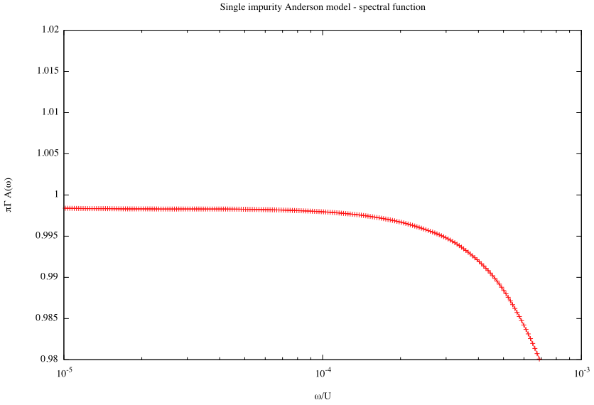

Slide 10
Exercises
1. Try increasing Λ. How do the results deteriorate?
2a1
2. Try changing the broadening α and the number of z points.
When do the oscillations appear?
3. How does the Kondo resonance evolve as U is decreased toward 0?

Slide 11



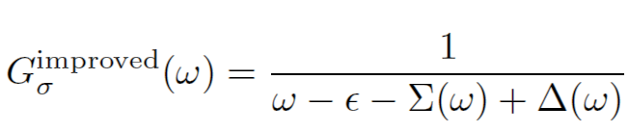
Self-energy (Σ) trick

Slide 12
12_self_energy_trick/1_zloop
#!/usr/bin/env looper
#PRELUDE: $Nz=8;
#AUTOLOOP: nrginit ; nrgrun
#OVERWRITE
[sweep]
Nz=8
[param]
symtype=QS
Lambda=2.0
Tmin=1e-8
keepmin=200
keepenergy=10.0
keep=10000
discretization=Z
@$z = 1/$Nz; $z <= 1.00001; $z += 1/$Nz
z=$z
model=../model.m
U=0.5
Gamma=0.03
delta=0.1
ops=A_d self_d
specd=A_d-A_d self_d-A_d
dmnrg=true
goodE=2.3
NN2avg=true
# Broadening is performed by an external tool
broaden_max=2
broaden_ratio=1.01
broaden_min=1e-6
bins=1000
broaden=false
savebins=true
T=1e-10

Slide 13
12_self_energy_trick/model.m
def1ch[1];
H = H0 + Hc + H1;
(* All operators which contain d[], except hybridization (Hc). *)
Hselfd = H1;
selfopd = ( Chop @ Expand @ komutator[Hselfd /. params, d[#1, #2]] )&;
(* Evaluate *)
Print["selfopd[CR,UP]=", selfopd[CR, UP]];
Print["selfopd[CR,DO]=", selfopd[CR, DO]];
Print["selfopd[AN,UP]=", selfopd[AN, UP]];
Print["selfopd[AN,DO]=", selfopd[AN, DO]];
H0 = Hamiltonian for the first site (index 0) of the Wilson chain
Hc = hybridization part of the Hamiltonian, hopping between the impurity and the first site of the Wilson chain
H1 = the impurity Hamiltonian

Slide 14
Postprocessing
z-averaging of both spectral functions,
A_{G} (A_d-A_d) and A_{F} (self_d-A_d)
compute the corresponding real parts to obtain the full Green's functions:
G=Re G-iπ A_{G}, similarly for F
compute the self-energy
calculate the improved spectral function
average
realparts
sigmatrick

Slide 15
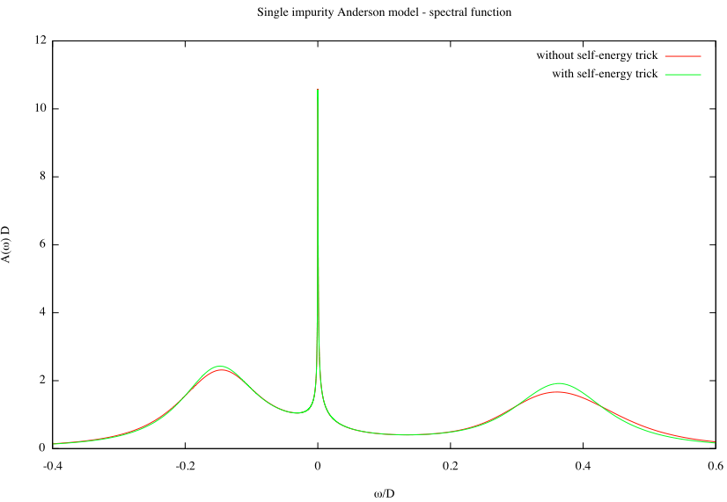
3a_plot

Slide 16
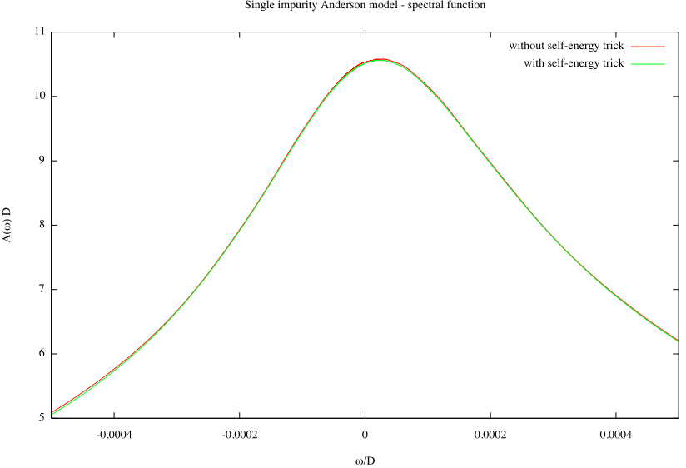
3b_plot_zoom

Slide 17
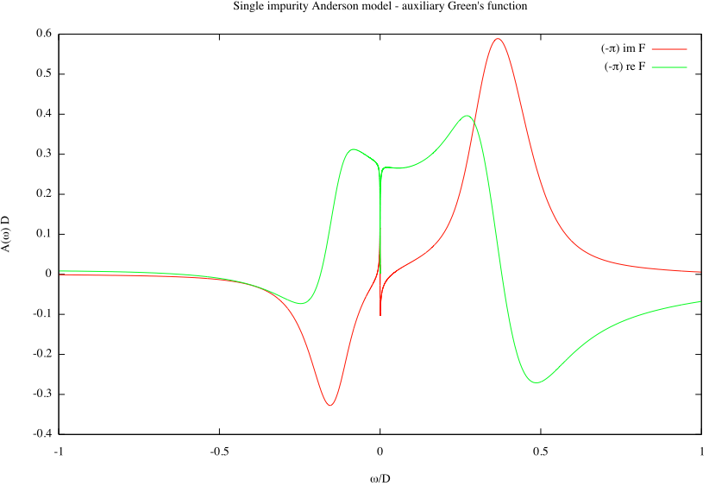
3c_plot_F

Slide 18
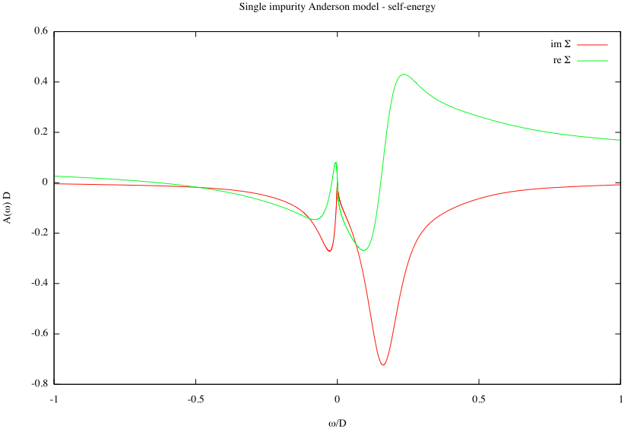
3d_plot_sigma

Slide 19
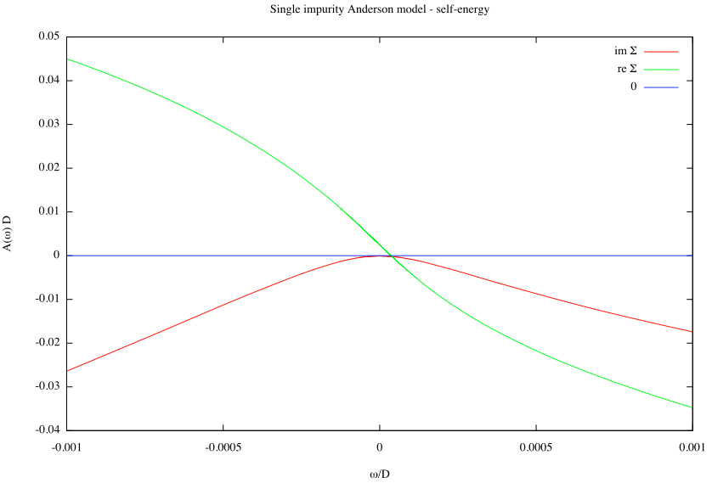
3e_plot_sigma_zoom
Re Σ - linear
Im Σ - quadratic

Slide 20
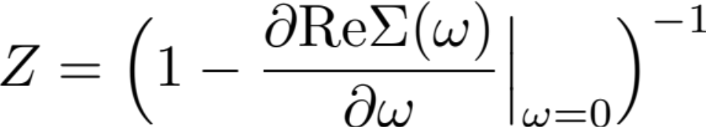
Exercises
1. Extract the quasiparticle renormalization factor Z, defined as
How does it vary with U? Is it related to T_{K}?
2. Is Im Σ really quadratic? Is its curvature related to Z?

Slide 21
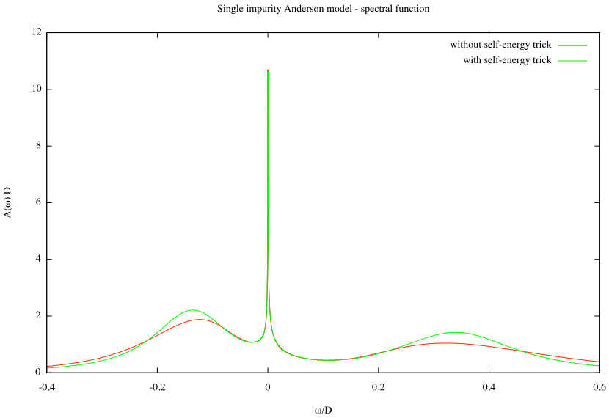
FDM, Λ=4, Nz=2, α=0.5

Slide 22
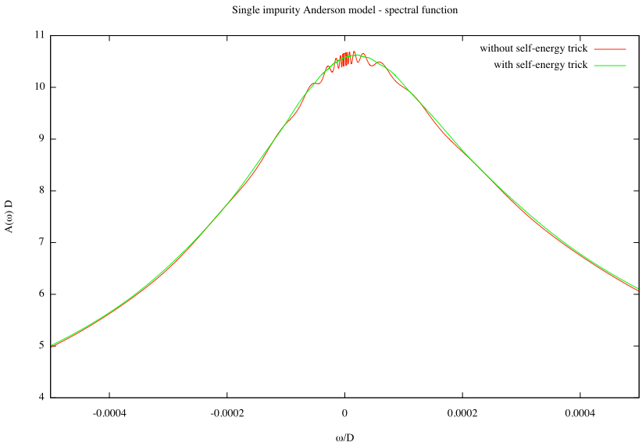

Slide 23
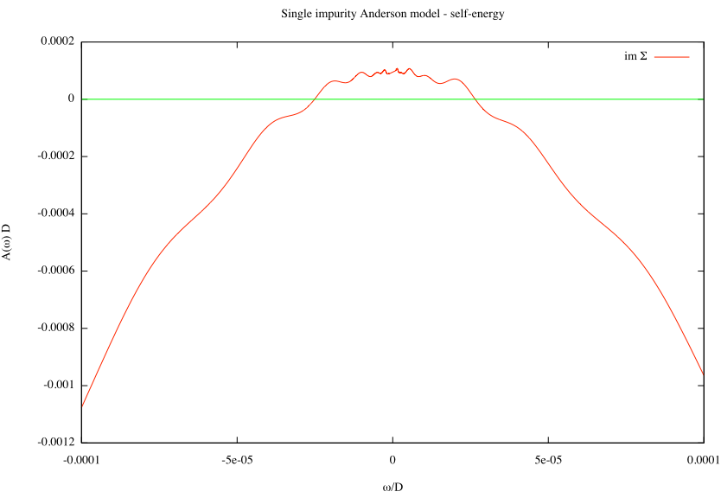

Slide 24
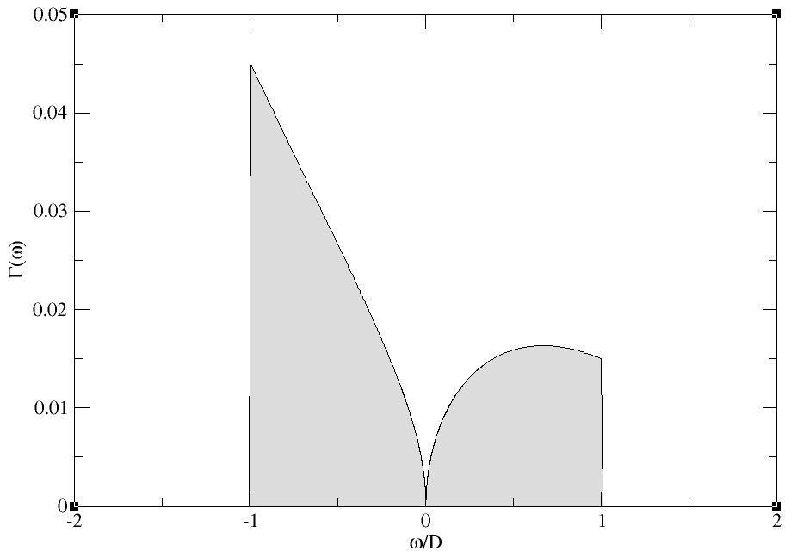
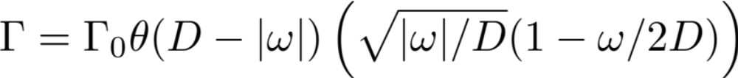
Arbitrary density of states
pseudogap
13_arbitrary_DOS
Notes:
http://iopscience.iop.org/0953-8984/9/47/014/pdf/0953-8984_9_47_014.pdf

Slide 25
02_zloop
[param]
symtype=QS
Lambda=2.0
Tmin=1e-8
keepmin=200
keepenergy=10.0
keep=10000
band=asymode
dos=../Delta.dat
discretization=Z
@$z = 1/$Nz; $z <= 1.00001; $z += 1/$Nz
z=$z
param
[param]
xmax=20
dos=Delta.dat
for "adapt" tool which solves the discretization ODE

Slide 26


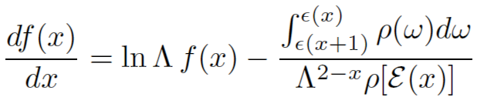
Diagonalization tool "adapt"
Input: Delta.dat
Output: FSOL.dat, FSOLNEG.dat
f(x) for positive and negative frequencies
Invocation:
adapt P
adapt N

Slide 27
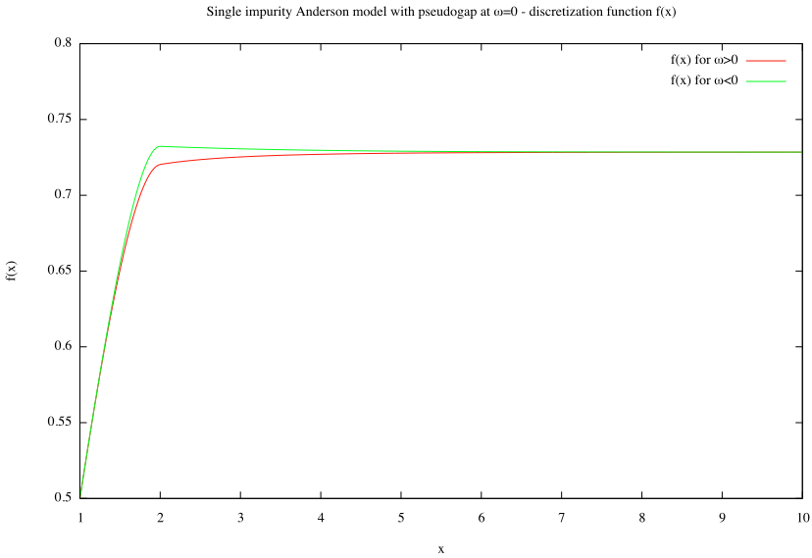
4c_plot_FSOL

Slide 28
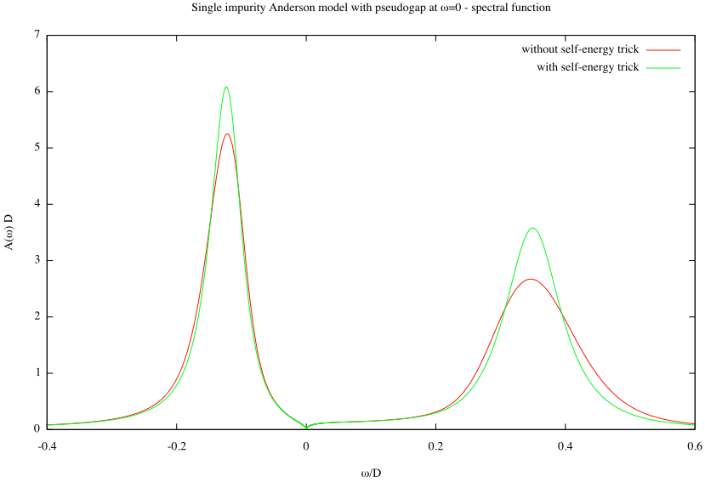
4a_plot

Slide 29
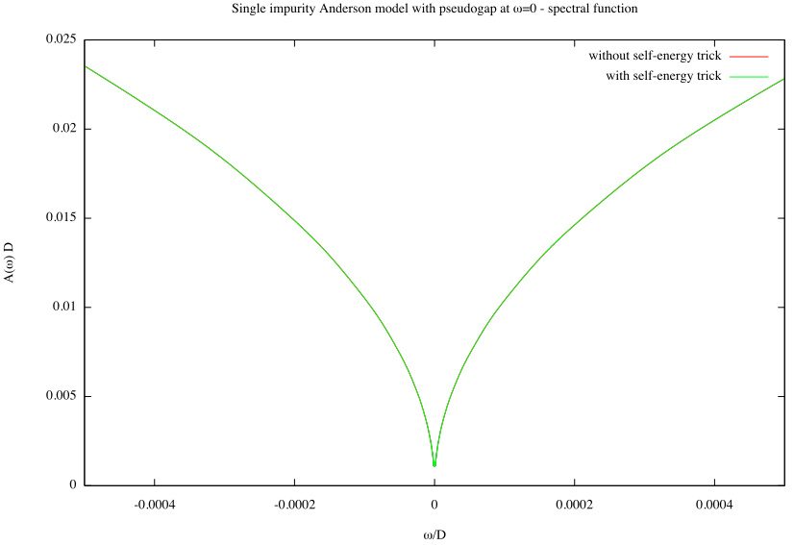
4b_plot_zoom

Slide 30
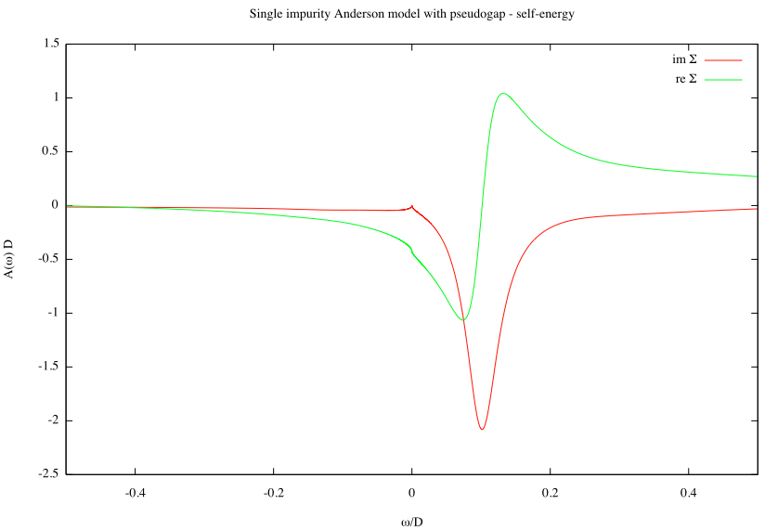
4e_plot_sigma

Slide 31
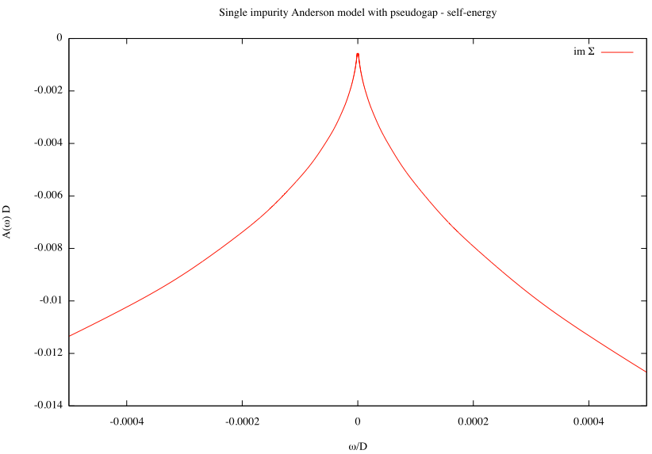
4f_plot_sigma_zoom

Slide 32
Exercises
Try some other densities of states in the band. How robust is the Kondo resonance?
When δ=0, show that the model is not particle-hole symmetric if the band isn't.
Can the code handle discontinuities in DOS? What about divergencies in DOS?

Slide 33
Finite-temperature spectral functions
05_spec_ft/1e-3
ops=A_d
specd=A_d-A_d
broaden_max=0.1
broaden_min=1e-7
broaden_ratio=1.02
fdm=true
T=1e-3
smooth=new
alpha=0.6
Full density matrix method (recommended for finite T)
Broadening kernel for finite T

Slide 34
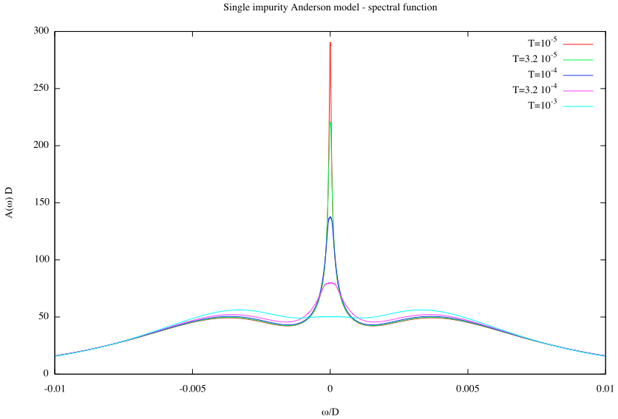
1a_plot

Slide 35
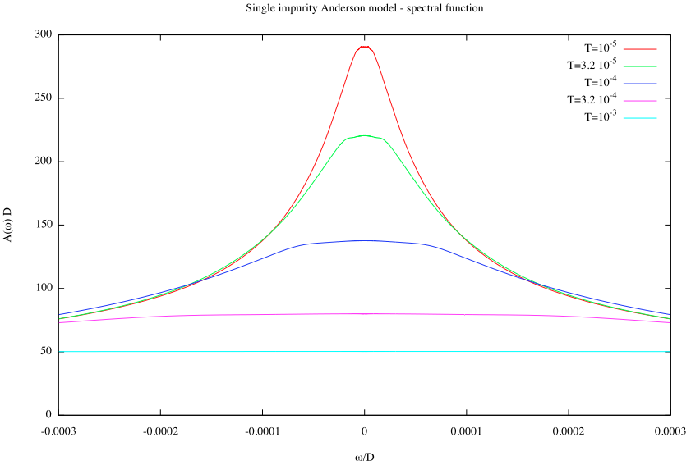
1b_plot_zoom

Slide 36
Exercises
Combine the code for the self-energy trick with that for finite-T calculations (using FDM NRG). How does Im Σ evolve with increasing temperature?

Slide 37

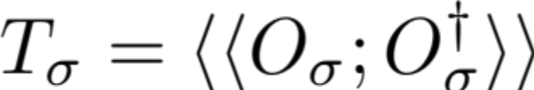
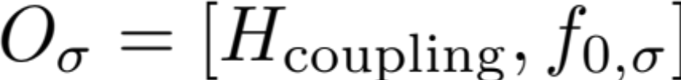
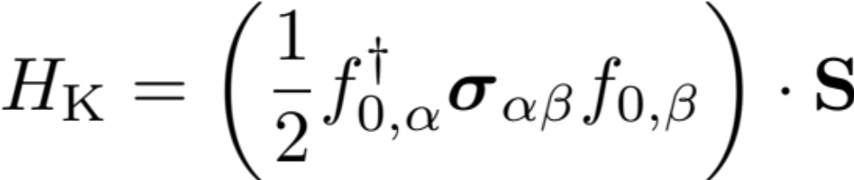
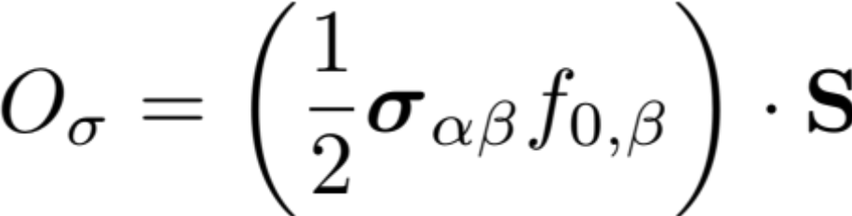
Kondo model

Slide 38
#!/usr/bin/env looper
#AUTOLOOP: nrginit ; nrgrun
#OVERWRITE
[extra]
spin=1/2
Jkondo=0.2
[param]
symtype=QS
discretization=Z
@$z = 1/4; $z <= 1; $z += 1/4
z=$z
Lambda=2
Tmin=1e-10
keepenergy=10
keep=10000
model=../kondo.m
ops=hyb_f SfSk
specd=hyb_f-hyb_f
broaden_max=0.1
broaden_min=1e-8
broaden_ratio=1.02
fdm=true
T=1e-11
smooth=new
alpha=0.3
omega0=1e-99
05_spec_kondo/1_zloop

Slide 39
def1ch[0];
SPIN = ToExpression @ param["spin", "extra"];
Module[{sx, sy, sz, ox, oy, oz, ss},
sx = spinketbraX[SPIN];
sy = spinketbraY[SPIN];
sz = spinketbraZ[SPIN];
ox = nc[ sx, spinx[ f[0] ] ];
oy = nc[ sy, spiny[ f[0] ] ];
oz = nc[ sz, spinz[ f[0] ] ];
ss = Expand[ox + oy + oz];
Hk = Jkondo ss;
];
H = H0 + Hk;
Hhyb = Hk;
MAKESPINKET = SPIN;
hybopf = ( Chop @ Expand @ komutator[Hhyb /. params, f[#1, 0, #2]] )&;
05_spec_kondo/model.m
NOTE: this is different from what we did in SIAM for the self-energy trick, where we computed the commutator with the interaction part of the Hamiltonian.

Slide 40
Module[{t={}},
If[calcopq["hyb_f"],
AppendTo[t, {"dhyb_f"}];
MPVCFAST = False;
t = Join[t, ireducTable[ hybopf ]];
MPVCFAST = True;
];
texportable = t;
];
texportable
05_spec_kondo/modeloperators.m

Slide 41
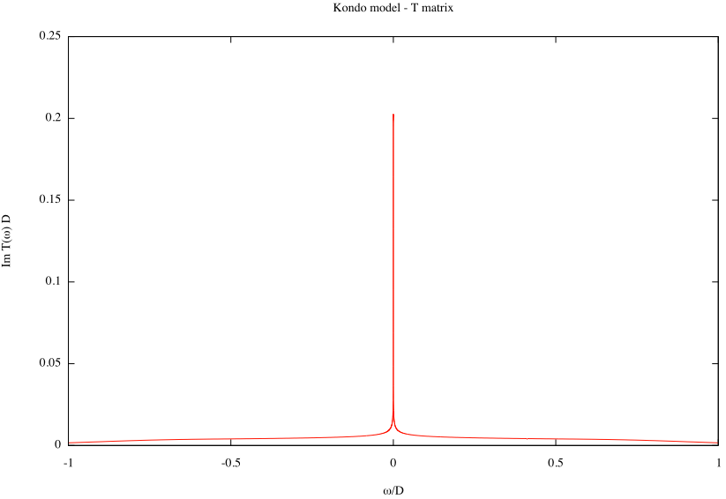
3a_plot

Slide 42
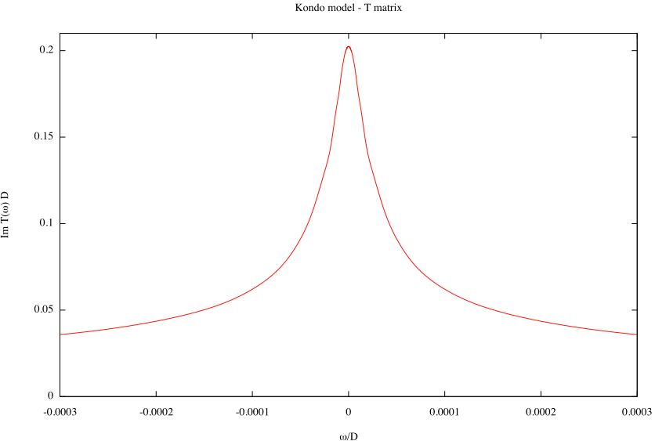
3b_plot_zoom

Slide 43
Exercises
How is the width (HWHM) of the Kondo resonance related to the Kondo temperature T_{K}?

