Slide 1
Spectral functions in NRG
Rok Žitko
Institute Jožef Stefan
Ljubljana, Slovenia

Slide 2
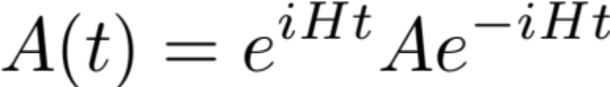
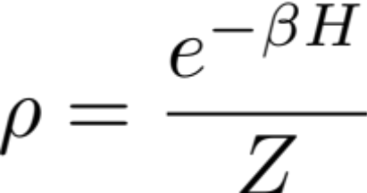
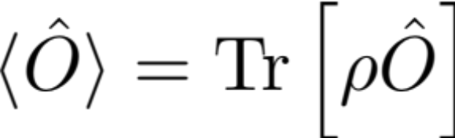
Green's functions - review
+ if A and B are fermionic operators
- if A and B are bosonic operators
Also known as the retarded Green's function.
NOTE: ħ=1
Following T. Pruschke: Vielteilchentheorie des Festkorpers

Slide 3
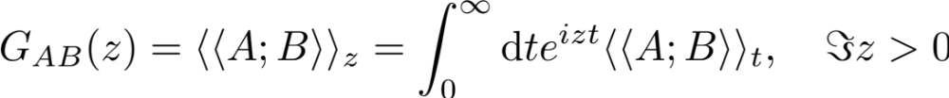
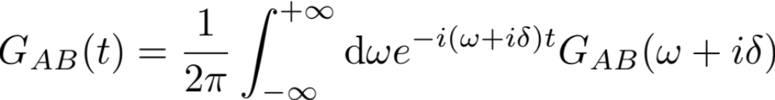
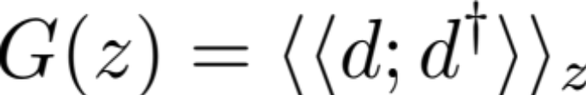
Laplace transformation:
Inverse Laplace transformation:
Impurity Green's function (for SIAM):

Slide 4
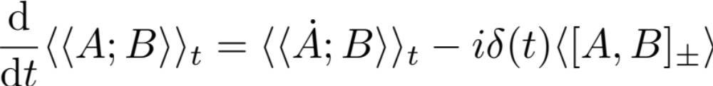
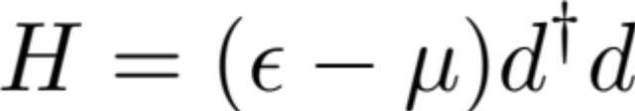
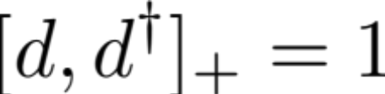
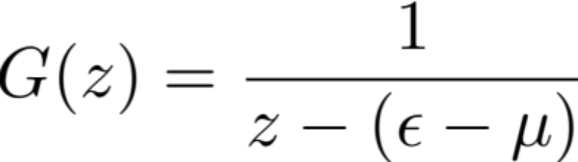
Equation of motion
Example 1:

Slide 5
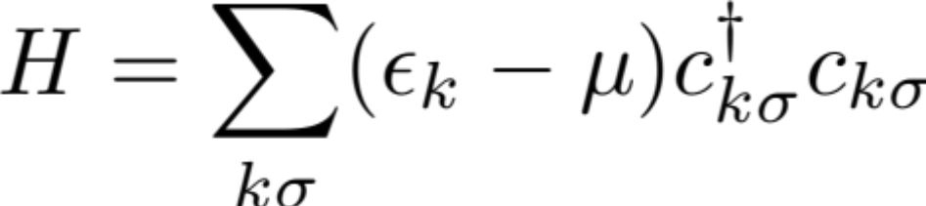

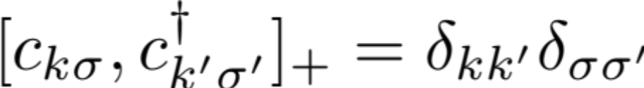
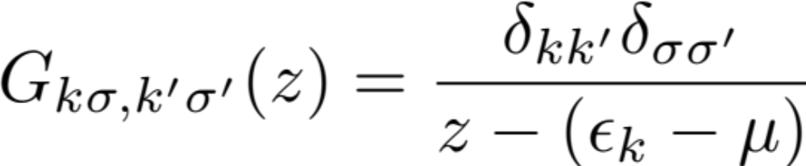
Example 2:

Slide 6
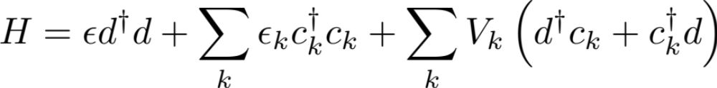
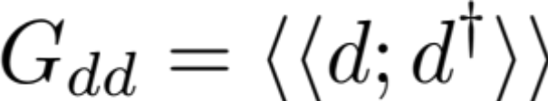

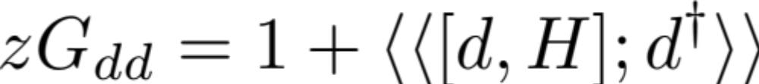
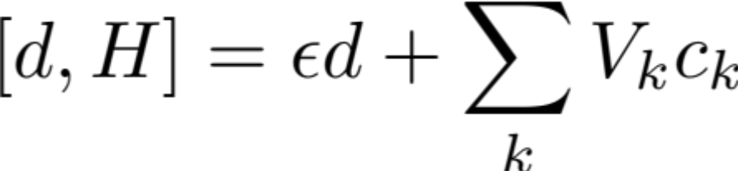

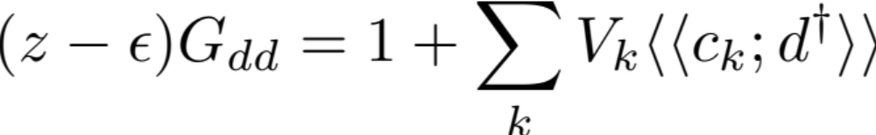
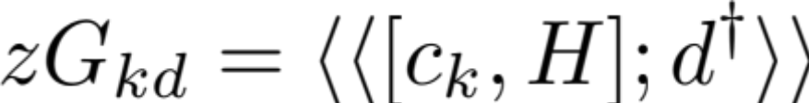
Example 3: resonant-level model
Here we have set μ=0. Actually, this convention is followed in the NRG, too.

Slide 7

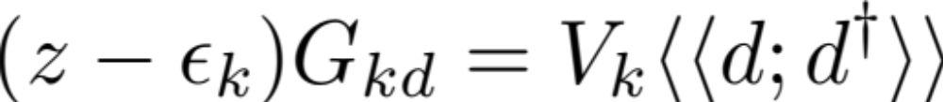
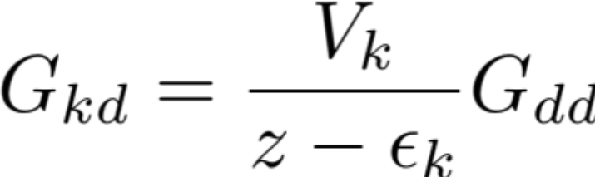
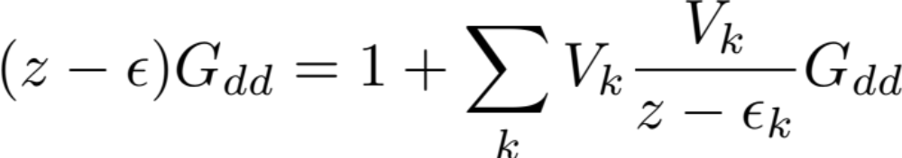
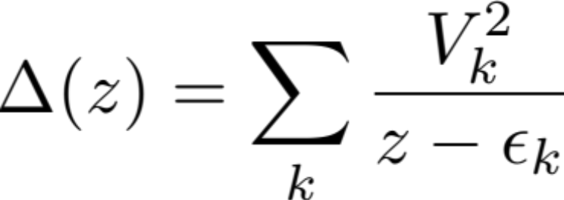
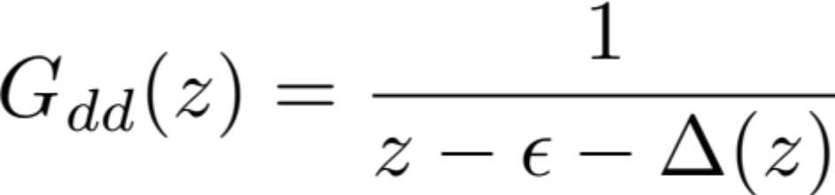
Hybridization function: fully describes the effect of
the conduction band on the impurity

Slide 8
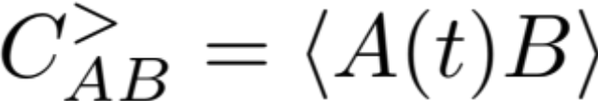
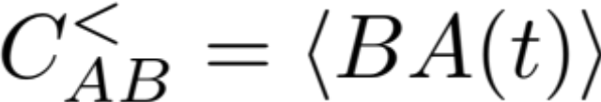
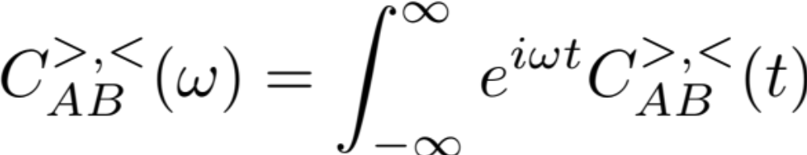
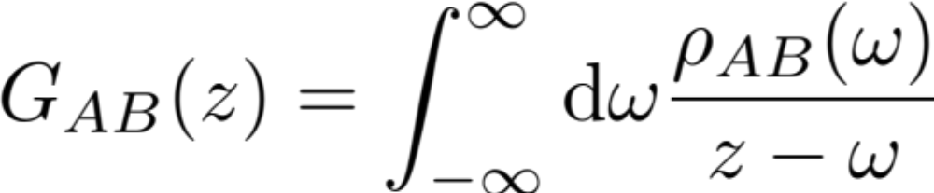
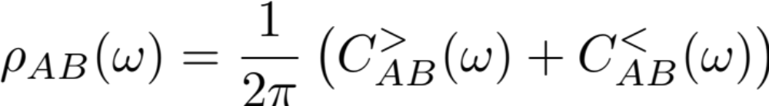
Spectral decomposition
ε=+1 if A and B are fermionic, otherwise ε=-1.
spectral representation
ε
spectral function

Slide 9
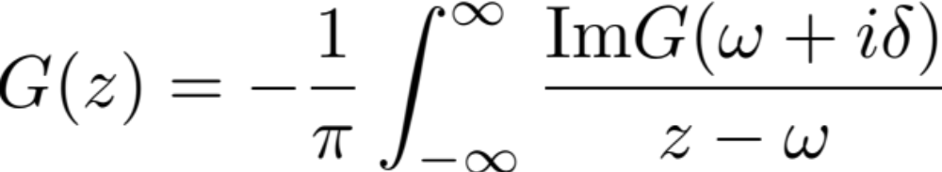

Slide 10
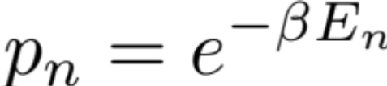
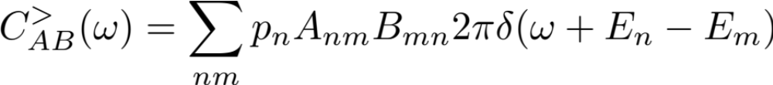

Lehmann representation

Slide 11
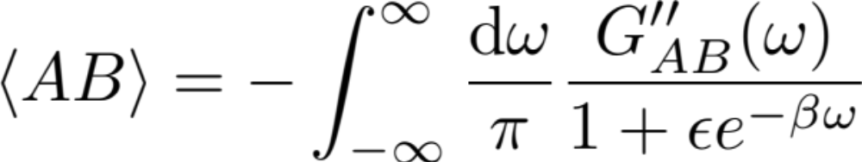
Fluctuation-dissipation theorem
Useful for testing the results of spectral-function calculations!
Caveat: G"(ω) may have a delta peak at ω=0, which NRG will not capture.

Slide 12
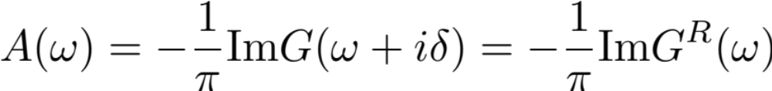
Dynamic quantities: Spectral density
Spectral density/function:
Describes single-particle excitations: at which energies it is possible to add an electron (ω>0) or a hole (ω<0).

Slide 13
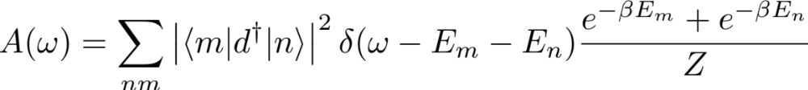
Traditional way: at NRG step N we take excitation energies in the interval [a ω_{N}: a Λ^{1/2} ω_{N}] or [a ω_{N}: a Λ ω_{N}], where a is a number of order 1. This defines the value of the spectral function in this same interval.

Slide 14
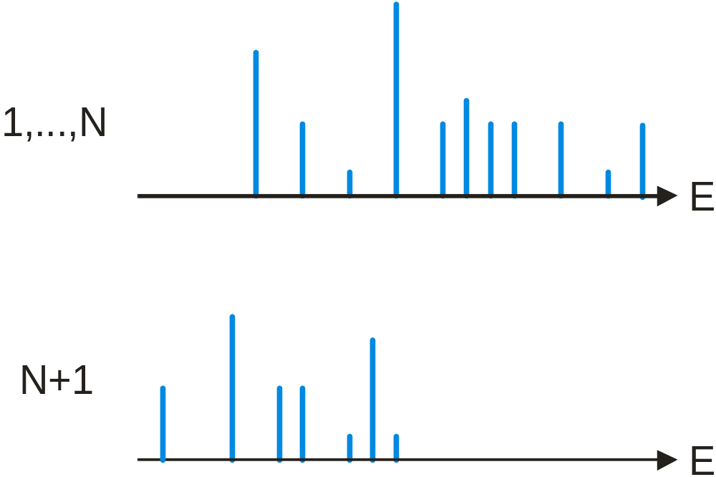
Patching

Slide 15
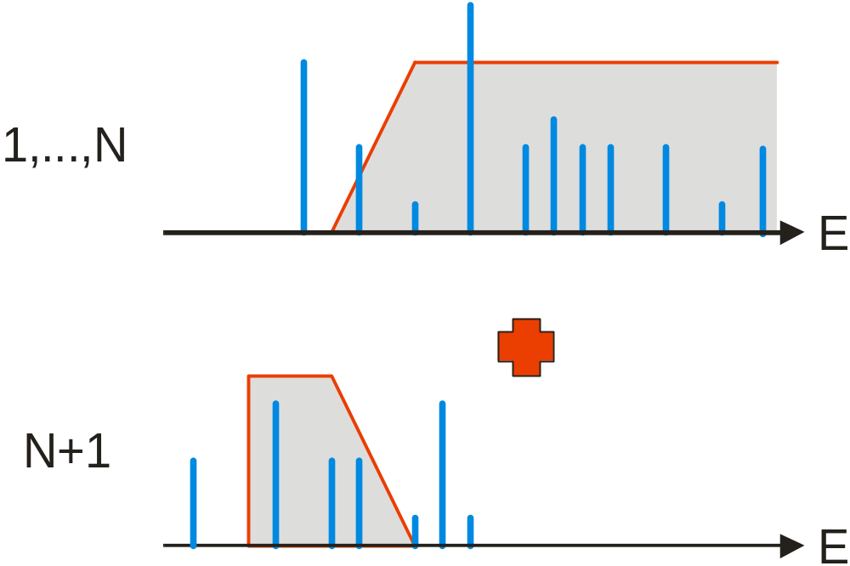
Patching
pΛ^{1/2}
p
pΛ
p: patching parameter (in units of energy scale at N+1-th iteration)

Slide 16


Broadening: traditional log-Gaussian
smooth=old

Slide 17




Broadening: modified log-Gaussian
smooth=wvd
for x<ω0, 1 otherwise.

Slide 18
Broadening:
modified log-Gaussian
smooth=new
Produces smoother spectral functions at finite temperatures (less artifacts at ω=T).

Slide 19
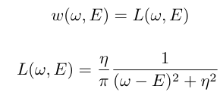
Other kernels
smooth=newsc
For problems with a superconducting gap (below Ω).
smooth=lorentz
If a kernel with constant width is required (rarely!).

Slide 20
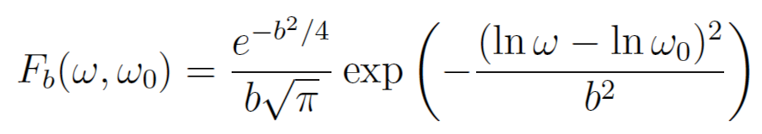
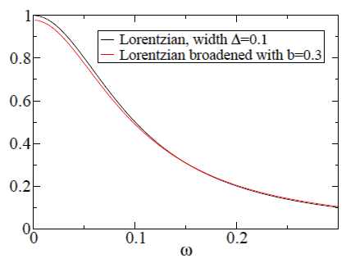
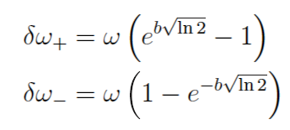
Log-Gaussian broadening
1) Features at ω=0
2) Features at ω≠0

Slide 21
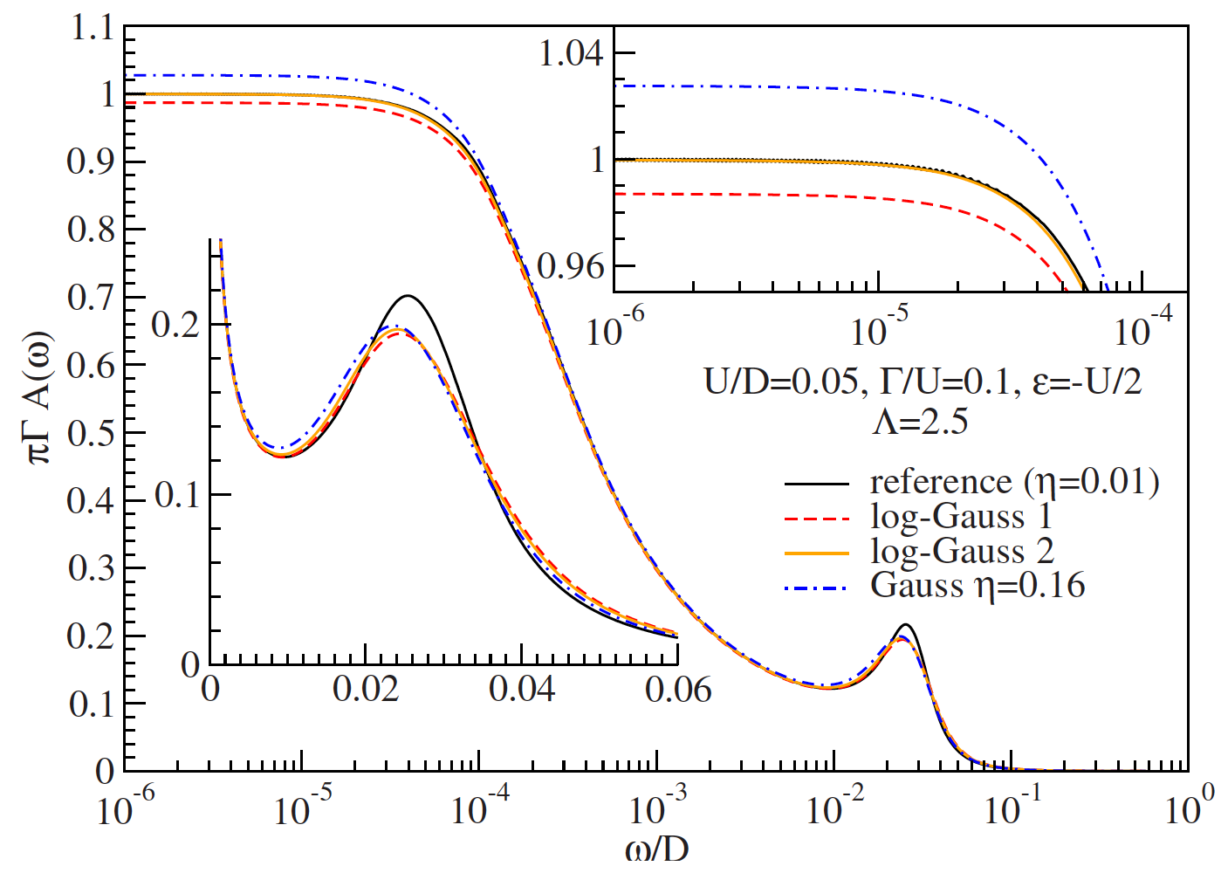

Slide 22
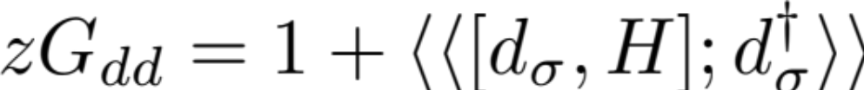
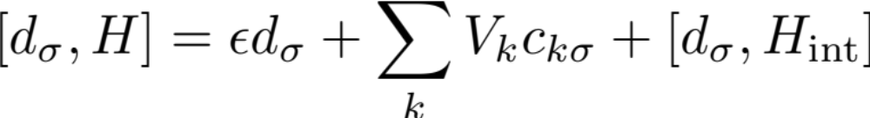
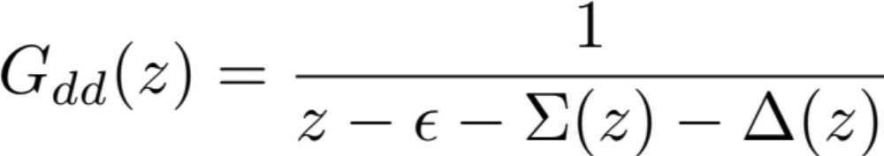
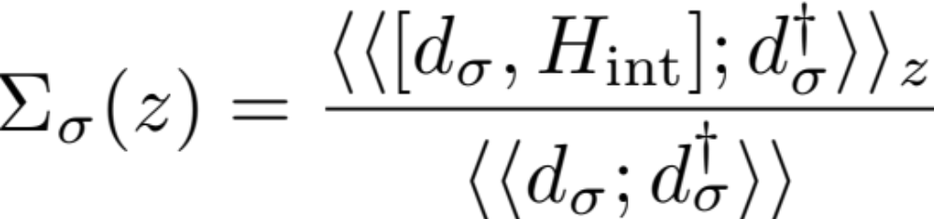
Equations of motion for SIAM:

Slide 23



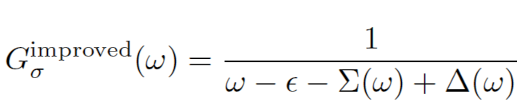
Self-energy trick

Slide 24
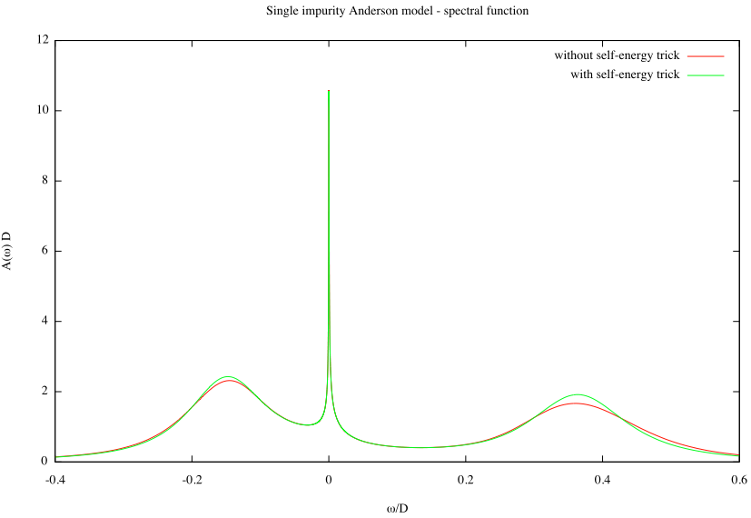

Slide 25

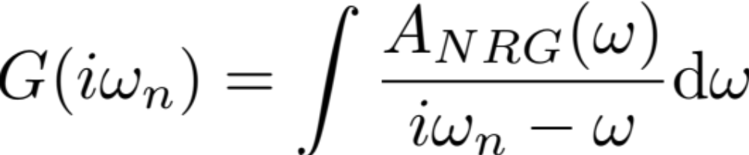
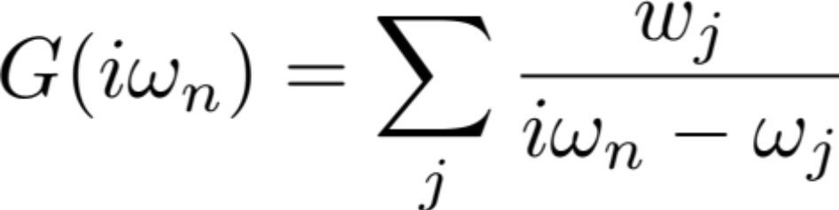
Non-orthodox approach: analytic continuation usng Padé approximants
We want to reconstruct G(z) on the real axis. We do that by fitting a rational function to G(z) on the imaginary axis (the Matsubara points). This works better than expected.
(This is an ill-posed numerical problem. Arbitrary-precision numerics is required.)
Ž. Osolin, R. Žitko, arXiv:1302.3334

Slide 26


Slide 27


Slide 28


Slide 29



Kramers-Kronig transformation

Slide 30



Notes:
Before NRG, there wasn’t really any unbiased method which could provide information about the line-shape.
Kondo peak and the high-energy (Hubbard) peak. The width of the peak is doubled, due to interactions. Thus even the high-energy part of the spectral
function is non-trivial.

Slide 31


Inverse-square-root asymptotic behavior
Notes:
But let us focus now on the low-energy part, i.e., the Kondo resonance.
At lowest frequencies it is quadratic, thus OK.
Actually, the agreement is not so good when better numerical results are used, thus this is a bit fortuitious!

Slide 32

Inverse square root behavior also found using the quantum Monte Carlo (QMC) approach:
Silver, Gubernatis, Sivia, Jarrell, Phys. Rev. Lett. 65 496 (1990)
Anderson orthogonality catastrophe physics
Doniach, Šunjić 1970 J. Phys. C: Solid State Phys. 3 285
Notes:
This picture was confirmed by later QMC calculations.
Origin: orthogonality catastrophe. Spin flips, thus the ground state of the remaining electrons needs to change. It is orthogonal to the original ground state. Such behavior leads to power-law divergences in spectral functions.

Slide 33


Notes:
Inv-sqr-root confirmed in later NRG works, also agrees with some analytical methods (local moment approach). Here: full line is NRG, dotted line is the parabolic fit to the low-energy part and the dashed line is inv-sqr-root fit to the high-energy tails of the Kondo resonance.

Slide 34


Arguments:
Kondo model features characteristic logarithmic behavior, i.e., as a function of T, all quantities are of the form [ln(T/T_{K})]^{-n}.
Better fit to the NRG data than the Doniach-Šunjić form.
(No constant term has to be added, either.)
Notes:
When a more detailed study using the analytical local-moment-approach has been attempted, it turned out that the Kondo peak line-shape is actually logarithmic.

Slide 35

Osolin, Žitko, 2013

Slide 36
Comparison with experiment?
Notes:
Thus, Lorentzian, inv-sqr-root, or logarithmic? Does it really matter? Is the experimental accuracy sufficient? Do we need these increasingly sophisticated descriptions of the Kondo resonance?

Slide 37


Excellent agreement
(apart from asymmetry, presumably due to some background processes)
NRG calculation
Experiment, Ti (S=1/2) on CuN/Cu(100) surface
A. F. Otte et al., Nature Physics 4, 847 (2008)
Notes:
The black lines are experimental results for Ti atom, which has S=1/2. Simples realization of the Kondo model. Funnily, these results are barely discussed in their paper. So, I tried a naive fitting with the universal NRG curve and the results was quite acceptable. There is some asymmetry, thus one cannot fit the full experimental curve with the same Kondo peak function, but the agreement is nevertheless surprisingly good.

Slide 38

Kondo resonance is not a simple Lorentzian,
it has
inverse-square-root tails!
1/√ω tail
Notes:
This becomes even more evident if the same experimental results are fitted with a Lorentzian (blue). The agreement is fine in the asymptotic zero-frequency regime, where parabolic behavior is expected, but this function cannot adequately describe the tails of the peak!
IMPORTANT: many mechanisms lead to a Lorentzian peak. Only the Kondo effect leads to a peak with inv-sqr-root tails!

Slide 39

Fano-like interference process between
resonant and background scattering:
Notes:
So what does this fit function consist of? I took the universal Kondo model Green’s function and then incorporated the possibility of an interference between a direct scattering channel and some background channel, as in the Fano model.
The Fano model is a standard approach in dealing with asymmetric line-shapes and is particularly important for magnetic adsorbates where very strong asymmetry is typically found. The present system (Ti/CuN/Cu(100))

Slide 40

RŽ, Phys. Rev. B 84, 195116 (2011)
Notes:
I’ve recently returned to this problem and attempted to account for the asymmetry in a simple phenomenological way. It turnes out that an excellent agreement can be obtained in the whole voltage range for which the experimental results were available.

Slide 41
Density-matrix NRG
Problem: Higher-energy parts of the spectra calculated without knowing the true ground state of the system
Solution: 1) Compute the density matrix at the temperature of interest. It contains full information about the ground state. 2) Evaluate the spectral function in an additional NRG run using the reduced density matrix instead of the simple Boltzmann weights.

Slide 42




W. Hofstetter, PRL 2000

Slide 43



DMNRG for non-Abelian symmetries: Zitko, Bonca, PRB 2006

Slide 44

Spectral function computed as:
W. Hofstetter, PRL 2000

Slide 45








Construction of the complete basis set

Slide 46




Completeness relation:
Complete-Fock-space NRG:
Anders, Schiller, PRL 2005, PRB 2006

Slide 47




Peters, Pruschke, Anders, PRB 2006

Slide 48


Full-density-matrix NRG:
Weichselbam, von Dellt, PRL 2007
Costi, Zlatić, PRB 2010

Slide 49
CFS vs. FDM vs. DMNRG
CFS and FDM equivalent at T=0
FDM recommended at T>0
CFS and FDM are slower than DMNRG
(all states need to be determined, more complex expressions for spectral functions)
No patching, thus no arbitrary parameter as in DMNRG

Slide 50

Error bars in NRG?
Rok Žitko, PRB 84, 085142 (2011)
Notes:
There are systematic NRG errors. This is well known. However, no one has really bother to quantify them. Because it’s very numerically expensive and time consuming! But now time has come for more accurate calculations and error estimation in order to compare with the most recent experiments.

Slide 51

Average + confidence region!
Notes:
Black: average over all calculations
Red: delineate the confidence region
Dashed line: a different technique for calculating the spectral function using NRG. Pretty good agreement with the averaged results.

Slide 52

Effect of the magnetic field: resonance splitting
Ti atom
S=1/2
A. F. Otte et al., Nature Physics 4, 847 (2008)
Notes:
The magnetic field has two effects: reduction of the Kondo resonance peak which, ultimatively, splits in two resonances (one for each spin projection).
Vključimo polje: spin se polarizira, čeprav ga senčijo prevodniški elektroni: Kondov pojav se izgubi, DERENORMALIZACIJA.
Po svoje presenetljivo: malo prej sem dejal, da elektroni spin zasenčijo, in da nečistoča postane efektivno nemagnetna. Vendar T chi=0, toda chi=1/T_K, torej se lahko polarizira! Opomba: Pri prostem spinu chi=1/T, divergira. Prevodniski elektroni, chi=1/D.

Slide 53



Numerical renormalization group (NRG) calculation
Notes:
The discussion of the Kondo peak splitting also has a long history. Two papers at roughly the same time, NRG and BA.
NRG results show how the peak is diminished and then splitting becomes visible.

Slide 54


Bethe Ansatz calculation using spinon density of states
Notes:
Naively, the ratio should be one, but there are certain renormalization processes due to Kondo physics which lead to a reduction to 2/3.

Slide 55

Exact result for B→0: Δ=(2/3)gμ_{B}B
Suggestion that for large B, Δ is larger than gμ_{B}B.
Notes:
Demonstration of the 2/3 renormalization factor. Ratio increasing above 1.

Slide 56


gives 2/3 for R=2,
in agreement with
Logan et al. (Factor 2
due to different convention.)
Also find that Δ > 1gμ_{B}B, but they note that this
might be non-universal behavior due to charge fluctuations in
the Anderson model (as opposed to the Kondo model).

Slide 57



Slide 58


Interrelated problems: systematic discretization errors and spectral broadening
α determines how δ peaks are smoothed out!
Notes:
The true peak position can be anywhere in the triangle ABC. This triangle corresponds to one sigma confidence region.
Another tehcnical issue: spectral function broadening.

Slide 59

Pessimistic error bars
Rok Žitko, PRB 84, 085142 (2011)

Slide 60

The correct result is obtained in the α→0 limit!
Optimistic error bars

Slide 61

Agreement within error bars!
NRG

Slide 62

B=7 T
Experimental results
for Ti adatoms:
F. Otte et al.,
Nature Physics 4,
847 (2008)
NRG calculation
R. Ž., submitted
Notes:
Model 1: when B is established, the model parameters remain the same, only Zeeman splitting is induced. In particular, orbital effects are ignored.
Model 2: exchange J is allowed to change, in other words, T_K allowed to be different! Due, for example, to orbital effects.
Splitting goes not depend on the direction of the field, thus the explanation based on orbital effects is perhaps not very convincing. The fact remains that the agreement is better, even though the reason is not entirely clear.
It could also be a non-equibrium effect.

Slide 63





Kondo model

