Slide 1
Tutorial 1 & 2: getting the code to run, thermodynamics, expectation values, flow diagrams, ground-state energy
Rok Žitko
Institute Jožef Stefan
Ljubljana, Slovenia

Slide 2
Material for these tutorials
Available from:
http://nrgljubljana.ijs.si/tutorial.tar.gz
The powerpoint slides will be posted at:
http://nrgljubljana.ijs.si/slides-sissa/

Slide 3
Running on SISSA terminals
wget nrgljubljana.ijs.si/nrgljubljana-sissa.tar.gz
wget nrgljubljana.ijs.si/tutorial-sissa.tar.gz
tar zxf nrgljubljana-sissa.tar.gz
tar zxf tutorial-sissa.tar.gz
. nrgljubljana/setpaths.ch
That's it!
Yes, that's a dot that you need to type!

Slide 4
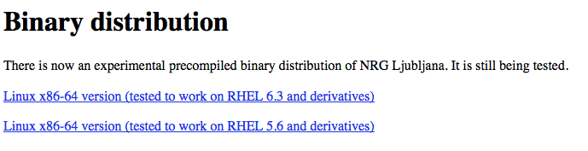
Alternatively, get the precompiled binaries
http://nrgljubljana.ijs.si/

Slide 5
Requirements for compiling the code
Boost C++ library (http://www.boost.org/):
ublas numerics, serialization, MPI, containers
BLAS, LAPACK routines (from ATLAS, Intel MKL, AMD Core Math Library, or from Apple framework Accelerate…)
Optional: GNU Scientific Library (GSL),
GNU multiple precision library (GMP)
Standard stuff: perl, python, gnuplot, C++ compiler, etc.
NOTE: these are all available as packages for most Linux distributions and for Mac via MacPorts.
You do not need to recompile them from source!

Slide 6
Mac and Xcode (1/2)
Use the instructions from the MacPorts project:
http://guide.macports.org/chunked/installing.xcode.html
http://www.macports.org/install.php
"Always make sure to install the latest available version of Xcode for your Mac OS X release; using outdated versions of Xcode may cause port install failures. Also note that Xcode is not updated via Mac OS X's Software Update utility on OS versions prior to 10.6, and is updated via the Mac App Store on 10.7."

Slide 7
Mac and Xcode (2/2)
Start Xcode
Go to Xcode/Preferences
Go to the tab "Download"
Install the "Command line tools"
The command line tools are required by MacPorts

Slide 8
MacPorts
Install Xcode and Xcode command line tools.
Install MacPorts, http://www.macports.org/install.php
Then run:
sudo port install boost
sudo port install atlas
sudo port install gsl
sudo port install gmp
You can use framework Accelerate instead.

Slide 9
RHEL 6.3 (or CentOS, Fedora, etc.)
As superuser (root) run the following in the shell:
yum groupinstall 'Development Tools'
yum install boost boost-devel
yum install atlas atlas-devel
yum install gsl gsl-devel
yum install gmp gmp-devel
yum install gcc-gfortran
yum install gnuplot
or yum install gnuplot44
If the compiler complains about not finding fortran compiler.
Try to get gnuplot version 4.4 or above.
Tested on Scientific Linux 6.3, on June 5th 2013

Slide 10
Handling problems with library linking (common problem, unfortunately...)
Problems with BLAS routines from ATLAS? Try:
export LDFLAGS="-L/usr/lib64/atlas"
Problems with linking boost routines? Try:
./configure –with-tools –prefix=$HOME
–with-boost-serialization=boost_serialization
Sometimes linking fails because the order of the arguments to the linker is not what the
linker expected. In such cases a simple (but inelegant) workaround is to copy & paste the
offending command and repeat the library calls at the end of the line (-lgsl –lgslcblas, when
linking gsl fails).
... or consult local computer experts!

Slide 11
Extra step on Mac computers
If compiling from source:
From nrgljubljana-2.3.20/ directory, do the following:
cd mac
sudo cp math /usr/local/bin
(This is necessary for nrginit to be able to call Mathematica. On Linux, the Mathematica installer does this for you.)
If using binary distribution: the script math is already in nrgljubljana/bin. You don't need to do anything.

Slide 12
Compiling boost from source
(if everything else fails)
Get boost (www.boost.org)
tar zxvf boost_1_53_0.tar.gz
cd boost_1_53_0
./bootstrap.sh --prefix=$HOME/boost
./b2 install
Then add --with-boost=$HOME/boost as an option to configure

Slide 13
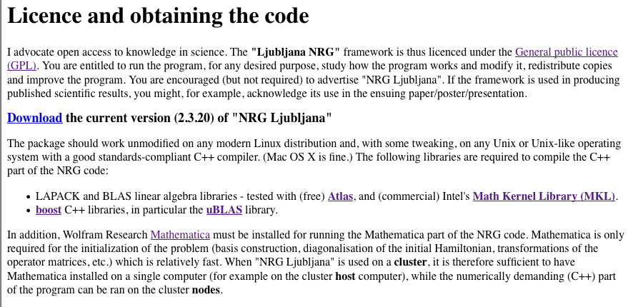
Obtaining the code
http://nrgljubljana.ijs.si/

Slide 14
Installation
Install the required libraries.
Uncompress NRG Ljubljana:
tar zxvf nrgljubljana-2.3.20.tar.gz
cd nrgljubljana-2.3.20
Configure:
./configure --with-tools --prefix=$HOME
Compile:
make
Install:
make install

Slide 15
Post installation step
If you used --prefix=$HOME, the executables are in $HOME/bin. Make sure this directory is in the $PATH. If it is not, you can, for example, add the following line to your .bachrc (or .bash_profile, .profile, or similar):
export PATH=~/bin:"${PATH}"
(You'll need to exit the shell session and start a new one for this to start having an effect.)

Slide 16
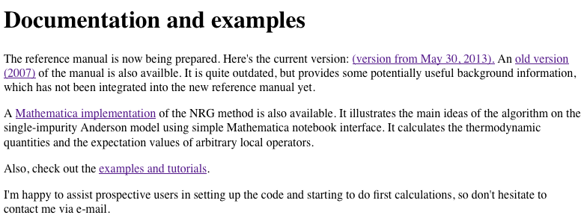
NRG Ljubljana documentation

Slide 17
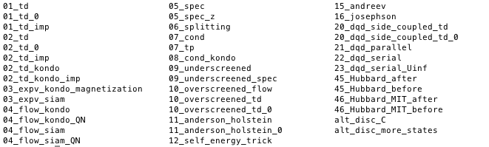
Content of tutorial.tar.gz
Each example directory contains the input file (called param), the numerical input to the NRG iteration code (called data), the full set of results, the scripts to recreate these results, as well as scripts for plotting the results (mostly using gnuplot).

Slide 18
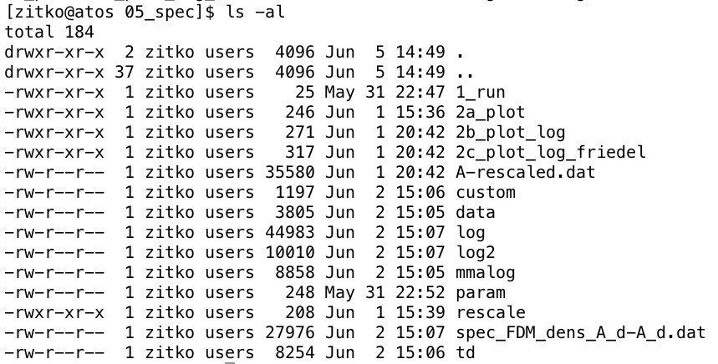
Organization of the directories

Slide 19
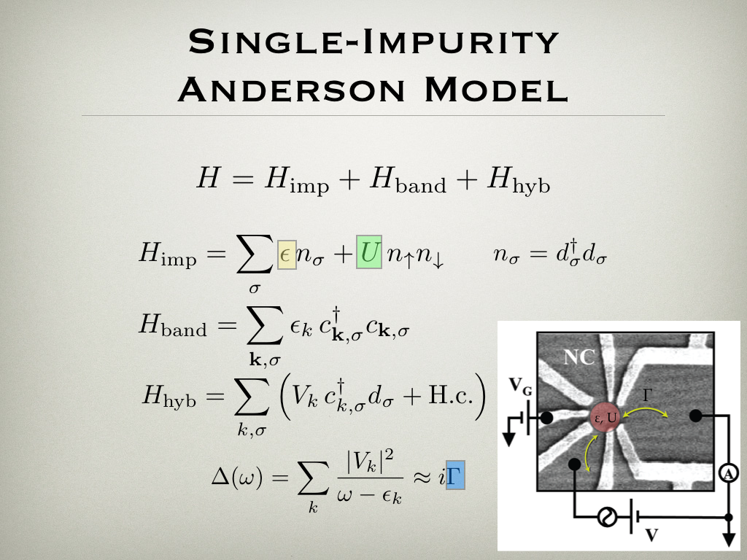

Slide 20
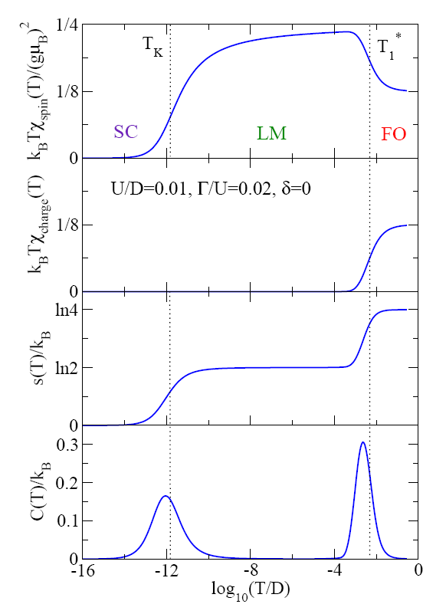
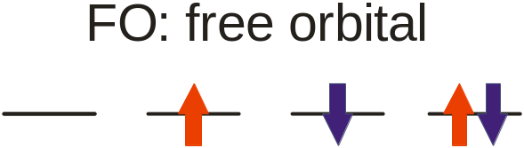

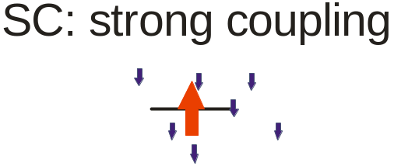
Krishnamurthy, Wilkins, Wilson, PRB 21, 1003 (1980)

Slide 21
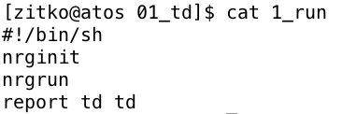
Example 1: thermodynamics of the SIAM
Go to 01_td/
Optionally run the script 1_run. It takes approx. 2-3 minutes to recalculate the results.
Use the scripts 2a_plot-entropy, etc., to produce the graphs.

Slide 22
The input file param
01_td/param
[param]
symtype=QS
discretization=Y
Lambda=2
Tmin=1e-10
keepenergy=10
keep=5000
model=SIAM
U=0.01
Gamma=0.0006
delta=0
symmetry: charge conservation Q, spin invariance S
discretization scheme: Y, C, Z
Λ
lowest temperature considered, controls the chain length
energy cutoff for the truncation of NRG states
maximum number of states kept
predefined model
model parameters

Slide 23
NRG initialization data
# Input file for NRG Ljubljana, Rok Zitko, rok.zitko@ijs.si, 2005-2012
# symtype QS
# $Id: initial.m,v 1.1 2012/05/15 09:58:19 rokzitko Exp rokzitko $
# Using sneg version 1.233
# Model: SIAM Variant: Channels: 1
# U= 0.01 Gamma= 0.0006 Delta= 0 t= 0.
#
# Gamma^(1/2)= 0.019928474108038798
# Lambda= 2. BAND= flat
# DISCRETIZATION= Y z= 1.
# ops=
#!7
# Number of channels, impurities, subspaces:
1 1 6
# SCALE 1.0606601717798214
# Energies (GS energy subtracted, multiplied by 1/SCALE):
-2 1
1
0.040008362507503385
-1 2
2
0.01871532881885043 0.05658735098824603
information about the code
(for reproducibility!)
model & parameters
eigenvalues

Slide 24
Output: thermodynamics, td
# $Id: nrg.cc,v 1.31 2012/10/26 10:18:22 rokzitko Exp rokzitko $ QS
# disk=Y band=flat Lambda=2 z=1
# keep=5000 keepenergy=10 Nmax=66 channels=1 dots=1 betabar=1
# T <Sz^2> <Q> <Q^2> <E> <E^2> C F S
1.06066 0.250273 0 0.998733 0.0372928 0.00174929 0.000358537 -2.73512 2.77241
0.75 0.342811 -2.38971e-17 1.36791 0.969774 1.43799 0.497526 -2.92227 3.89204
0.53033 0.414585 8.91184e-17 1.65363 1.15726 2.52562 1.18637 -3.65375 4.81102
0.375 0.455022 3.7147e-16 1.81343 1.87943 5.61993 2.08768 -3.53284 5.41226
0.265165 0.471207 -9.43152e-17 1.87542 1.80704 6.10112 2.83573 -3.89572 5.70276
0.1875 0.475324 -9.8978e-16 1.888 2.16353 7.87683 3.19596 -3.62524 5.78877
0.132583 0.476624 -2.83157e-15 1.88772 1.91076 6.91681 3.26581 -3.89142 5.80218
0.09375 0.47758 -5.60621e-15 1.88382 2.18488 8.04907 3.27538 -3.61793 5.80281
0.0662913 0.478891 -7.23267e-15 1.8782 1.94711 7.0622 3.27096 -3.85433 5.80144
0.046875 0.480536 -7.50049e-15 1.86956 2.20899 8.15927 3.27963 -3.58985 5.79884
0.0331456 0.482907 -3.86627e-15 1.85772 1.99794 7.26981 3.27802 -3.79613 5.79407
0.0234375 0.486071 8.91873e-15 1.84081 2.25118 8.36007 3.29226 -3.53571 5.78689
0.0165728 0.490519 2.7768e-14 1.81792 2.06758 7.57761 3.30273 -3.70759 5.77517
0.0117188 0.496412 5.0081e-14 1.78636 2.31348 8.68439 3.33222 -3.44287 5.75634
0.00828641 0.504261 7.34783e-14 1.74507 2.1487 7.98583 3.36893 -3.5773 5.726
0.00585938 0.514037 9.40466e-14 1.69217 2.37433 9.07244 3.43501 -3.30375 5.67808
0.0041432 0.525532 1.06593e-13 1.62974 2.19753 8.33671 3.50756 -3.40808 5.60561
0.00292969 0.537363 1.05941e-13 1.56276 2.36443 9.1721 3.58156 -3.14198 5.50641
0.0020716 0.547672 8.82013e-14 1.50188 2.1434 8.19096 3.59678 -3.24663 5.39004
0.00146484 0.554371 6.35151e-14 1.45639 2.25527 8.62897 3.54274 -3.02525 5.28052
0.0010358 0.557172 3.90226e-14 1.42979 2.04731 7.62564 3.43417 -3.15395 5.20126
0.000732422 0.557003 2.35007e-14 1.41647 2.17528 8.08395 3.35209 -2.98178 5.15707
0.0005179 0.555377 1.01226e-14 1.41031 2.02307 7.39646 3.30365 -3.11228 5.13535
0.000366211 0.55296 2.08221e-15 1.40669 2.15468 7.93408 3.29142 -2.96906 5.12375
0.00025895 0.550169 -1.63703e-15 1.40468 2.03516 7.42282 3.28095 -3.08073 5.11589
0.000183105 0.54694 1.71493e-15 1.40301 2.14669 7.88892 3.28064 -2.9629 5.1096
0.000129475 0.543412 9.45343e-15 1.40215 2.0571 7.50807 3.27643 -3.04708 5.10417
9.15527e-05 0.539392 1.66439e-14 1.40124 2.14047 7.8606 3.27899 -2.95829 5.09875
6.47376e-05 0.534972 2.28651e-14 1.40089 2.0861 7.63009 3.27826 -3.00722 5.09333
temperature
magnetization
heat capacity
entropy

Slide 25
Plotting with gnuplot
01_td/2a_plot-entropy
#!/bin/sh
gnuplot --persist <<EOF
set termoption enh
set title "Single impurity Anderson model"
set logscale x
set format x '10^{%L}'
set xlabel 'Temperature'
set ylabel 'S(T)/k_B'
plot 'td-S.dat' with lp title 'entropy'
plot window persists after gnuplot exits
support for Greek characters, subscripts,etc.
10^{x} notation for powers

Slide 26
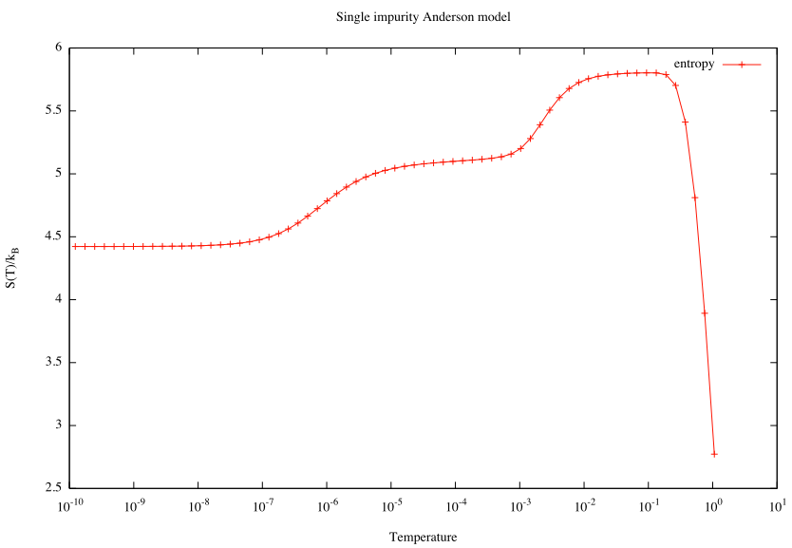
2a_plot-entropy
?

Slide 27
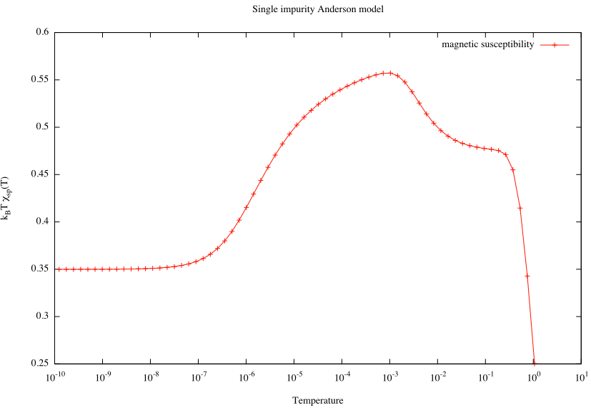
2a_plot-magnetic_susceptibility
?

Slide 28


What should we be computing?
Impurity contribution to a thermodynamic quantity o
System with impurity
Clean system

Slide 29
The reference system:
Wilson chain without any impurities
Calculation for the impurity problem: 01_td
Reference calculation: 01_td_0
Taking the difference: 01_td_imp

Slide 30
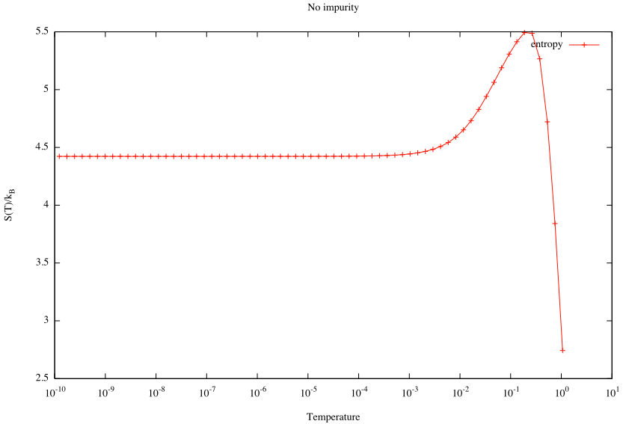
01_td_0/2a_plot-entropy
!

Slide 31
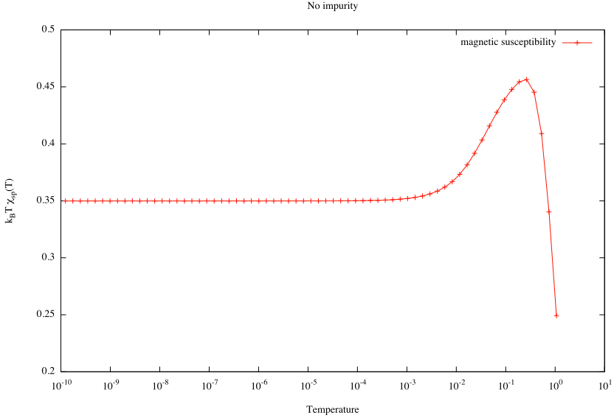
01_td_0/2a_plot-magnetic_susceptibility
!

Slide 32
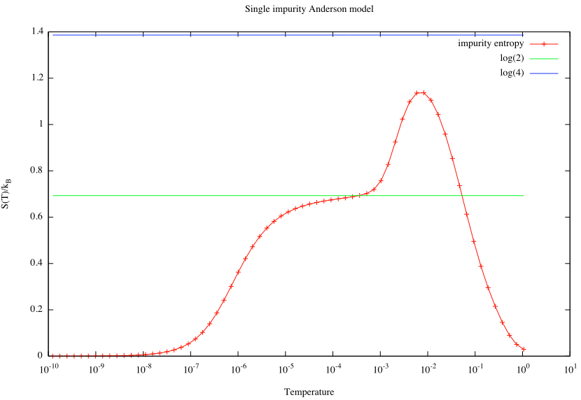
01_td_imp/2a_plot-entropy
OK!
?
OK!

Slide 33
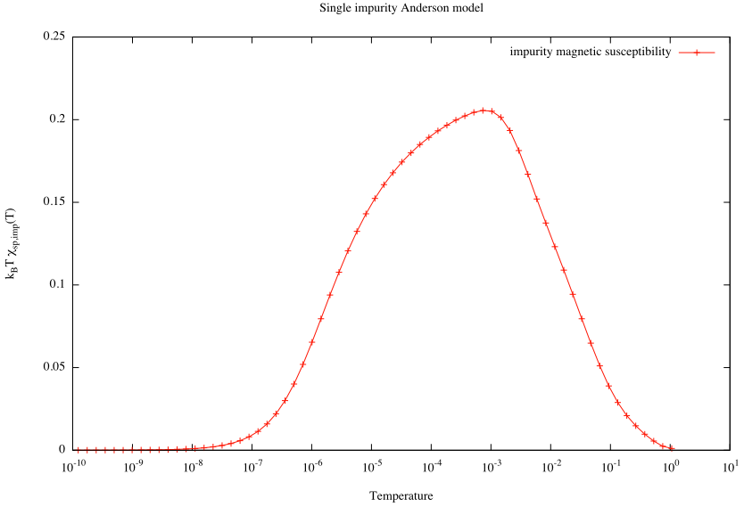

01_td_imp/2a_plot-magnetic_susceptibility
?
OK!

Slide 34
Z-averaging helps to recover the expected high-temperature asymptotics
02_td/1_zloop
#!/usr/bin/env looper
#AUTOLOOP: nrginit ; nrgrun
#OVERWRITE
[param]
symtype=QS
discretization=Z
@$z = 1/4; $z <= 1; $z += 1/4
z=$z
Lambda=2
Tmin=1e-10
keepenergy=10
keep=5000
model=SIAM
U=0.01
Gamma=0.0006
delta=0
looper is a script bundled
with NRG Ljubljana
This is essentially a for
loop using perl syntax!

Slide 35
Postprocessing tools
02_td/2_proc
#!/bin/sh
# Gather therodynamics results -> td.dat
gathertd_nosrt
# Average over z: td.dat -> td-avg.dat
tdavg -c
02_td_imp/1_proc
#!/bin/sh
# Copy the results and reference results
cp ../02_td/td.dat td.dat
cp ../02_td_0/td.dat td-ref.dat
# Average over z: td.dat & td-ref.dat -> td-avg.dat
tdavg -c
# Split according to the columns
report td-avg.dat td

Slide 36
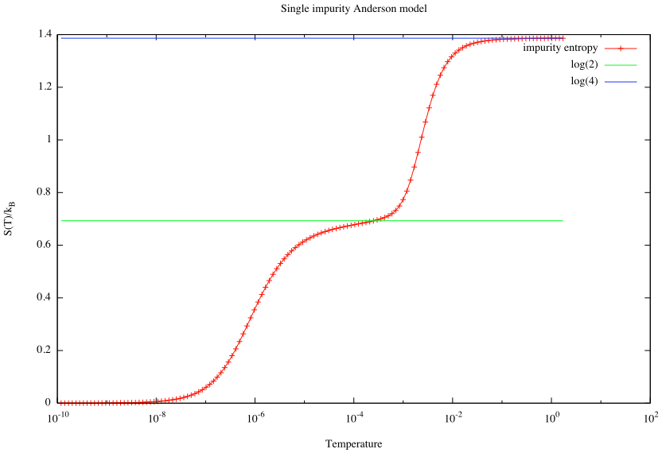
02_td_imp/2a_plot-entropy
OK!
OK!
OK!

Slide 37
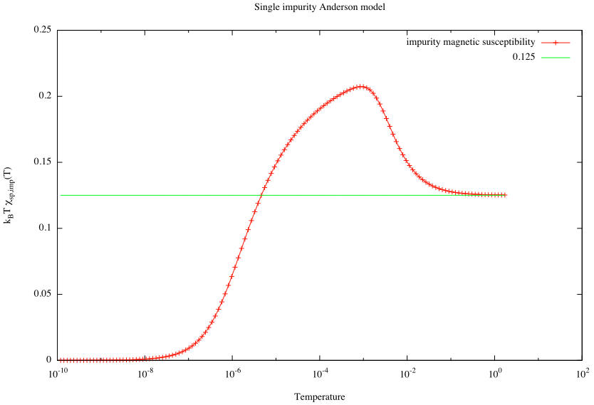
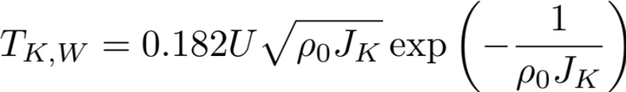
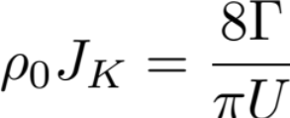
02_td_imp/2a_plot-magnetic_susceptibility
OK!
OK!

Slide 38
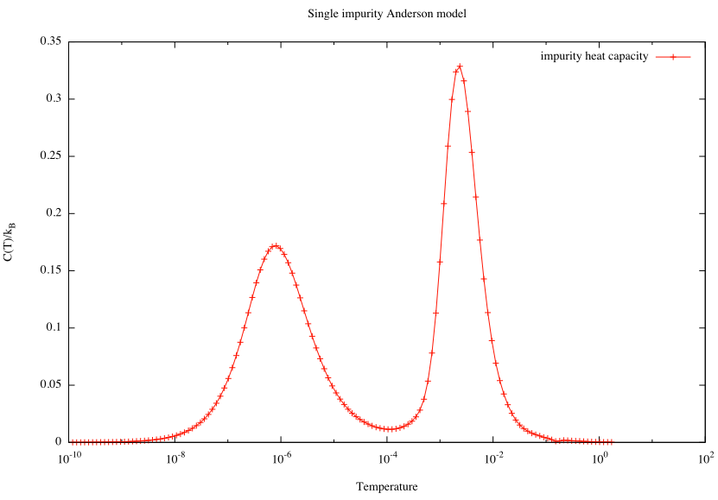
02_td_imp/2a_plot-heat_capacity

Slide 39
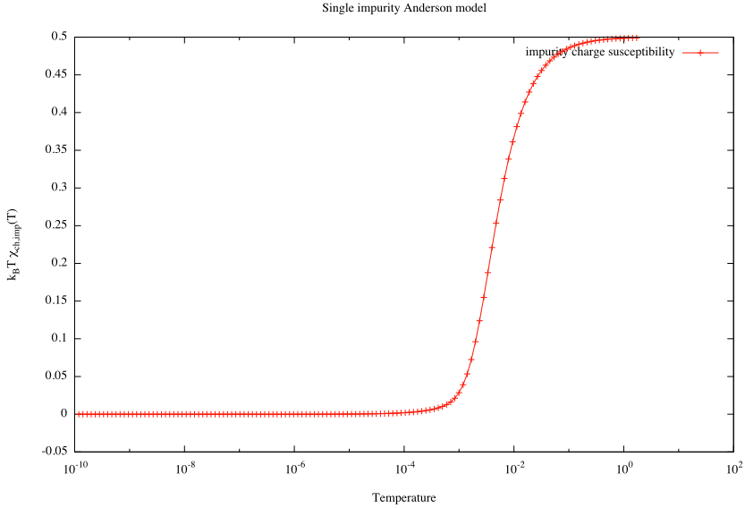

02_td_imp/2a_plot-charge_susceptibility

Slide 40
Exercises
Try increasing the parameter δ=ε+U/2. What happens when δ>U/2?
Try increasing the parameter Γ. What happens when Γ>U/π?
Decrease systematically keepenergy from 10 to small values. How does the quality of the results deteriorate?
Increase Λ (to 4, then to 8). Try to do the z-averaging with a different number of z values.
1a1
1a2
1a3
1a4

Slide 41
Change the symmetry type from QS to QSZ. How much slower is the calculation?
Try redoing the calculations with different discretization schemes (Z, C, Y). How much do the results differ?
Verify the formula for T_{K}, by performing the calculation for a range of Γ and plotting lnT_{K} vs. Γ.
1a5
1a2

Slide 42
Expectation values
03_expv_siam/1_zloop
#!/usr/bin/env looper
#AUTOLOOP: nrginit ; nrgrun
#OVERWRITE
[param]
symtype=QS
discretization=Z
@$z = 1/4; $z <= 1; $z += 1/4
z=$z
# We may increase Lambda for this calculation
Lambda=3
Tmin=1e-10
keepenergy=10
keep=5000
model=SIAM
U=0.01
Gamma=0.0006
delta=0
ops=n_d n_d^2 n_d_ud flm hop0

Slide 43
Output: expectation values vs. T, custom
# $Id: nrg.cc,v 1.31 2012/10/26 10:18:22 rokzitko Exp rokzitko $ QS
# disk=Z band=flat Lambda=3 z=0.25
# keep=5000 keepenergy=10 Nmax=43 channels=1 dots=1 betabar=1
# 1 2 3 4 5 6
# T flm hop0 n_d n_d^2 n_d_ud
2.39588 0.500522 -0.00815732 1 1.49948 0.249739
1.38326 0.500904 -0.0139248 1 1.4991 0.249548
0.798628 0.501565 -0.0234987 1 1.49844 0.249218
0.461088 0.502712 -0.0380832 1 1.49729 0.248644
0.266209 0.504689 -0.0574889 1 1.49531 0.247655
0.153696 0.508127 -0.0790268 1 1.49187 0.245937
0.0887365 0.514001 -0.100339 1 1.486 0.243
0.051232 0.524112 -0.121695 1 1.47589 0.237944
0.0295788 0.541309 -0.142702 1 1.45869 0.229346
0.0170773 0.570167 -0.16338 1 1.42983 0.214916
0.00985961 0.616671 -0.1828 1 1.38333 0.191665
0.00569245 0.686505 -0.199825 1 1.31349 0.156747
0.00328654 0.77532 -0.211715 1 1.22468 0.11234
0.00189748 0.856776 -0.216771 1 1.14322 0.0716121
0.00109551 0.901107 -0.216847 1 1.09889 0.0494463
0.000632494 0.91364 -0.216375 1 1.08636 0.04318
0.000365171 0.915606 -0.216489 1 1.08439 0.0421972

Slide 44
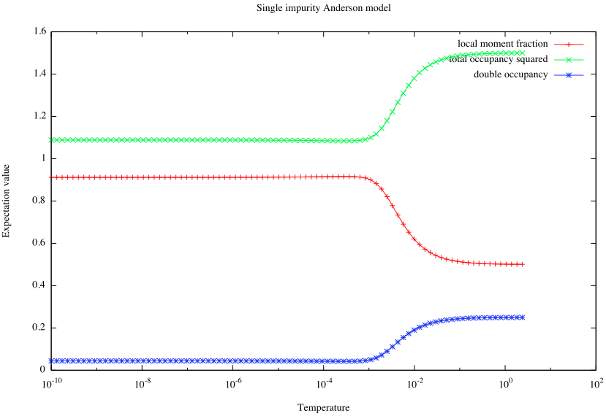
03_expv_siam/3_plot-expv

Slide 45
Kondo model
1_zloop
kondo.m
#!/usr/bin/env looper
#AUTOLOOP: nrginit ; nrgrun
#OVERWRITE
[extra]
spin=1/2
Jkondo=0.2
[param]
symtype=QS
discretization=Z
@$z = 1/4; $z <= 1; $z += 1/4
z=$z
Lambda=2
Tmin=1e-10
keepenergy=10
keep=5000
model=../kondo.m
def1ch[0];
SPIN = ToExpression @ param["spin", "extra"];
Module[{sx, sy, sz, ox, oy, oz, ss},
sx = spinketbraX[SPIN];
sy = spinketbraY[SPIN];
sz = spinketbraZ[SPIN];
ox = nc[ sx, spinx[ f[0] ] ];
oy = nc[ sy, spiny[ f[0] ] ];
oz = nc[ sz, spinz[ f[0] ] ];
ss = Expand[ox + oy + oz];
Hk = Jkondo ss;
];
H = H0 + Hk;
MAKESPINKET = SPIN;

Slide 46
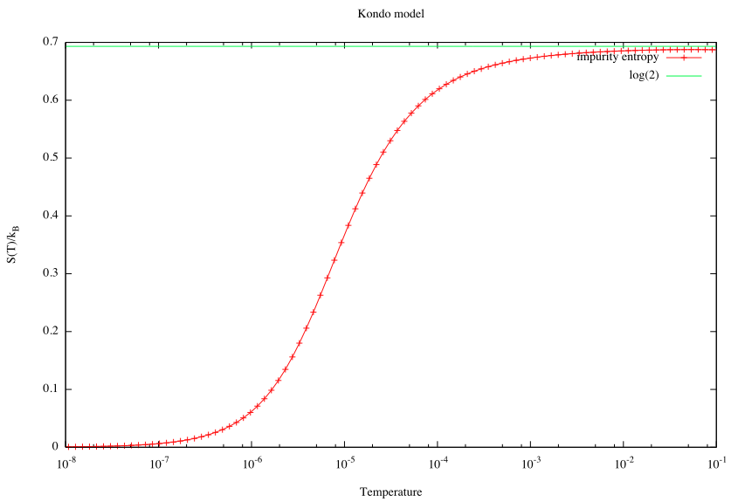

Slide 47
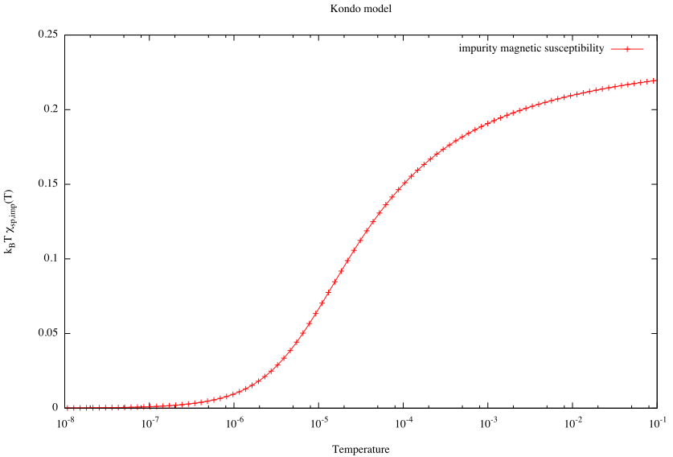

Slide 48
Running parameter sweeps
Example: magnetization of the impurity spin (Kondo model) in magnetic field <Sz>(B) at T=0.
#!/usr/bin/env perl
open (O, ">magnetization.dat") or die;
for ($b = 1e-8 ; $b <= 1e-1; $b *= 1.5) {
system "m4 -DFIELD=$b param.m4 >param";
system "nrginit ; nrgrun";
$SZ = `extractcolumn custom SZ | tail -n 1`;
$SZ *= -1; # flip sign
print O "$b $SZ\n";
}
03_expv_kondo_magnetization/

Slide 49
03_expv_kondo_magnetization/param.m4
template file, to be processed by the m4 macro processor
[extra]
spin=1/2
Jkondo=0.2
B=FIELD
[param]
symtype=QSZ
discretization=Z
Lambda=3
Tmin=1e-10
keepenergy=10
keep=5000
model=kondo.m
ops=SZ
In the presence of the magnetic field, only Sz is
a good quantum number, i.e., SU(2) spin symmetry
is reduced to a U(1) axial spin symmetry.

Slide 50
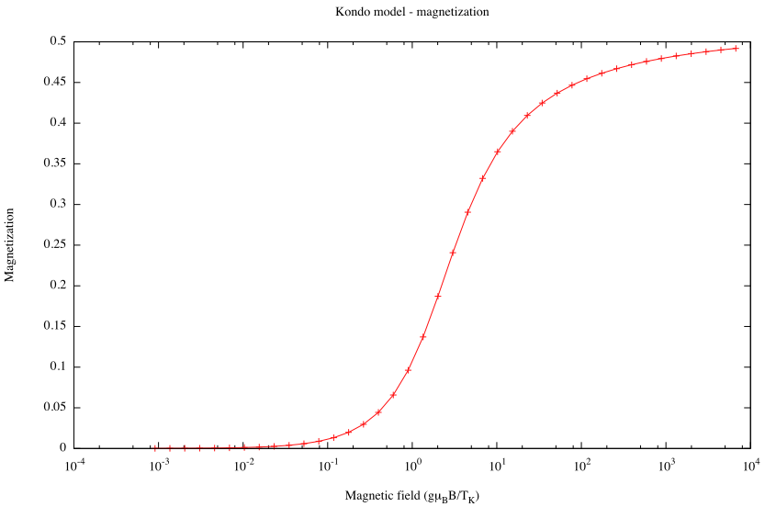
03_expv_kondo_magnetization/2_plot

Slide 51
Exercises
For SIAM, plot n_d for a sweep of the parameter δ. Notice how the occupancy is pinned to 1 in a wide interval of δ.
For Kondo model, calculate the spin polarization SZ for a S=1 Kondo model for a range of magnetic field B going from negative to positive values.
1b1
1b2

Slide 52
Renormalization group flow diagrams
[param]
symtype=QS
discretization=Z
Lambda=2
Tmin=1e-10
keepenergy=8
keep=5000
model=SIAM
U=0.01
Gamma=0.0006
delta=0
dumpannotated=100
generates annotated.dat
04_flow_siam/

Slide 53
# $Id: nrg.cc,v 1.31 2012/10/26 10:18:22 rokzitko Exp rokzitko $ QS
# disk=Z band=flat Lambda=2 z=1
# keep=5000 keepenergy=8 Nmax=66 channels=1 dots=1 betabar=1
0 (0 1) [1]
0.019080451 (-1 2), (1 2) [4]
0.035944171 (0 3) [3]
0.040845462 (-2 1), (0 1), (2 1) [3]
0.057709182 (-1 2), (1 2) [4]
0.076789633 (0 1) [1]
0 (0 2) [2]
0.0069136957 (-1 1), (1 1) [2]
0.75640994 (-1 3), (1 3) [6]
0.7564277 (-1 1), (1 1) [2]
0.76331475 (0 2) [2]
0.76333251 (-2 2), (0 2), (2 2) [6]
1.5128199 (0 4) [4]
1.5128288 (-2 2), (0 2), (2 2) [6]
1.5128465 (0 2) [2]
1.5197247 (-1 1), (1 1) [2]
1.5197424 (-1 3), (1 3) [6]
1.5197513 (-1 1), (-3 1), (1 1), (3 1) [4]
2.2692387 (-1 3), (1 3) [6]
2.2692565 (-1 1), (1 1) [2]
2.2761435 (0 2) [2]
annotated.dat

Slide 54
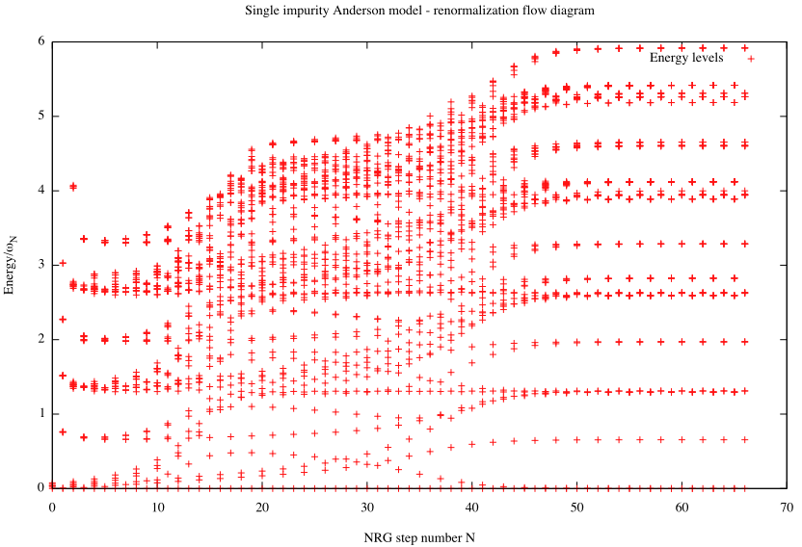
2a_plot-all

Slide 55
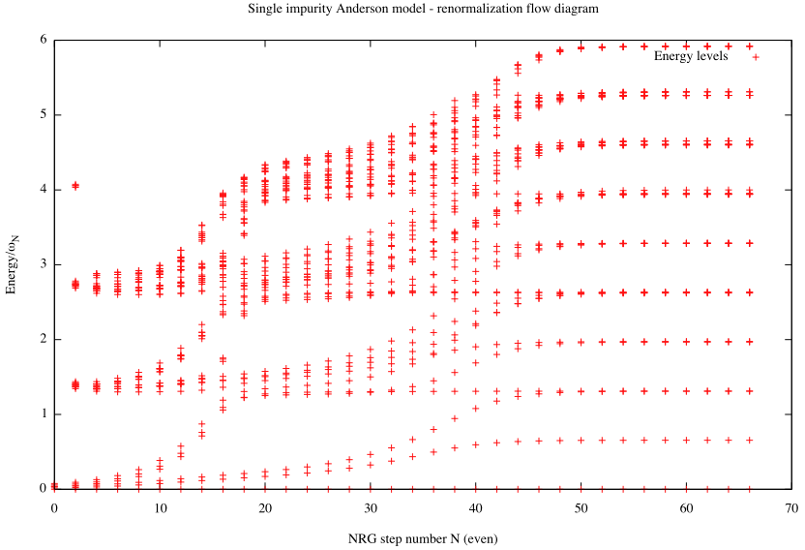

2a_plot-even

Slide 56
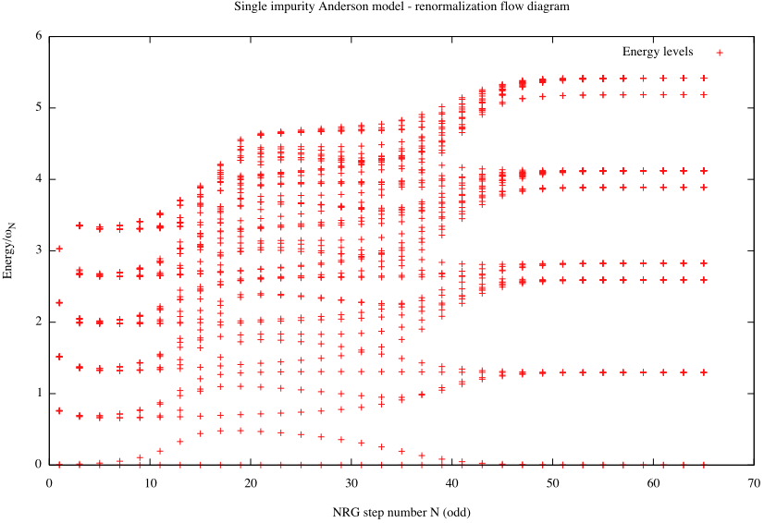
2a_plot-odd

Slide 57
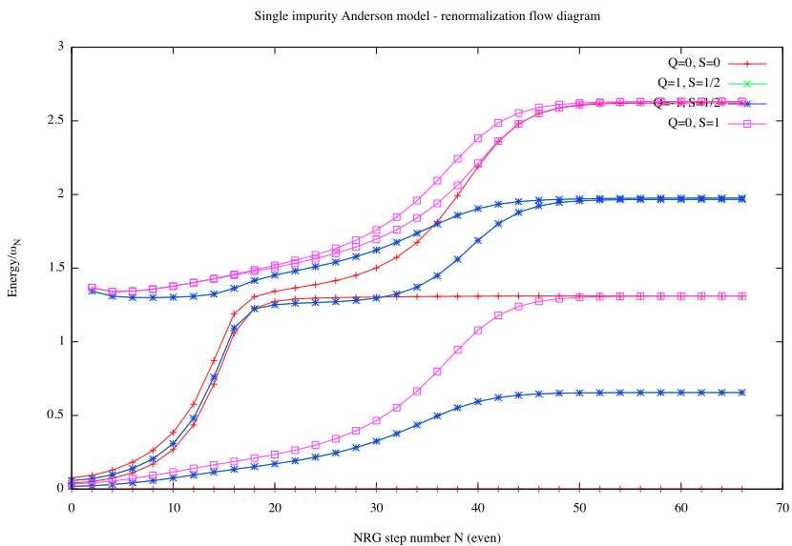
04_flow_siam_QN/3_plot

Slide 58
Exercises
In SIAM, does the low-energy fixed point change if Γ is increased to large values? How is the behavior at intermediate energies affected?
Increase δ to large values. How is the low-energy fixed point affected? Compare the flow diagrams for even and odd chain lengths.
1c1

Slide 59


Binding energy
#!/usr/bin/env perl
my $Nz = 4;
sub getE
{
my $dir = shift;
my $sum = 0;
for ($i = 1; $i <= $Nz; $i++) {
$sum += `gettotalenergy $dir/$i/log`;
}
my $E = $sum/$Nz;
return $E;
}
my $E1 = getE('../02_td_kondo');
my $E0 = getE('../02_td_0');
my $Eimp = $E1-$E0;
print "Impurity binding energy: $Eimp\n";
Kondo, ρJ=0.1
02_td_energy

