Slide 1
Implementing a NRG code, handling second quantization expressions, symmetries, parallelization issues
Rok Žitko
Institute Jožef Stefan
Ljubljana, Slovenia

Slide 2
Tools: SNEG and NRG Ljubljana
Add-on package for the computer algebra system Mathematica for performing calculations involving
non-commuting operators
Efficient general purpose
numerical renormalization group code
flexible and adaptable
highly optimized (partially parallelized)
easy to use

Slide 3
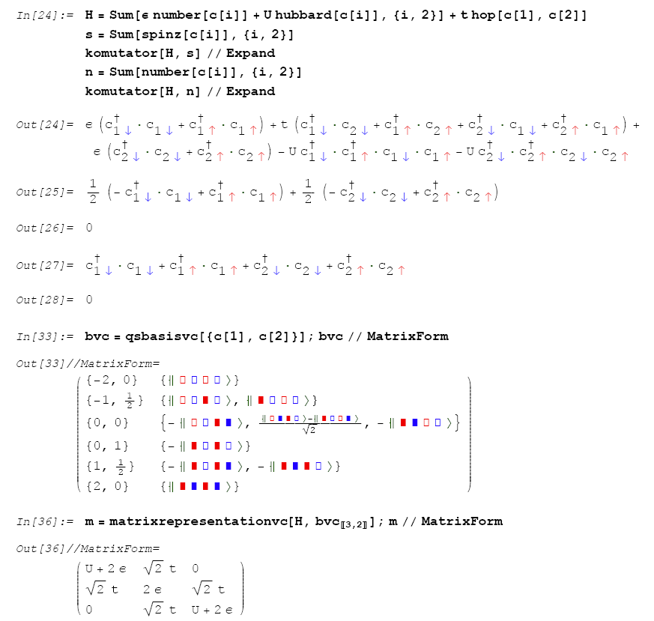
t
ε, U
ε, U
Notes:
Essentially a screen shot from an interactive Mathematica session using package SNEG.
Example of a cluster of two orbitals coupled by hopping, in other words: two site Hubbard chain.
Either explicit 2nd quant expressions, or use of high-level functions to generate these expressions.

Slide 4
SNEG - features
fermionic (Majorana, Dirac) and bosonic operators, Grassman numbers
basis construction (well defined number and spin (Q,S), isospin and spin (I,S), etc.)
symbolic sums over dummy indexes (k, σ)
Wick’s theorem (with either empty band or Fermi sea vacuum states)
Dirac’s bra and ket notation
Simplifications using Baker-Campbell-Hausdorff and Mendaš-Milutinović formula
Notes:
User provides the anti-commutation rules and the off you go.

Slide 5
SNEG - applications
exact diagonalization of small clusters
perturbation theory to high order
high-temperature series expansion
evaluation of (anti-)commutators of complex expressions
NRG
  derivation of coefficients required in the NRG iteration
  problem setup

Slide 6
“NRG Ljubljana” - goals
Flexibility (very few hard-coded limits, adaptability)
Implementation using modern high-level programming paradigms
(functional programming in Mathematica,
object oriented programming in C++)
⇒ short and maintainable code
Efficiency (LAPACK routines for diagonalization)
Free availability
Notes:
Making it open course, more an afterthought than an original design goal.

Slide 7
Definition of a quantum impurity problem in “NRG Ljubljana”
f_{0,L}
f_{0,R}
t
a
b
Himp = eps (number[a[]]+number[b[]])+
U/2 (pow[number[a[]]-1,2]+pow[number[b[]]-1,2])
Hab = t hop[a[],b[]]
Hc = Sqrt[Gamma] (hop[a[],f[L]] + hop[b[],f[R]])
+ J spinspin[a[],b[]]
+ V chargecharge[a[],b[]]

Slide 8
Definition of a quantum impurity problem in “NRG Ljubljana”
f_{0,L}
f_{0,R}
t
a
b
Himp = epsa number[a[]] + epsb number[b[]] +
U/2 (pow[number[a[]]-1,2]+pow[number[b[]]-1,2])
Hab = t hop[a[],b[]]
Hc = Sqrt[Gamma] (hop[a[],f[L]] + hop[b[],f[R]])

Slide 9
“By relieving the brain of all unnecessary work, a good
notation sets it free to concentrate on more advanced problems, and in effect increases the mental power of the race.”
Alfred North Whitehead

Slide 10
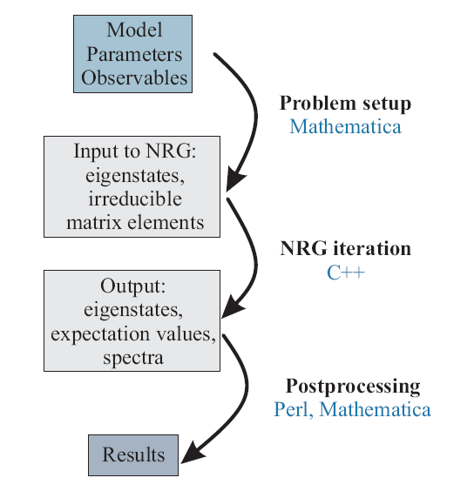
nrginit
nrgrun
various scripts
Notes:
postprocessing: z averaging, etc.

Slide 11
Computable quantities
Finite-site excitation spectra (flow diagrams)
Thermodynamics:
magnetic and charge susceptibility, entropy, heat capacity
Correlations:
spin-spin correlations, charge fluctuations,...
spinspin[a[],b[]]
number[d[]]
pow[number[d[]], 2]
Dynamics:
spectral functions, dynamical magnetic and charge susceptibility, other response functions

Slide 12
Sample input file
[param]
model=SIAM
U=1.0
Gamma=0.04
Lambda=3
Nmax=40
keepenergy=10.0
keep=2000
ops=q_d q_d^2 A_d
Model and parameters
NRG iteration parameters
Computed quantities
Spectral function
Charge fluctuations
Occupancy
Notes:
User friendly!

Slide 13




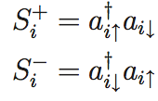



Spin symmetry

Slide 14



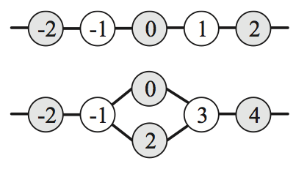
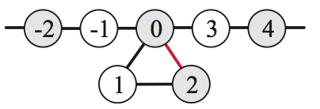
Charge and particle-hole symmetry

Slide 15

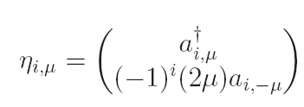
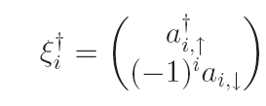

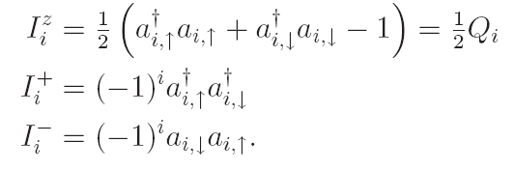
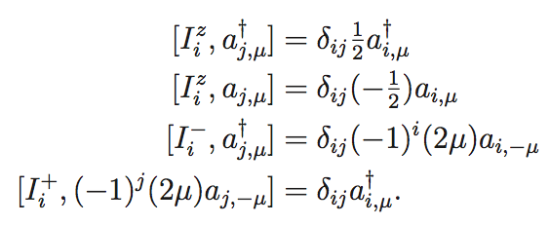
Isospin symmetry
Nambu spinor:
Izospin operator:
charge
pairing

Slide 16
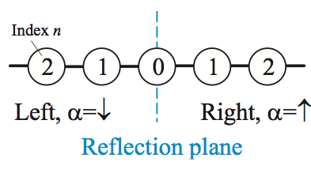

Reflection symmetry
Parity Z₂ quantum number P
"Flavor symmetry" SU(2)_{flavor}:

Slide 17
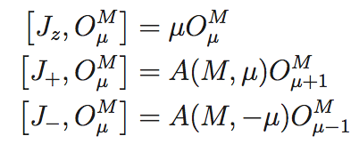

Wigner-Eckart theorem
O is a spherical tensor
operator of rank M if:
Clebsch-Gordan coefficients for SU(2)
For a more general treatment of non-Abelian symmetries in NRG, see
A. I. Toth, C. P. Moca, O. Legeza, G. Zarand, PRB 78, 245109 (2008),
A. Weichselbaum, Annals of Physics 327, 2972-3047 (2012).

Slide 18
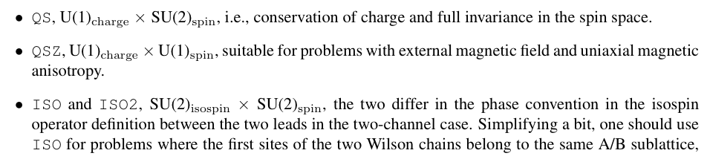
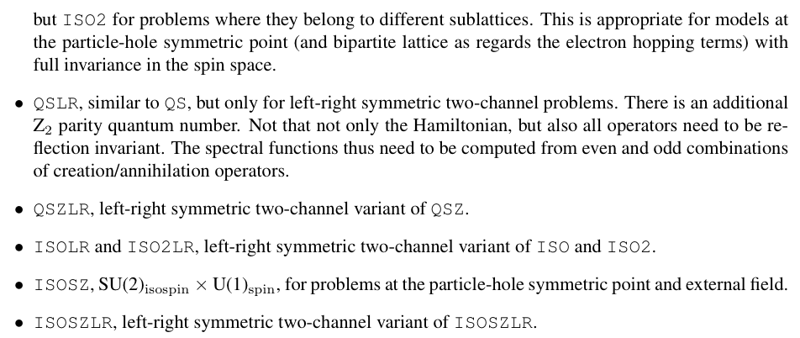

Slide 19
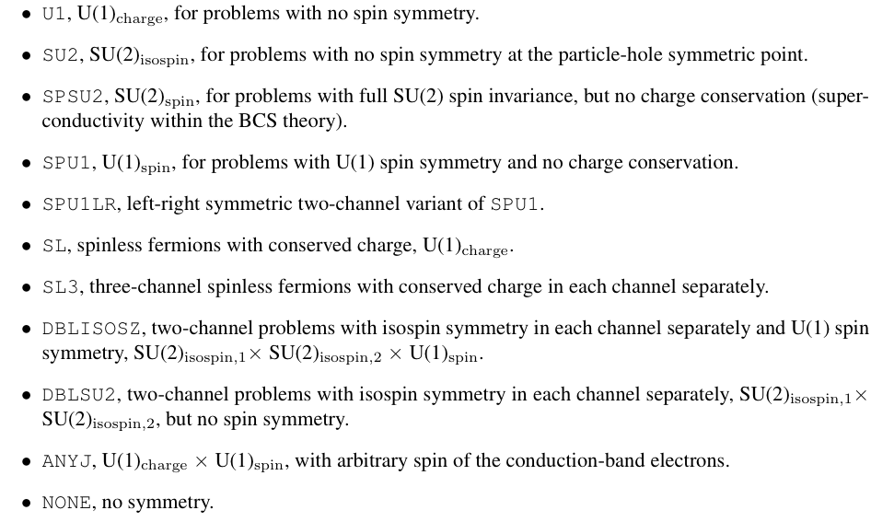

Slide 20
Diagonalization
Full diagonalizations with dsyev/zheev
Partial diagonalizations with dsyevr/zheevr
(possible when CFS/FDM is not used)
For most problems this is where the largest amount of the processor time is spent.
Note: symmetric eigenvalue problem has a high memory to arithmetic ratio. Unclear if GPUs would help much for large problems.

Slide 21

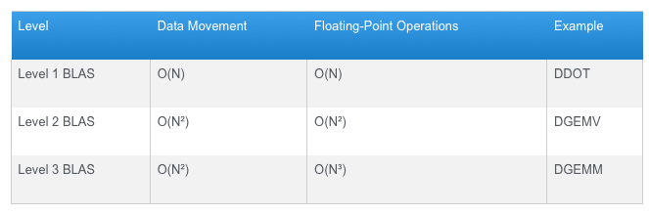
Recalculation of operators
Important to be efficiently implemented! We use BLAS routine GEMM (general matrix multiply). (GEMM from Intel MKL library has >80% efficiency on Xeon processors.)

Slide 22
Parallelization
Multi-threading on multi-processor computers (pthreads or OpenMP).
  Intel MKL implementation of LAPACK takes advantage of multi-core CPUs.
  DSYEV does not scale linearly, but there is some speedup.
Parallelization across multiple computers using message passing (MPI).
  Parallel diagonalisations using LAPACK, or parallelized diagonalisation using ScaLAPACK.

Slide 23
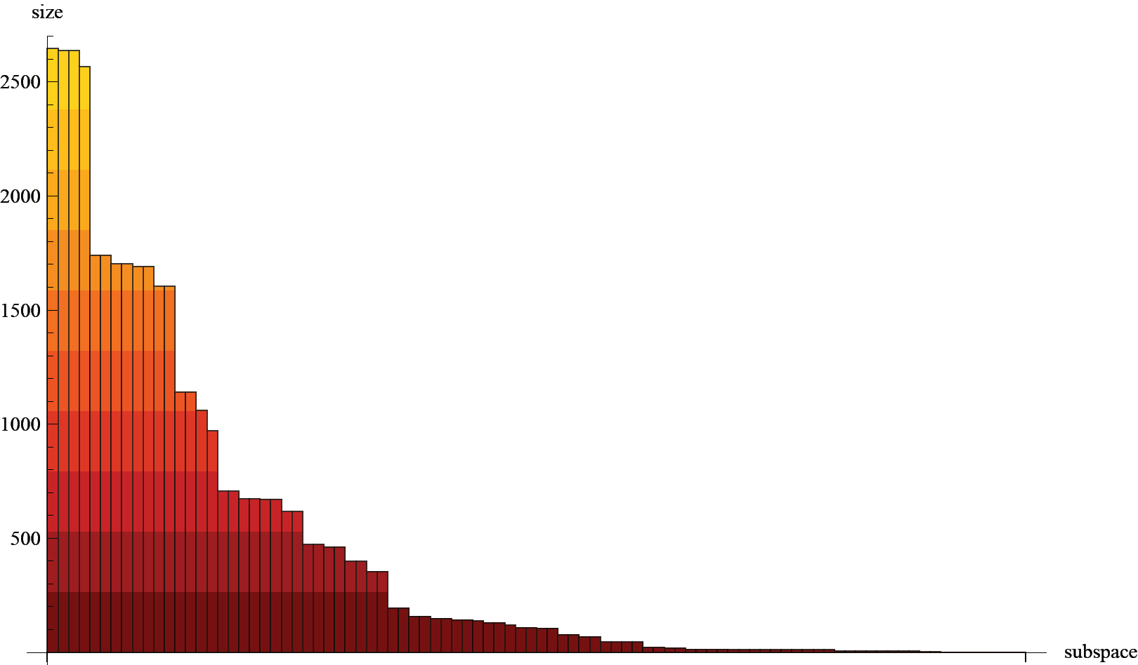
Matrix dimensions in different invariant subspaces.
SIAM, U(1)_{charge} x U(1)_{spin} symmetry type

Slide 24
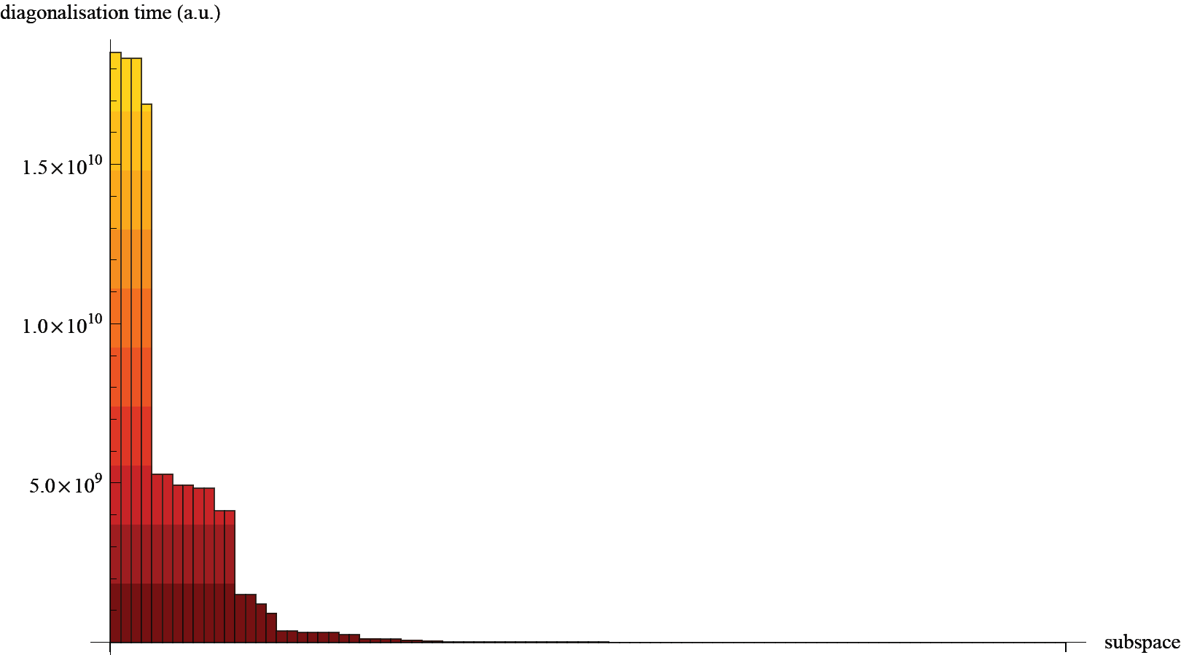
Conclusion: up to ~5-6 simultaneous diagonalisations.

Slide 25
Master-slave strategy using MPI
Master delegates diagonalisations of large matrices to slave nodes.
Master diagonalizes small matrices locally.
slaves
master
Communication overhead is negligible!

Slide 26
OpenMP + MPI
Best so far: spread calculation across 5-6 nodes, use multi-threaded DSYEV on each node (4 threads).
More recently: 4 CPUs, 8 threads each.
TO DO: evaluate ScaLAPACK on machines with fast interconnect (such as Infiniband).

Slide 27
Nested parallelism with OpenMP & Intel MKL
OMP_NESTED=TRUE
OMP_NUM_THREADS=4
MKL_NUM_THREADS=16
MKL_DYNAMIC=FALSE
Significant improvement, when it works! (Segmentation faults,...)

Slide 28
Toy implementation of NRG
http://nrgljubljana.ijs.si/nrg.nb
Implements SIAM in (Q,S) basis, it computes flow diagrams, thermodynamics and expectation values
Reasonably fast (Mathematica internally uses Intel MKL libraries for numerical linear algebra and there is little overhead)

Slide 29
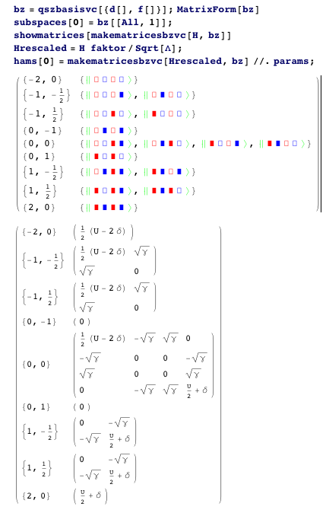

Slide 30
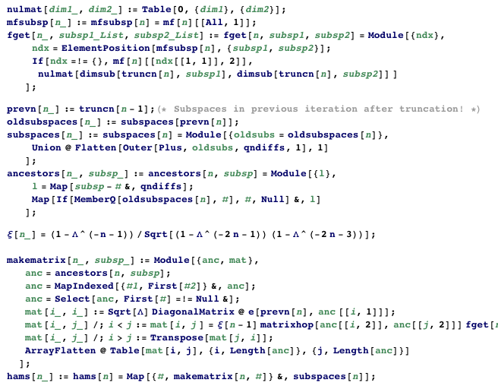

Slide 31
